Slide 1
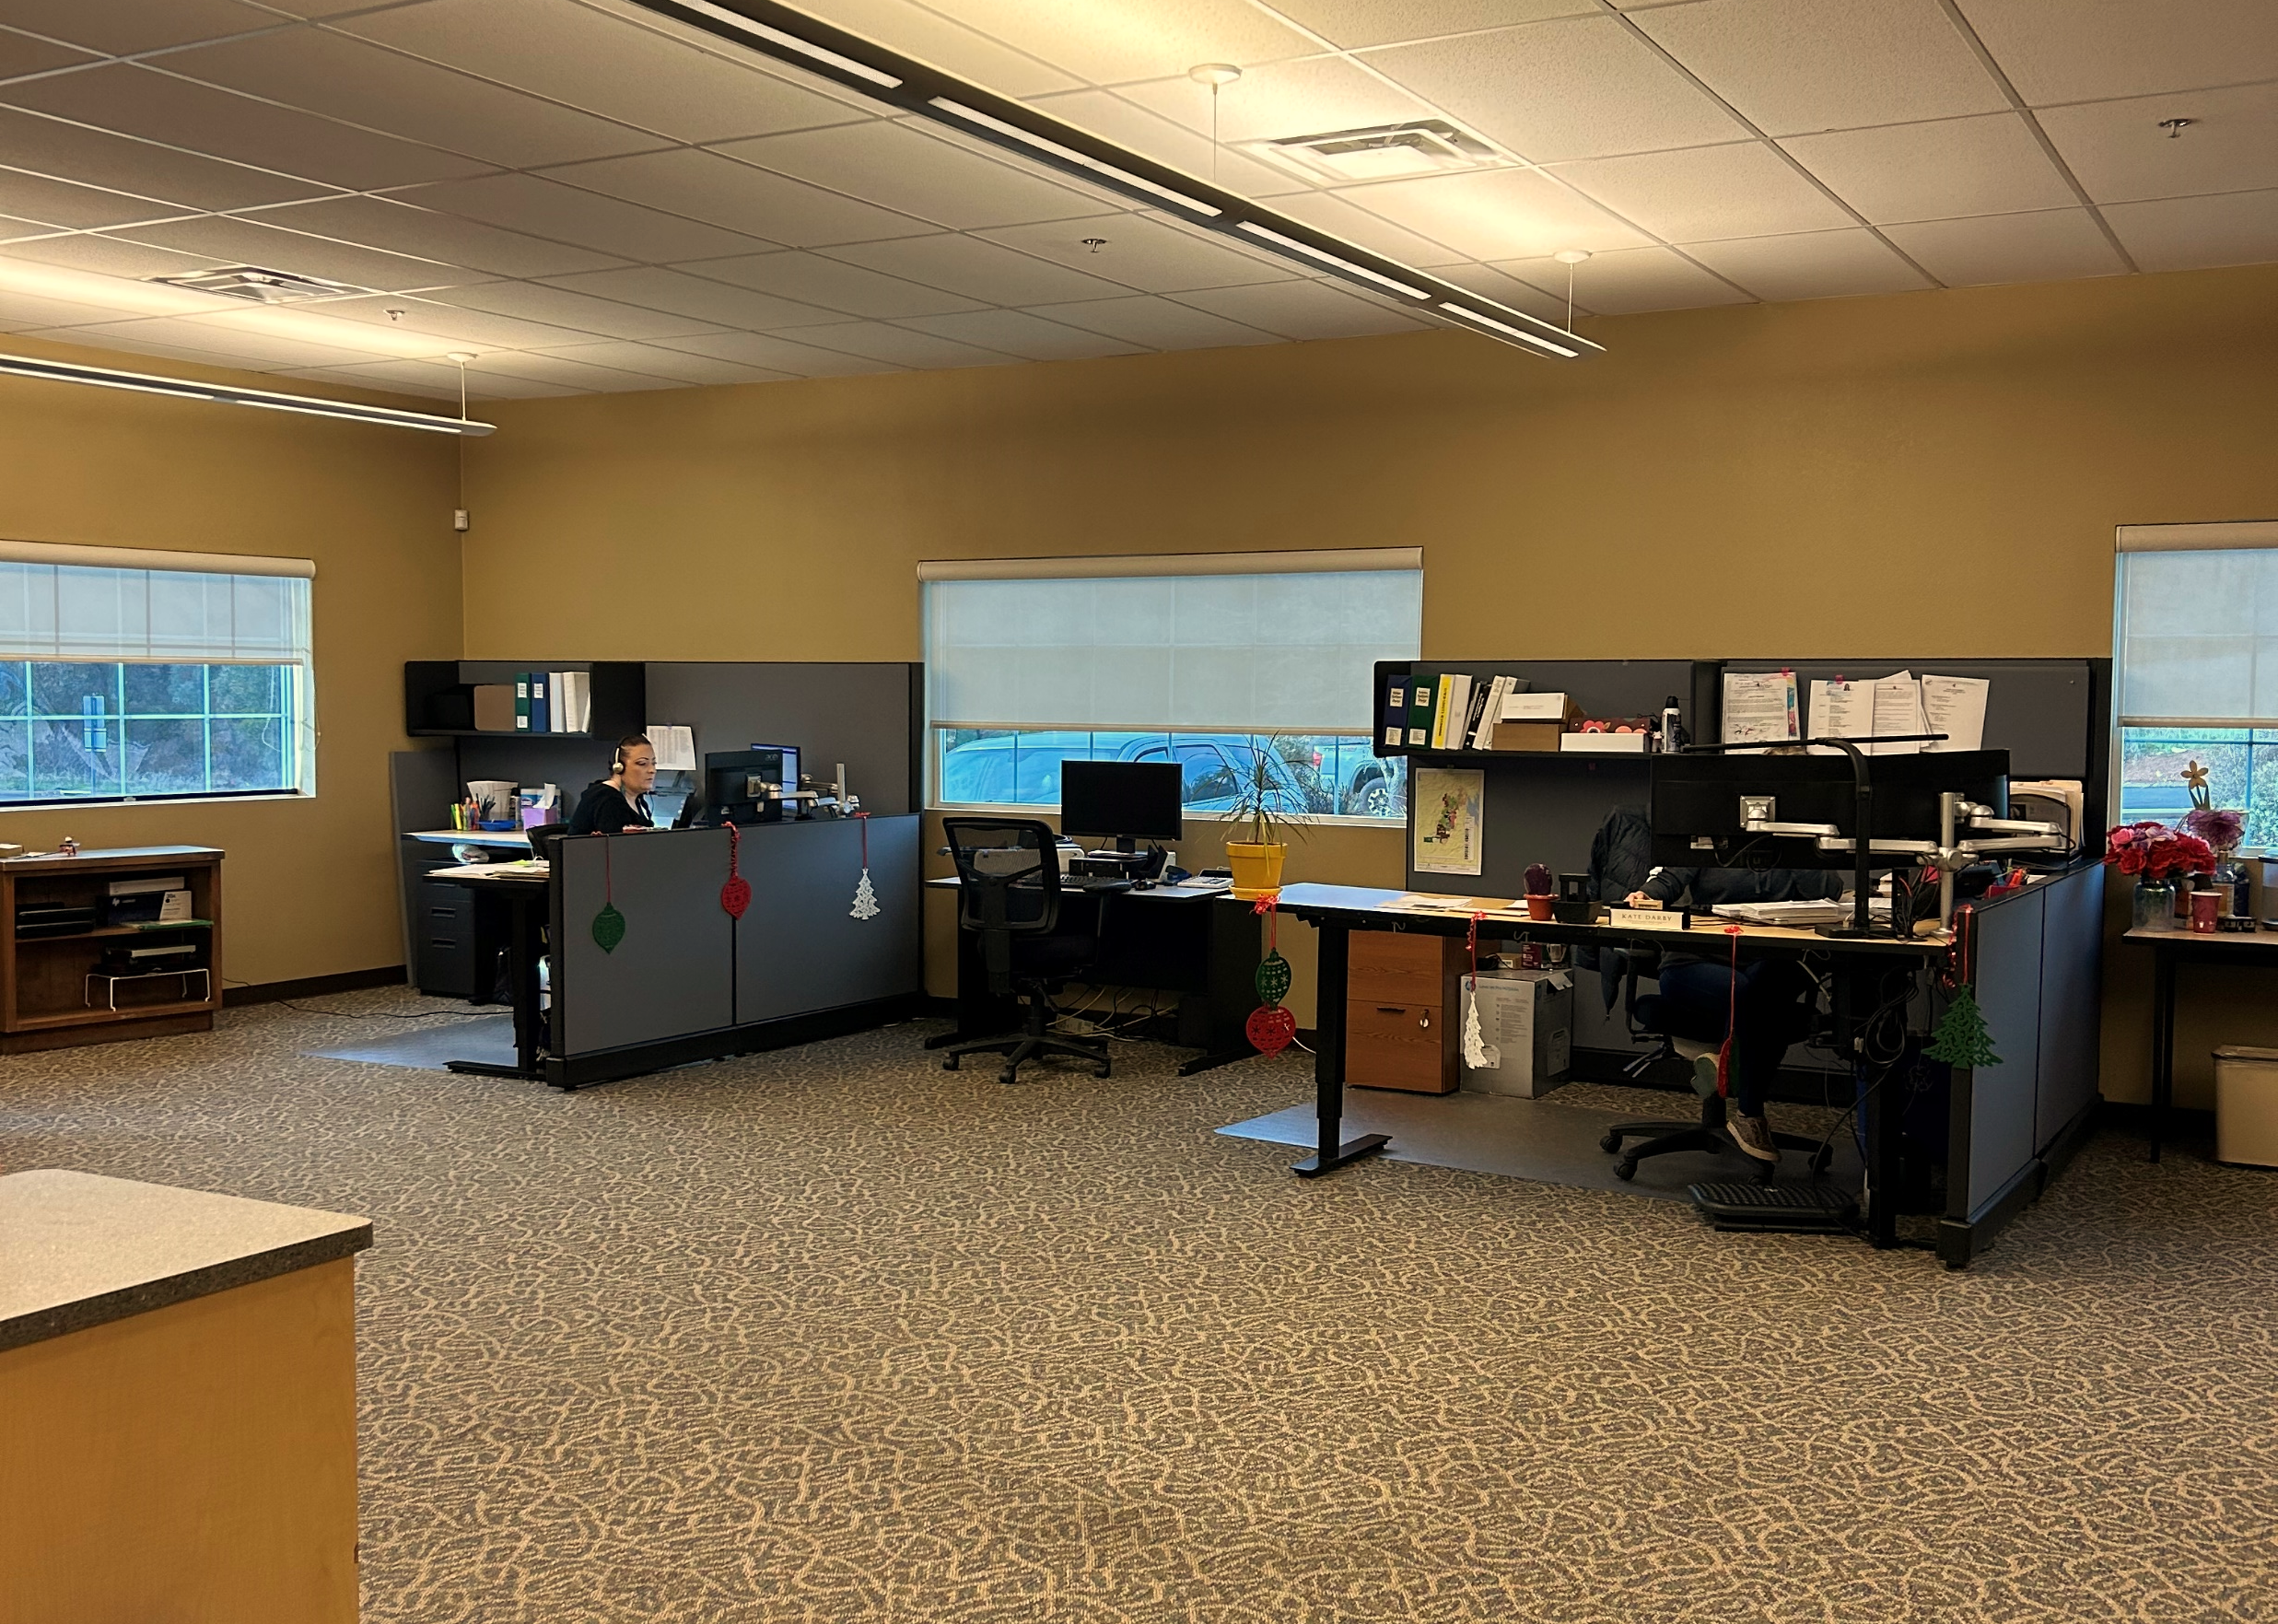
CUSTOMER
SERVICE

Slide 2
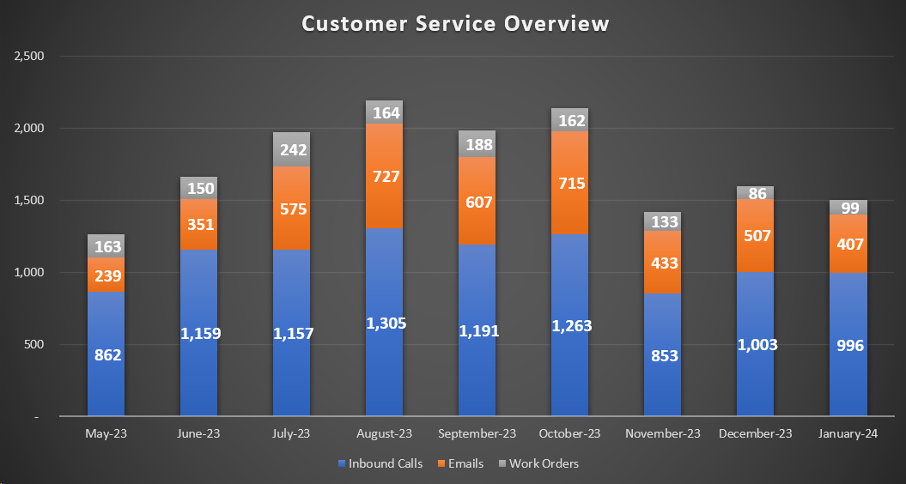
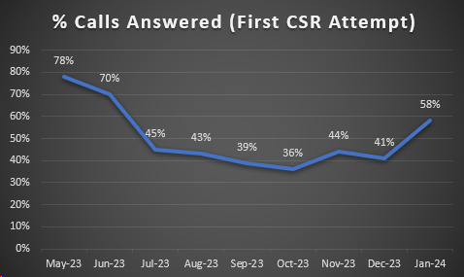
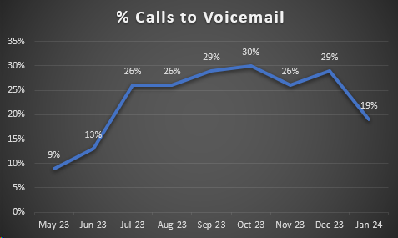
CALL QUEUES,
EMAILS &
WORK ORDERS
Common Inquiries for January:
CCWD-side & customer-side leaks/concerns
Water usage/billing questions
Rate Study/Cost of Service Inquiries
Flushing - Jenny Lind & Ebbetts Pass
Customer Portal enrollment
Call Analytics for January:
Avg. Calls Handled/Day: 48
Avg. Handle Time: 4:14 minutes
Total % Employee Hours on Calls: 14%

Slide 3
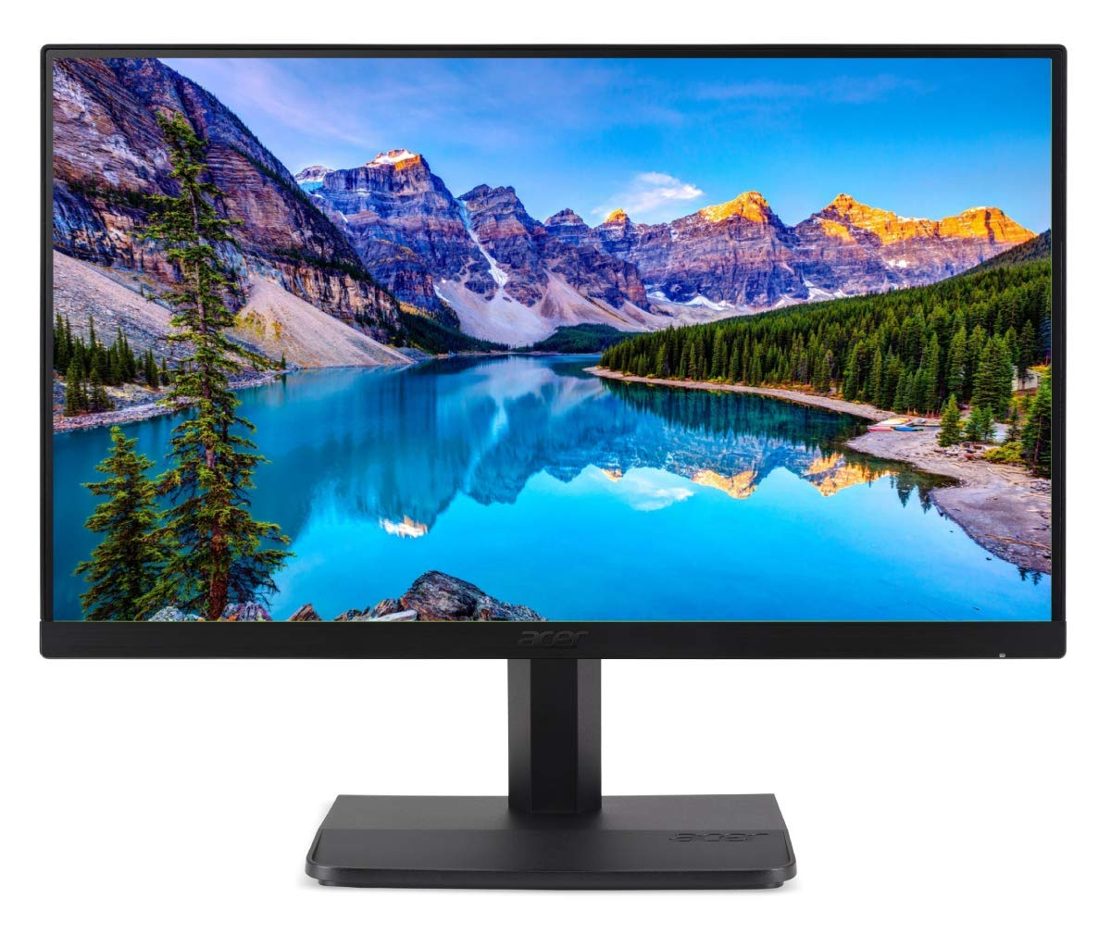
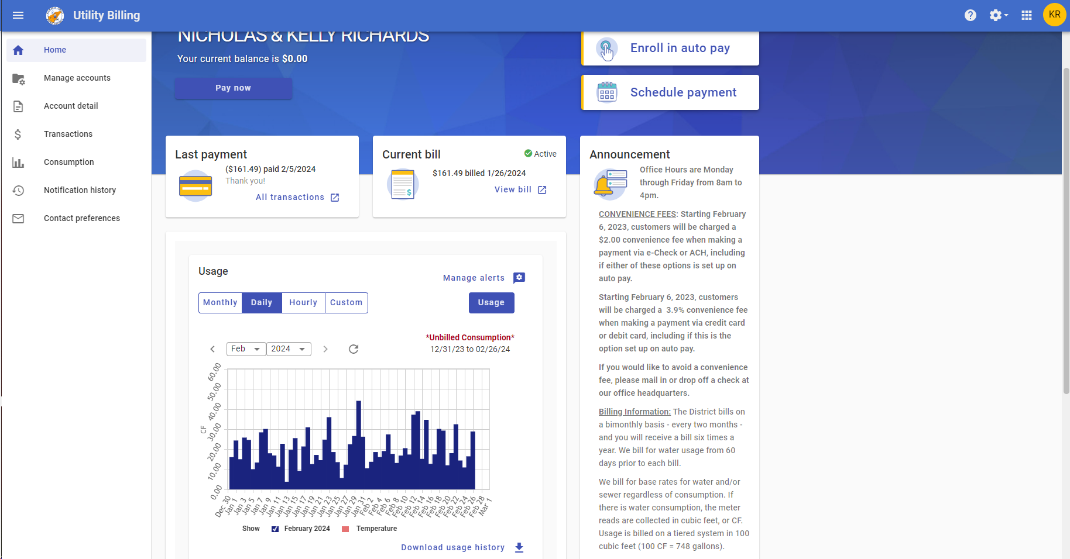
CUSTOMER PORTAL DEMONSTRATION
Customer Service Department
NEW FEATURES!
Hourly, Daily, Monthly & Custom Usage Graph
View up to 60 days at a time
Toggle the temperature readings on or off
“Monthly” view provides billed consumption
Billing period, usage amount, billed amount
Compares to prior year for easy comparison
Manage Alerts
Consumption Threshold, Leak & Vacation Threshold
Email, Call or Text – or more than one!
DEMO

Slide 4
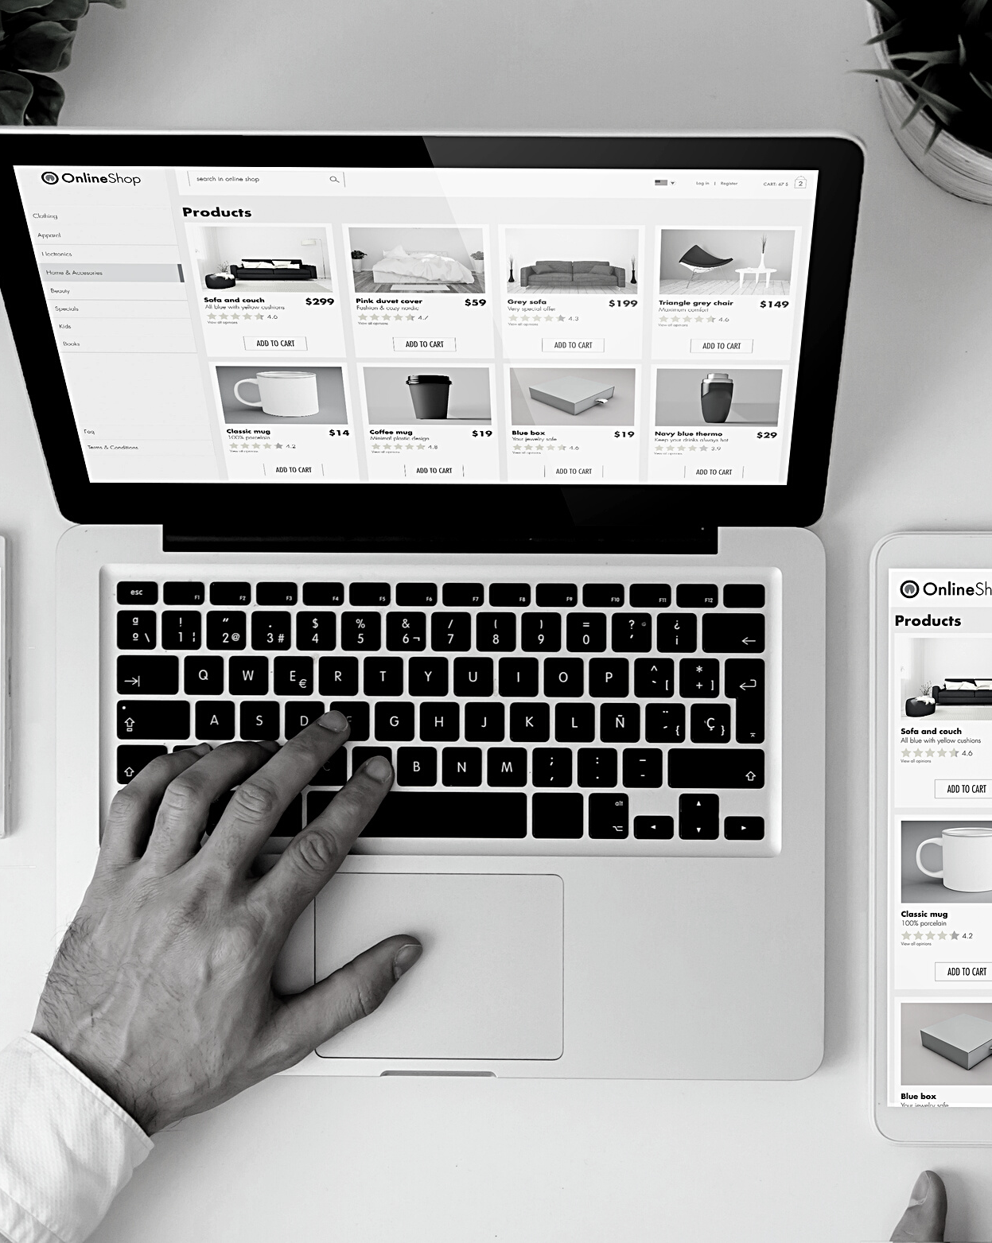
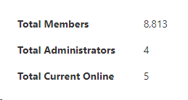
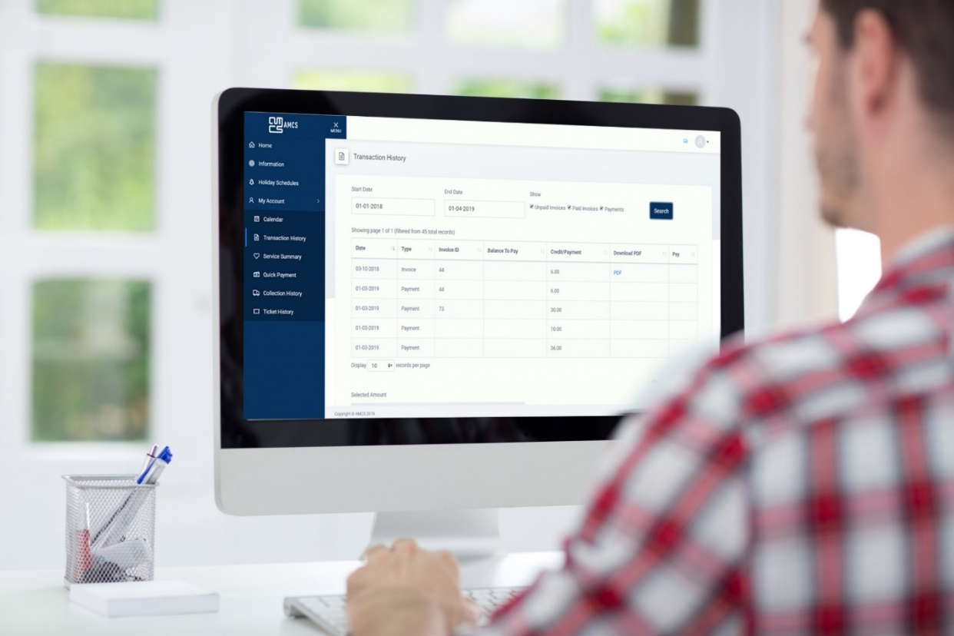
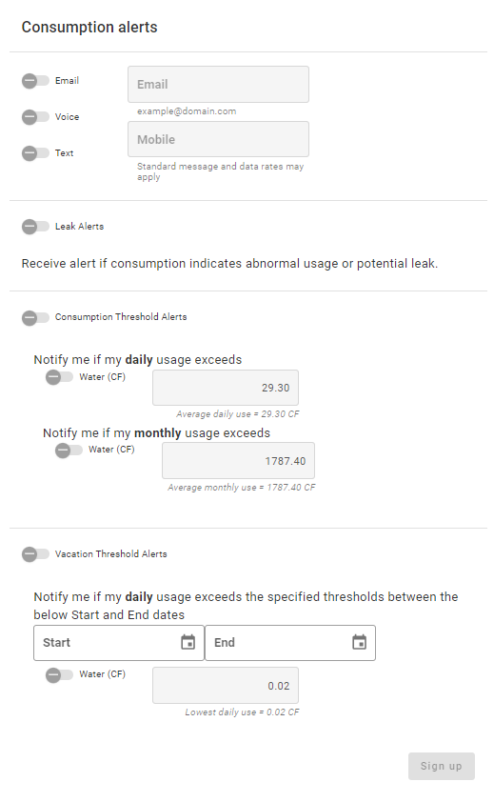
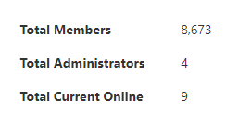
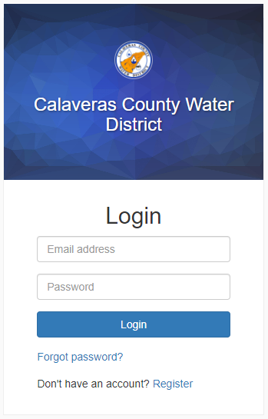
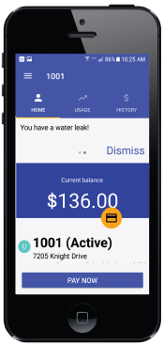
CUSTOMER
PORTAL UPDATE
MEMBERS – JANUARY
MEMBERS – DECEMBER
140
SMART METER PORTAL
Staff is continuing to collaborate with Tyler Technologies to improve the customer interface and tailor the portal to CCWD customers
Create an account TODAY!

Slide 5
CUSTOMER
ASSISTANCE
GENERAL STATS - CAP
Water
198 of 237 filled
**39 open spots
Wastewater
108 of 175 filled
**67 open spots
CCWD Customer Assistance Program (CAP)
$20/billing cycle for water
$30/billing cycle for wastewater
Funded through non-rate payer revenues
Requirements:
account in good standing, PG&E CARE program enrollment or 200% below poverty level
Program Renewals to begin in May!
ATCAA Low Income Housing Water Assistance Program (LIHWAP)
Program reallocated funding to Calaveras & Amador Counties to the tune of $15,000
Federally funded
State program facilitated by ATCAA, application information on their website
Hundreds to thousands of dollars in assistance to customers with past due or current bills
Deadline to submit applications: March 20, 2024
Program Ends: March 31, 2024
GENERAL STATS – LIHWAP
$53,431
worth of assistance to CCWD customers
67 accounts assisted
PROGRAM RENEWED!
Contact Customer Service!

Slide 6
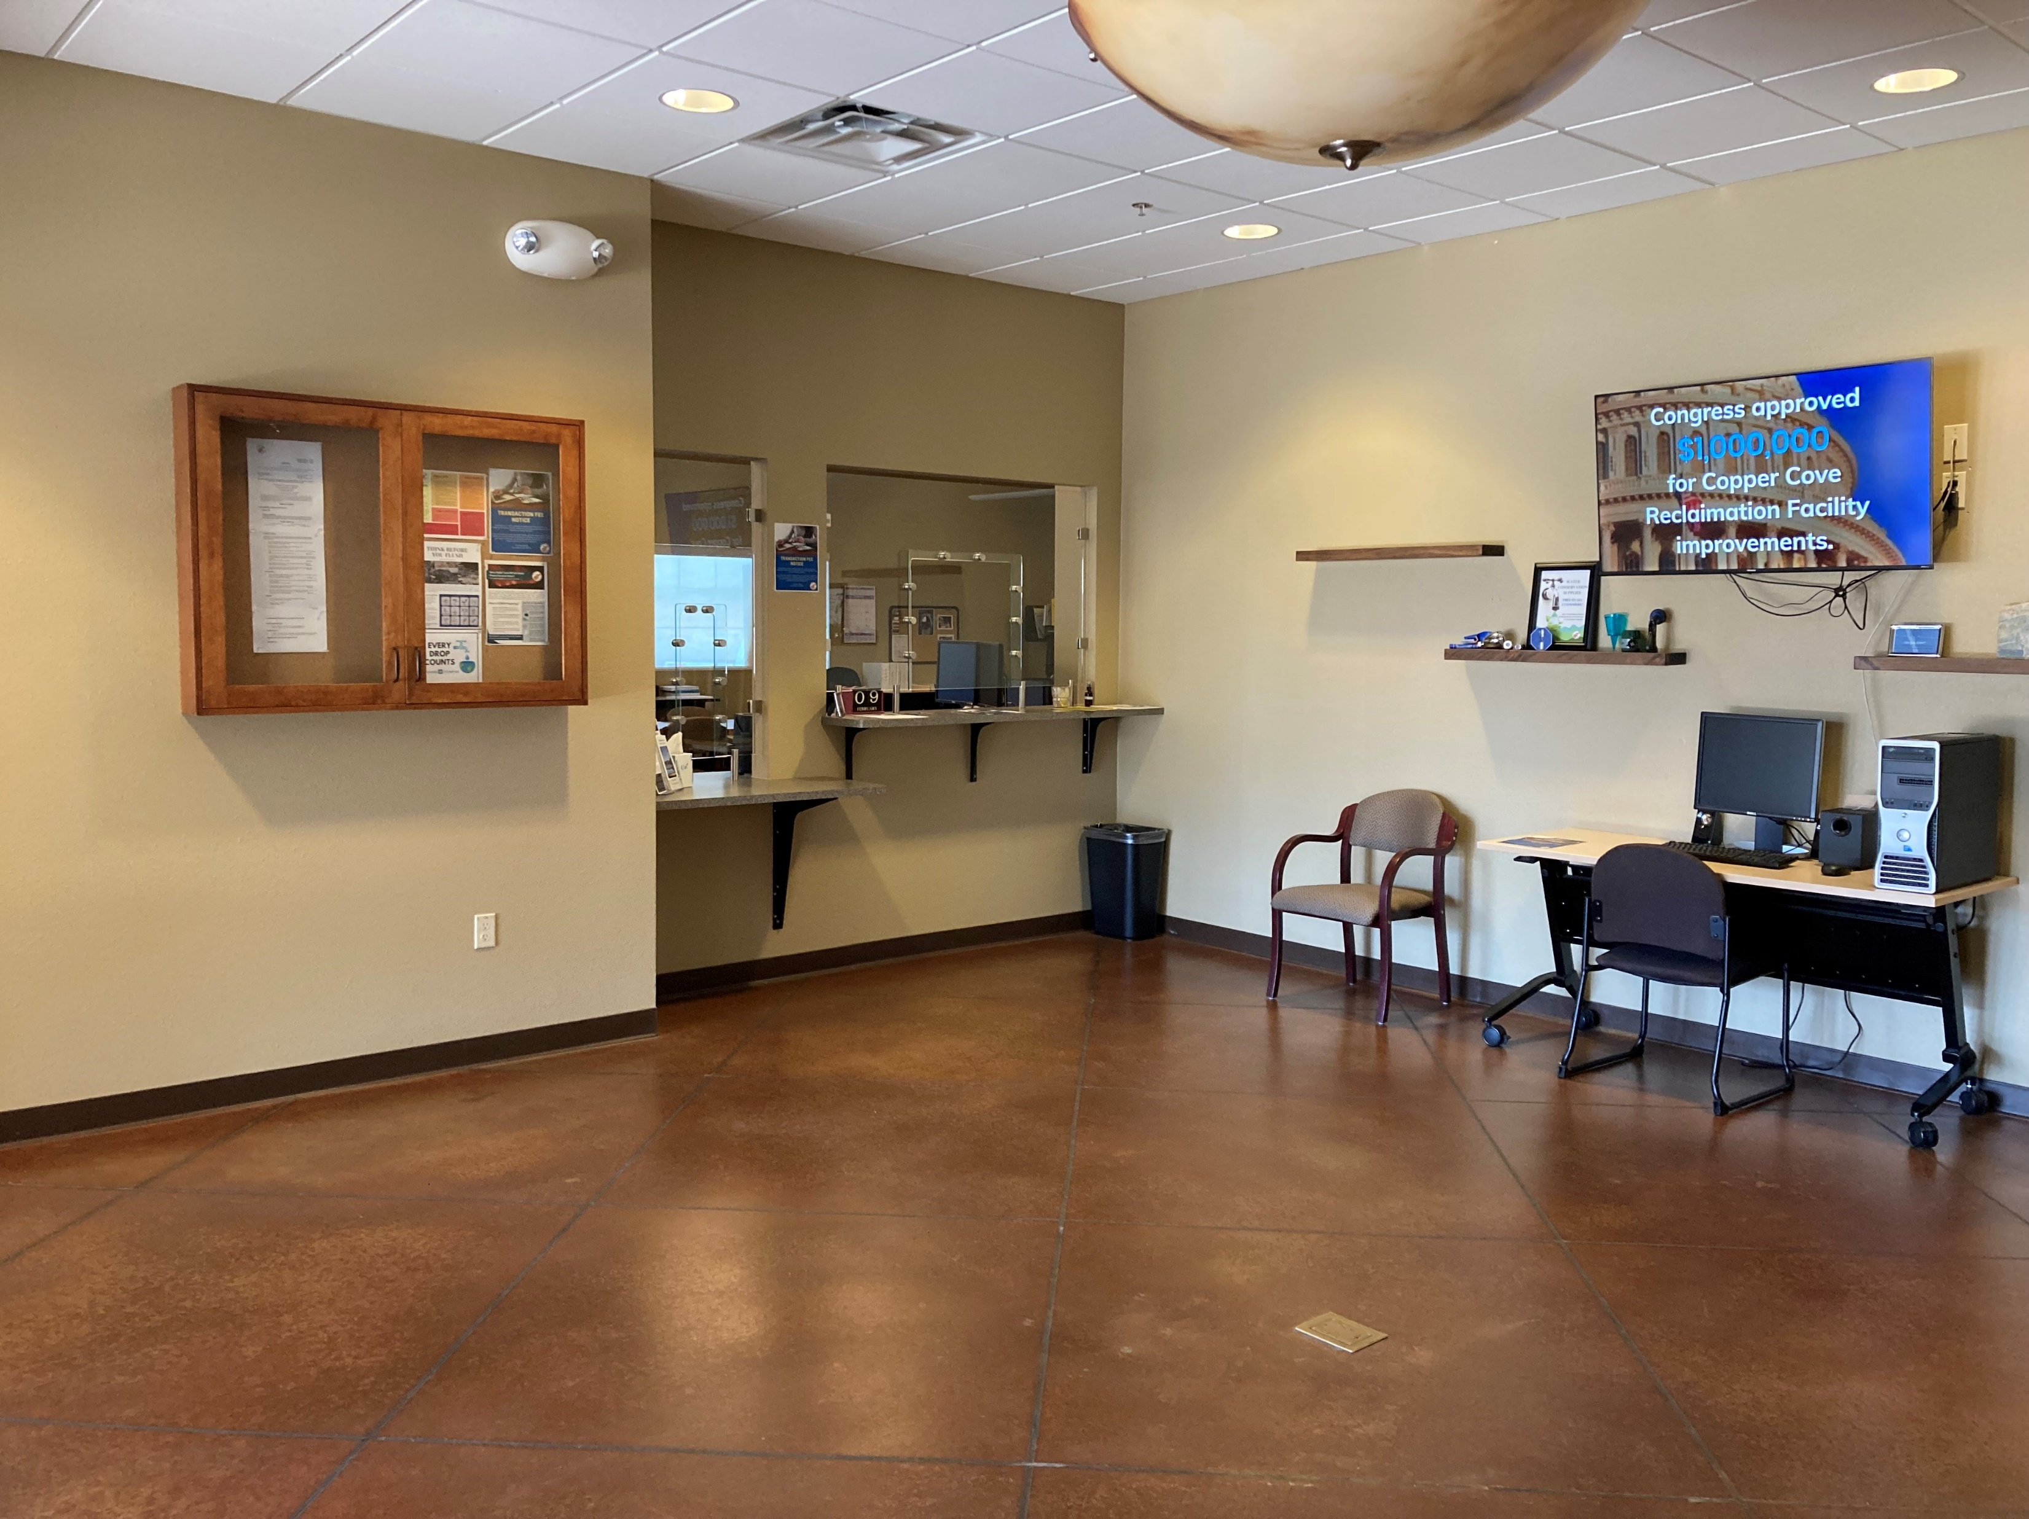
Thank You

