Slide 1


Initial funding research report – May 2024
Calaveras county water district
Engineering Committee meeting
June 4, 2024

Slide 2
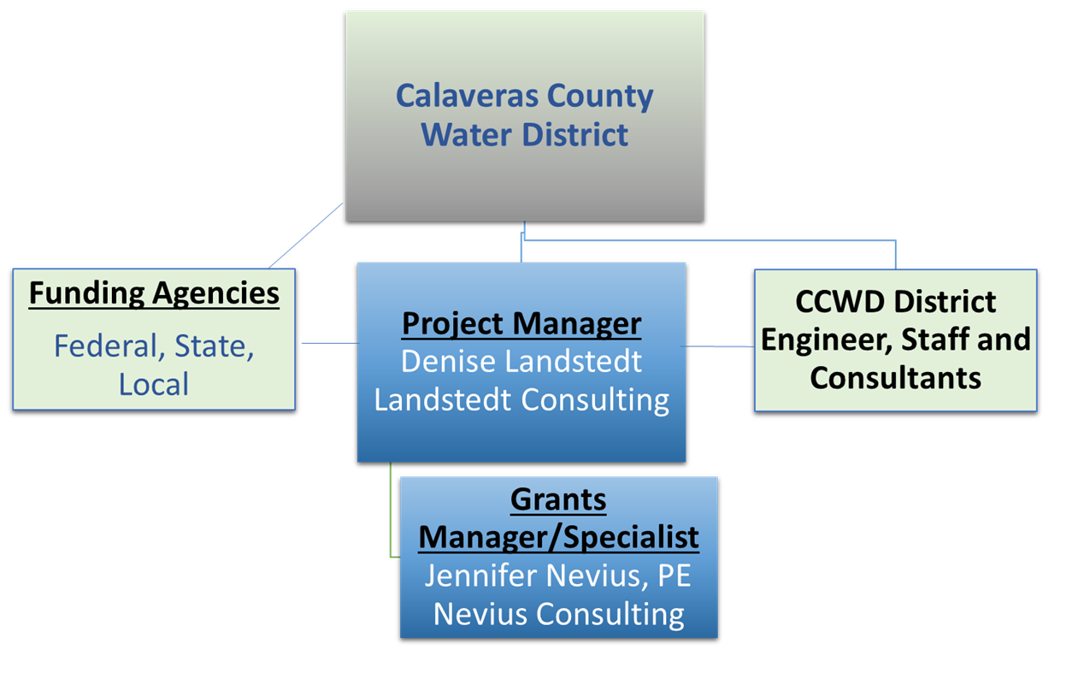
Funding team

Slide 3
Funding Research Approach
Identify priority Calaveras County Water District (CCWD) water and wastewater projects
  Present a summary of CCWD’s priority project information
  Develop project information as fully as possible to be most competitive
  Ready to prepare competitive funding applications within the timeframe required
Research Funding Opportunities
  Present potential funding opportunities matched to CCWD priority projects or of a general nature that may support other potential CCWD projects
    Includes local, state, federal – current with due dates, continuous, and future
  Present detail on funding opportunities and provide a preliminary funding analysis priority – High, Medium, Low – for preliminary competitiveness screening
  Participate in informational webinars, funding fairs, and funding meetings, as appropriate

Slide 4
Project - funding opportunity matches

Slide 5
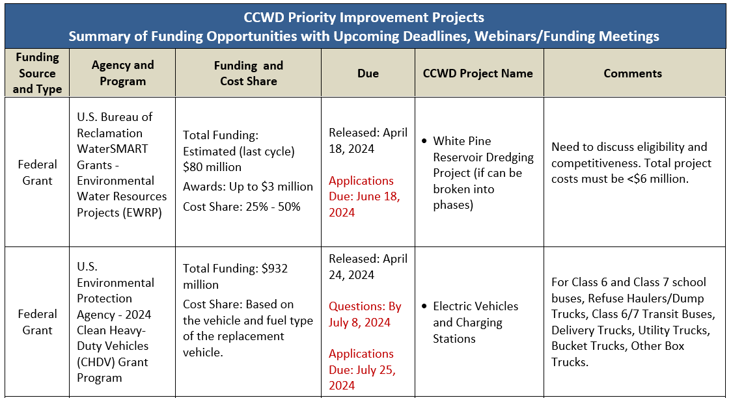
Project - funding opportunity summary

Slide 6


Go/No Go Assessment
Tailored to each specific funding opportunity
requires both a thorough understanding of the project and analysis of the funding opportunity
Utilizes a Pre-application questionnaire as a guide to consider:
  CCWD Objectives and Priorities
  Project Eligibility
  Competitiveness
  Timing
  Funding Amount in Total and Per Award
  Funding Schedule
  Other Considerations
Decision to apply

Slide 7
Application Preparation
Establish the core application team – CCWD and Landstedt consulting
Hold an application kickoff meeting, set communication protocol, and Establish an application preparation schedule
Develop the application framework of required information
develop key Project information to meet funding solicitation requirements
Seek additional information from the funder as needed
Obtain Board resolution as required
Obtain letters of supports where requested
Submit the application using the specified online Application site
Track funding applications submitted

Slide 8
Bi-monthly funding research reports
Future reports will be bi-monthly - next in July 2024
updated from the Initial Funding Report through ongoing research
includes available project and funding information at the time of reporting
Time sensitive opportunities WILL BE provided through a Funding Alert email with sufficient funding detail to determine if the opportunity should be considered further

Slide 9


