Slide 1
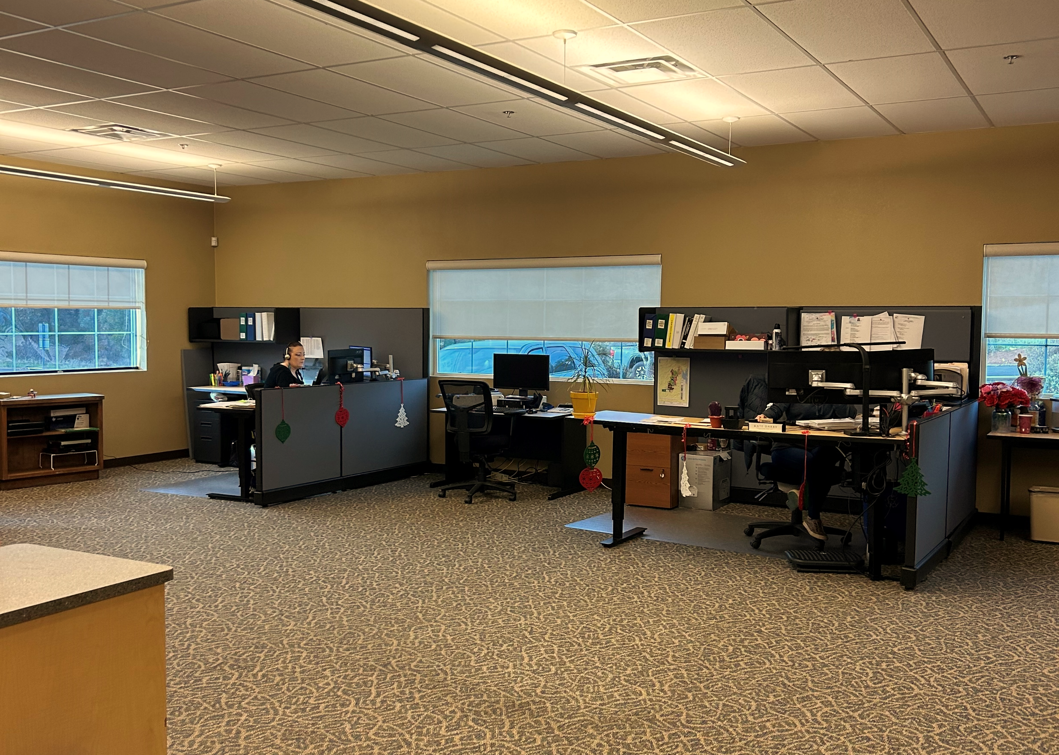
CUSTOMER
SERVICE

Slide 2
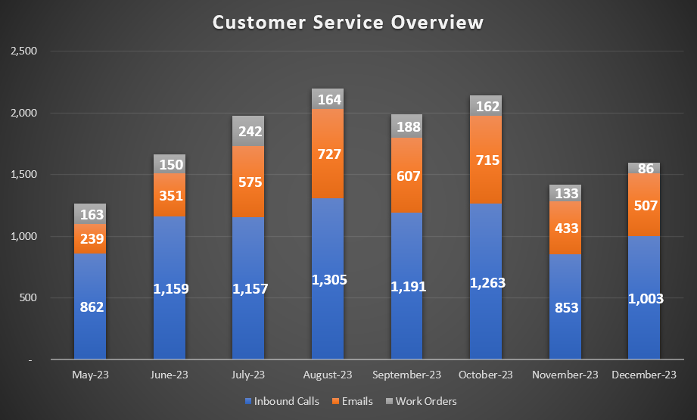
CALL QUEUES,
EMAILS &
WORK ORDERS
Common Inquiries for December:
CCWD-side & customer-side leaks/concerns
Water usage/billing questions
Rate Study/Cost of Service Inquiries
Call Analytics for December:
Avg. Calls Handled/Day: 53
Avg. Handle Time: 3:09 minutes
Total % Employee Hours on Calls: 10%
Recruitment Update!
Our new Customer Service Representative
Robin Patolo
started on December 18

Slide 3
THE INNER WORKINGS OF THE
Customer Service Department
Selling water & sewer
Residential
Commercial
Utility Service Requests (USR’s)
Opening new accounts
Legal deeded ownership changes through County programs
Water Service Agreements (WSA’s)
Temporary water
Move-ins
Move outs
Account updates
Bills to secondary parties
Rebates
Payment processing
Leak adjustments
Foreclosure abatement
Regular billing
Final billing
Property liens & lien releases
Billing Account Customer Inquiries
Phone Calls
Letters
Emails
Most incoming District calls
Routing for all departments
Post-billing Delinquency Process
Reminder Notices
Door tags
Lock off’s
Dispatching inspection staff
Tracking service inspections
Filing
File & track default notices through County records
District mail processing & sorting
Refunds
Conservation
Notices & violation letters
Conservation supplies
Collections
Bankruptcies
Customer Assistance Program (CAP)
Initial enrollment
Annual renewals
Payment/account activity reconciliation & balancing
Returned payments
Credit applications to accounts
Rate & fee updates
Meter auditing
Service order creation for field staff
Dispatching of field staff
Credit reference letters
Various account adjustments
District claims
Suspension of Service
Reports
Water consumption
State reporting

Slide 4
THE INNER WORKINGS OF THE
Customer Service Department
CROSS-DEPARTMENTAL INVOLVEMENT
Cost-to-Serves
Termination of Service
ADU’s
Notifications for shutdowns, planned projects
Customer/public outreach
Tax Roll/Teeter
Backflow program fees
Lead & copper credits
Various CCWD committees
Special projects/implementations
Rules & regulations, procedures development & evaluation
District maps
Verification of service availability
Locations
System pressures for customers & outside agencies
Interface with various outside agencies
Building Department
Planning Department
Environmental Health
ATCAA
Assessors Office
County Recorders Office

Slide 5
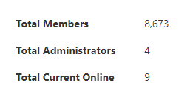
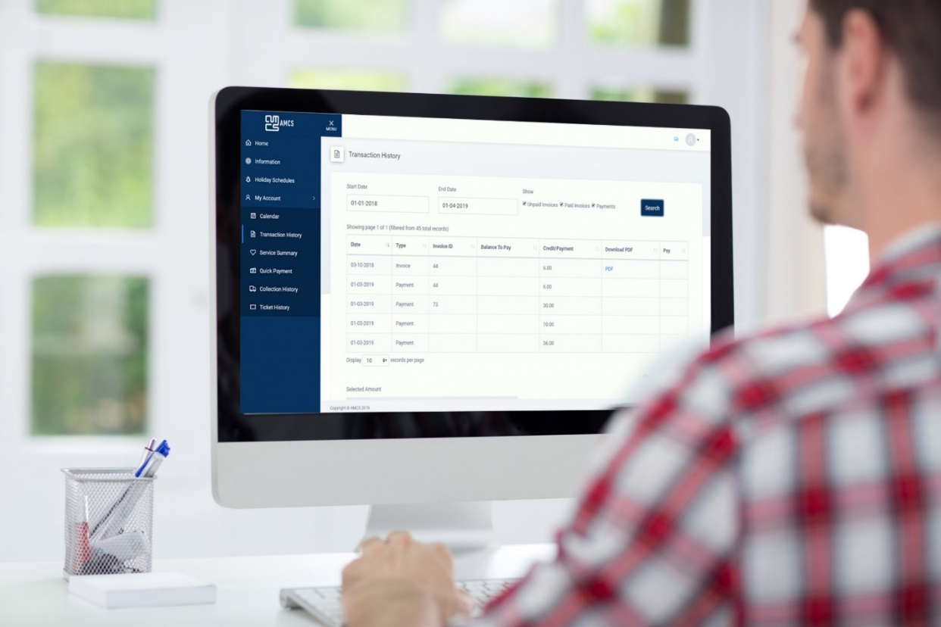
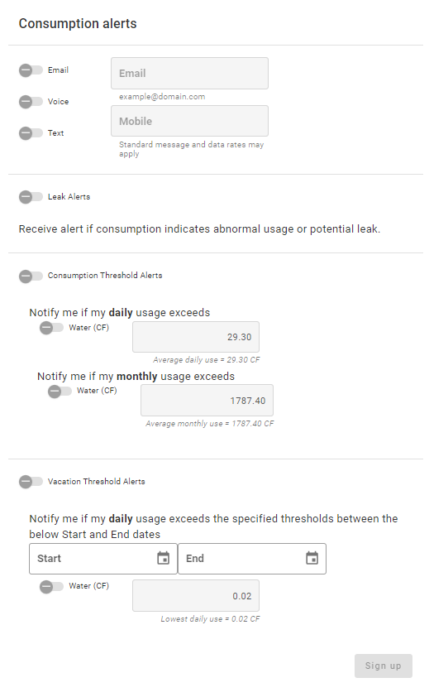
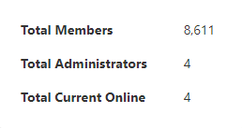
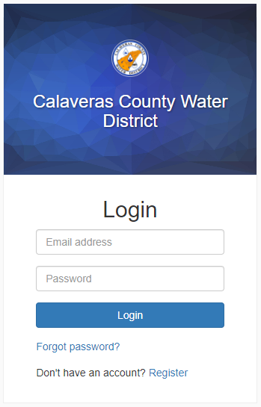
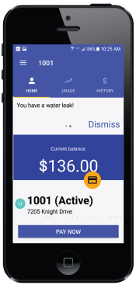
CUSTOMER
PORTAL UPDATE
MEMBERS – DECEMBER
MEMBERS – OCTOBER/NOVEMBER
62
SMART METER PORTAL
GO LIVE PROJECTED THIS MONTH!
Create an account TODAY!

Slide 6
CUSTOMER
ASSISTANCE
GENERAL STATS - CAP
Water
192 of 237 filled
**45 open spots
Wastewater
106 of 175 filled
**69 open spots
CCWD Customer Assistance Program (CAP)
$20/billing cycle for water
$30/billing cycle for wastewater
Funded through non-rate payer revenues
Requirements:
account in good standing, PG&E CARE program enrollment or 200% below poverty level
ATCAA Low Income Housing Water Assistance Program (LIHWAP)
Program reallocated funding to Calaveras & Amador Counties to the tune of $15,000
Federally funded
State program facilitated by ATCAA, application information on their website
Hundreds to thousands of dollars in assistance to customers with past due or current bills
GENERAL STATS – LIHWAP
$52,242
worth of assistance to CCWD customers
64 accounts assisted
PROGRAM RENEWED!
EXPANDING CUSTOMER ASSISTANCE
Discussions on how to best utilize current funding allocated to CAP program
Expand outreach for current program
Customer Assistance Survey Possibility

Slide 7
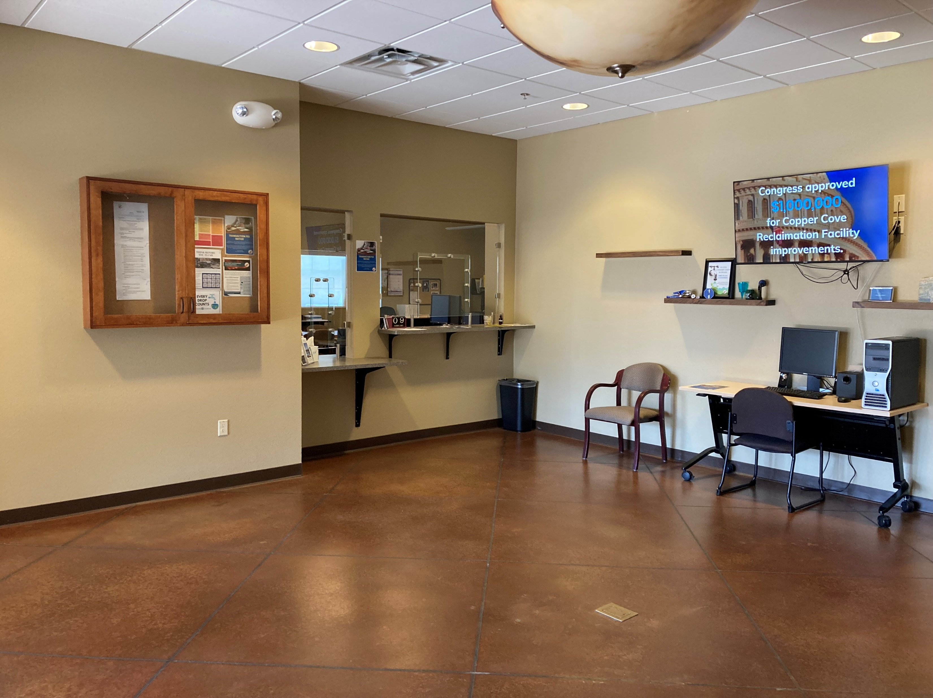
Thank You

