Slide 1
Year-End Legislative Report
October 22, 2024

Slide 2
Uniting the voice of California’s
2,000 special districts
and the communities they serve
Environment and Disaster Preparedness
Human Resources and Personnel
Public Works
Local Revenue
Governance

Slide 3
csda.net/GrantAccessibility

Slide 4
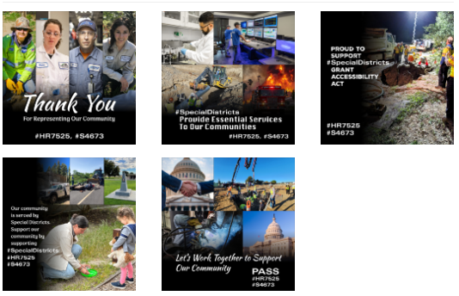
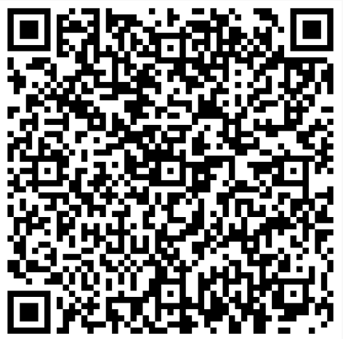
CALL TO ACTION
Special District Grant Accessibility Act
Digital Toolkit

Slide 5
Fix Our Forests Act
H.R. 8790
Expedite environmental reviews, limit frivolous lawsuits, and increase restoration projects
Amendment requested by NSDC and submitted by Rep. John Garamendi makes clear special districts are explicitly included and expands Good Neighbor Authority to special districts
Passed House 268-151
In U.S. Senate, facing opposition from Biden Admin.

Slide 6
csda.net/VoterLimitations

Slide 7
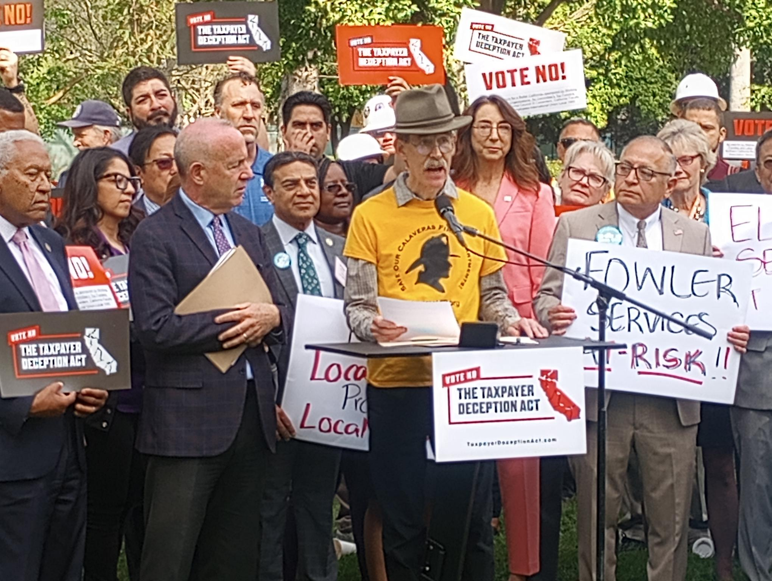
csda.net/VoterLimitations

Slide 8
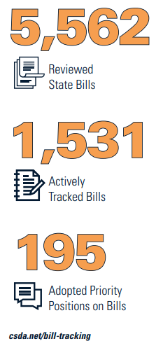
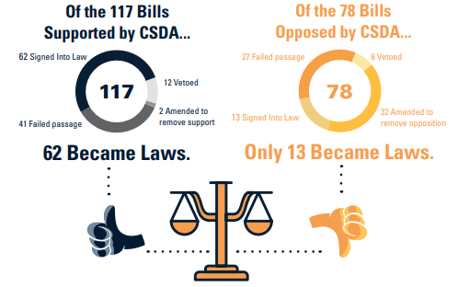

Slide 14
New Laws of 2025 Series
CSDA eNews
Running October 15 – December 31, 2024
Social Media Use by Public Officials
Vacant Positions
Brown Act
Prop 218 Fees and Charges
Development Related Fees
Bid Thresholds
Employment Laws
Employee Leave
Retirement Laws

Slide 15
Join CSDA’s Expert Feedback Teams
Environment & Disaster Preparedness
Governance
Human Resources & Personnel
Public Works, Facilities, and State Infrastructure Investment & Partnership
Local Revenue
csda.net/get-involved

Slide 16
Annual Legislative Conference
LegislativeDays.csda.net

Slide 17
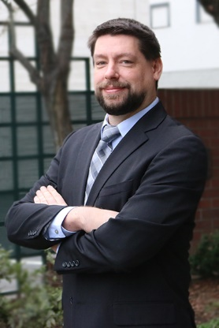
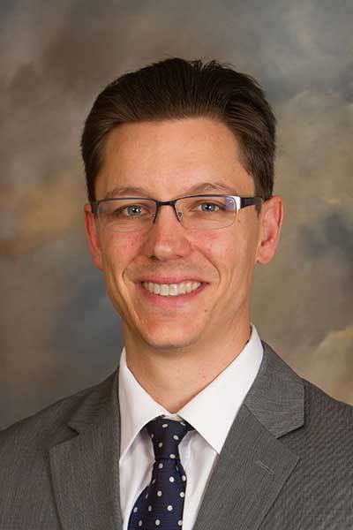
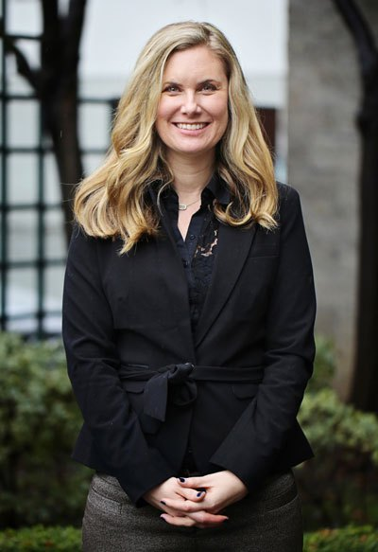
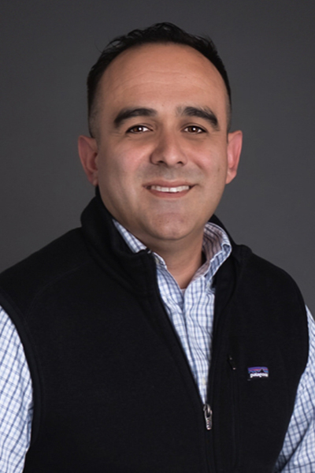
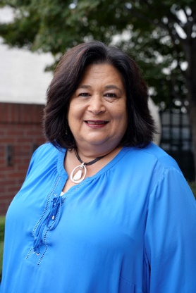
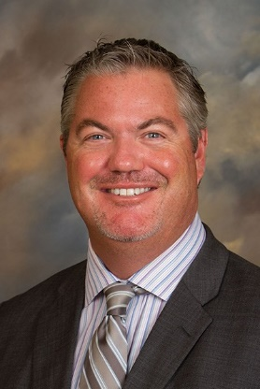
Public Affairs Field Coordinators
Christopher Norden Dane Wadle Colleen Haley
Northern Network Sierra Network Bay Area Network
Erasmo Viveros Richelle Noroyan Chris Palmer
Central Network Coastal Network Southern Network

