Slide 1

Engineering Committee
Calaveras County Water District
Section 219 Grants
New Hogan Reservoir to Jenny Lind WTP
New Raw Water Line
September 9, 2025
Senior Civil Engineer
Alex Brown, M.Eng., PE

Slide 2
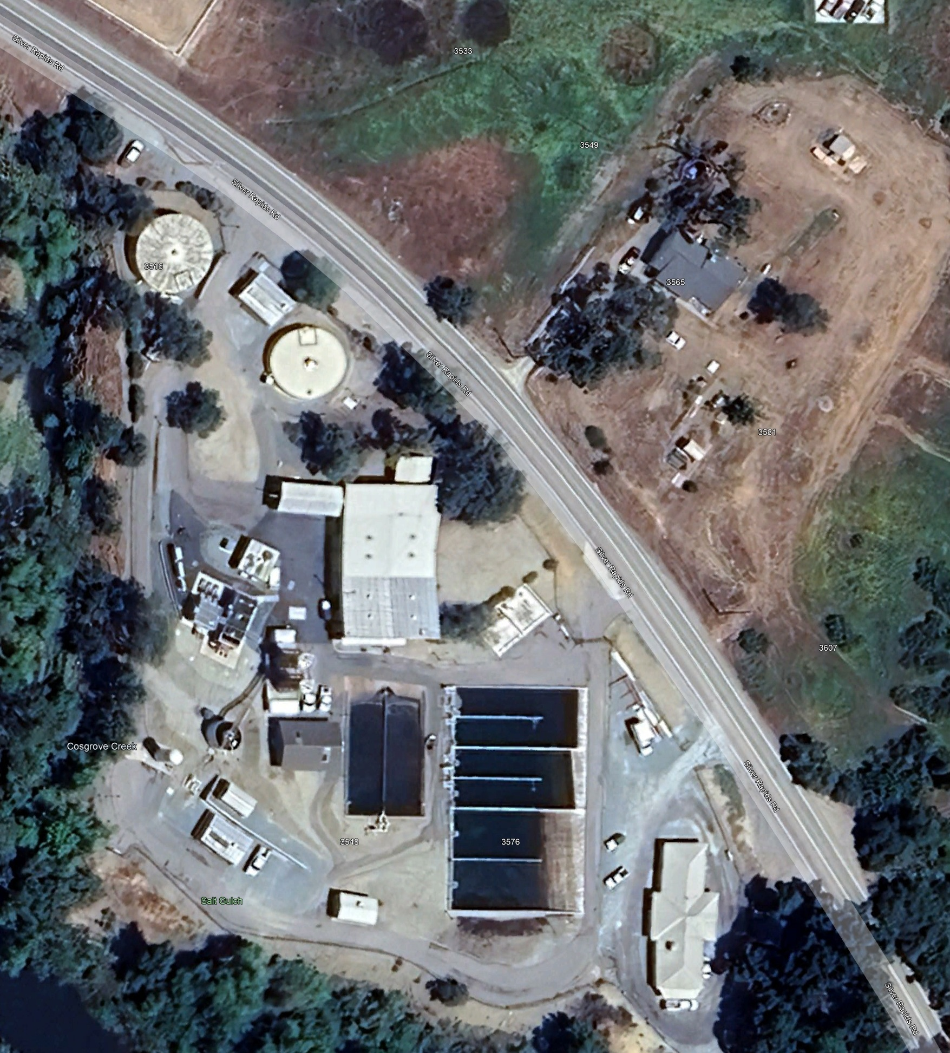
Engineering Committee September 9, 2025
Calaveras County Water District Agenda Item XZ
Jenny Lind Water Treatment Plant (JLWTP)
Sources raw water from the Calaveras River
Raw water enters plants through an aging infiltration gallery
Located at the confluence of the Calaveras River & Cosgrove Creek.
The confluence is prone to:
flooding
sediment deposition
seasonal algal bloom
The managed releases of New Hogan Reservoir compromise operations

Slide 3
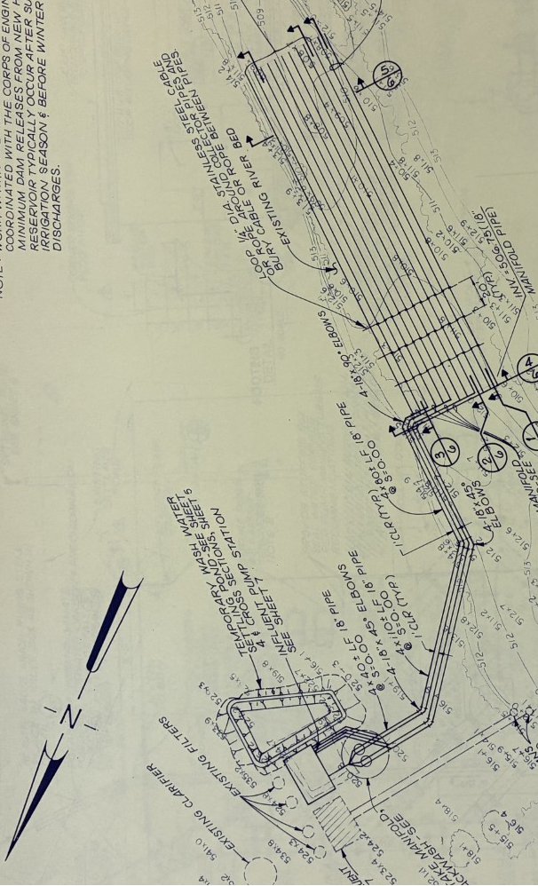
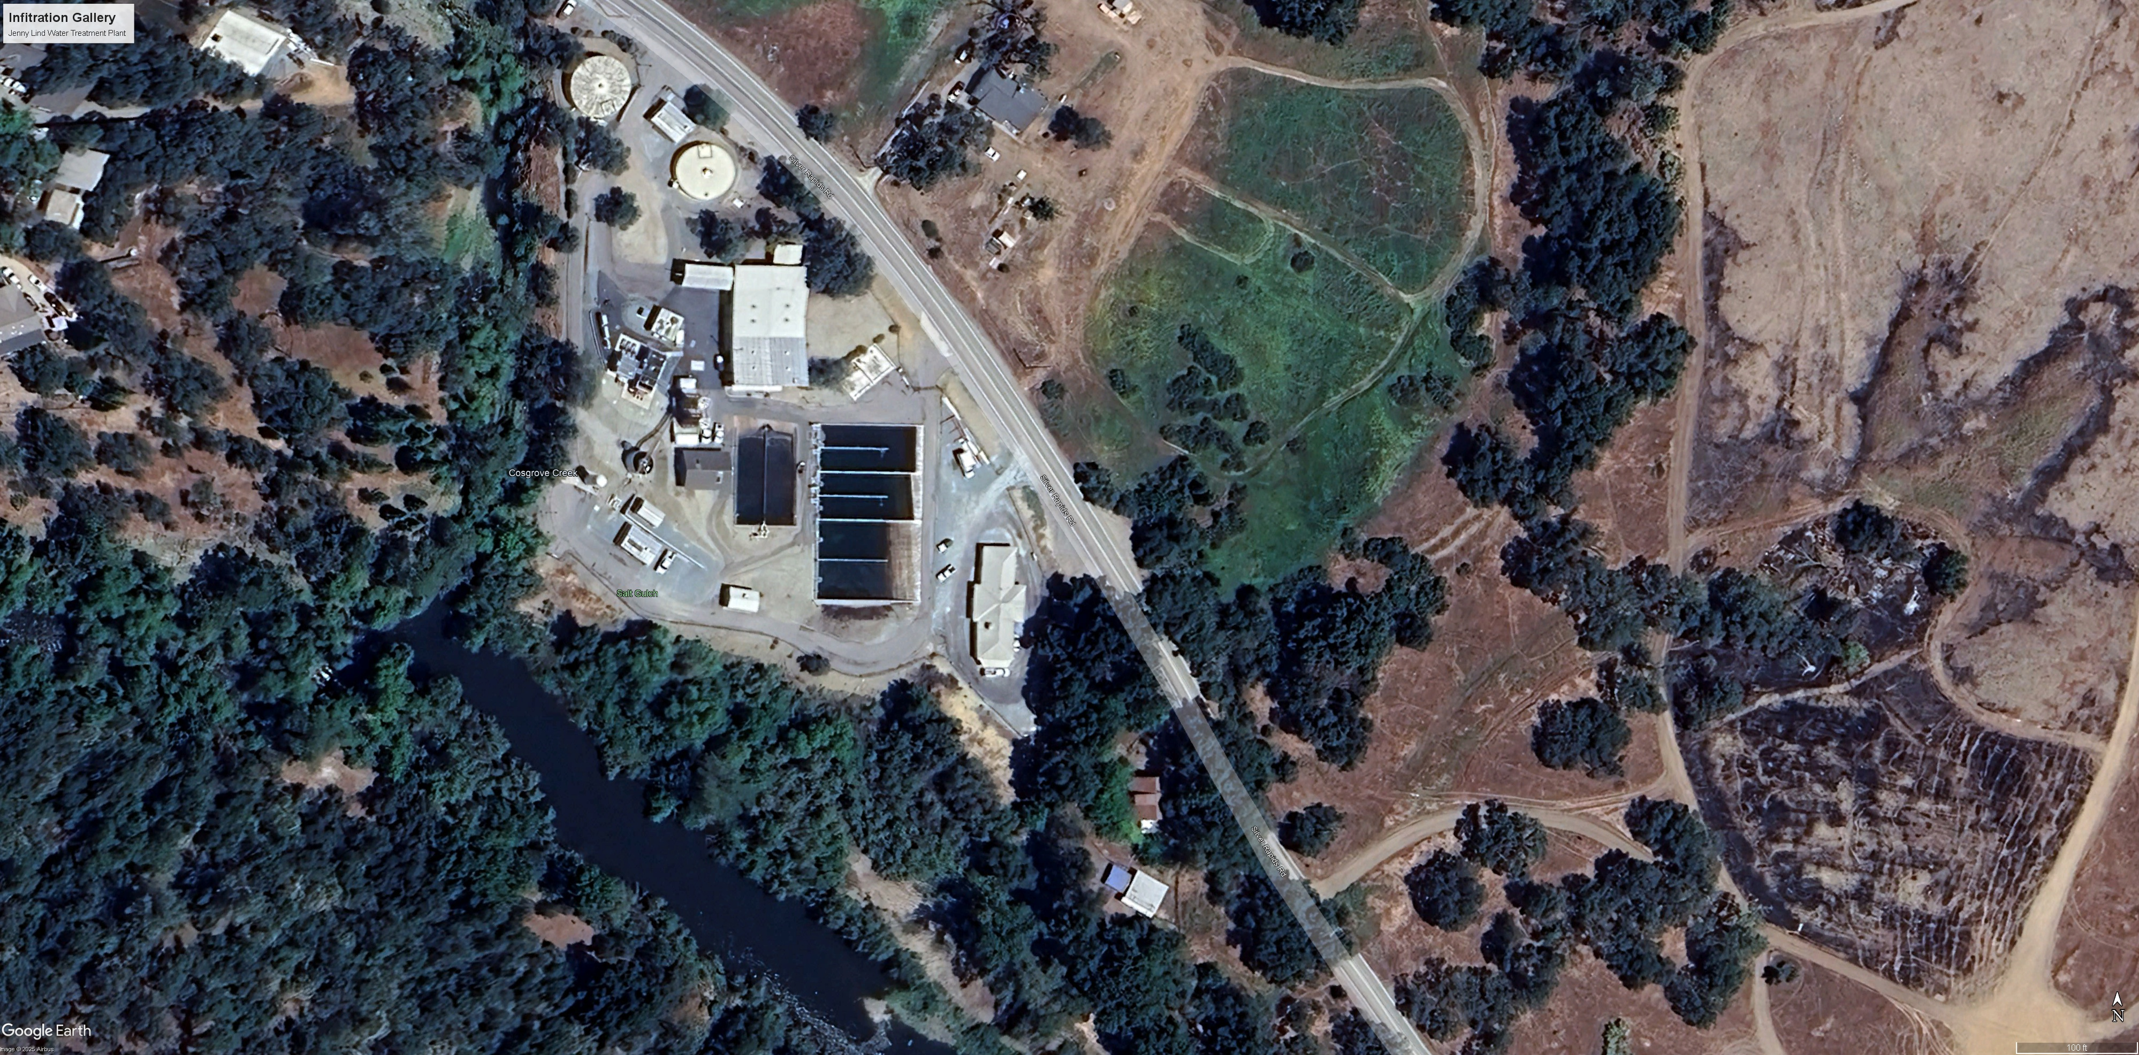
Engineering Committee September 9, 2025
Calaveras County Water District Agenda Item XZ
Infiltration Gallery
JLWTP Infiltration Gallery
Raw water enters plants through an aging infiltration gallery
The intake to JLWTP is in an environmentally and culturally sensitive zone
Low flows from drought reduce capacity
Water quality concerns
Varying flows,
Sedimentation and,
algal blooms
High flows concerns
Destroys gravel pad access
Disrupt Operations
Threaten water quality
Cosgrove Creek
Calaveras River
Infiltration Gallery

Slide 4
Engineering Committee September 9, 2025
Calaveras County Water District Agenda Item XZ
Alternatives
Alternative A
A waterline running through the natural earth to Hogan Dam Road. This line would extend to the junction of Hogan Dam Road and Silver Rapids Road. This junction is at the Northeast end of the bridge that crosses the Calaveras River.
Alternative A
A water line running from a junction with the New Hogan Powerhouse, through natural earth to the undeveloped road that parallels the Calaveras River and crosse the river to the Northeast side of the bridge where the waterline joins the treatment plant on Silver Rapids Rd.

Slide 5
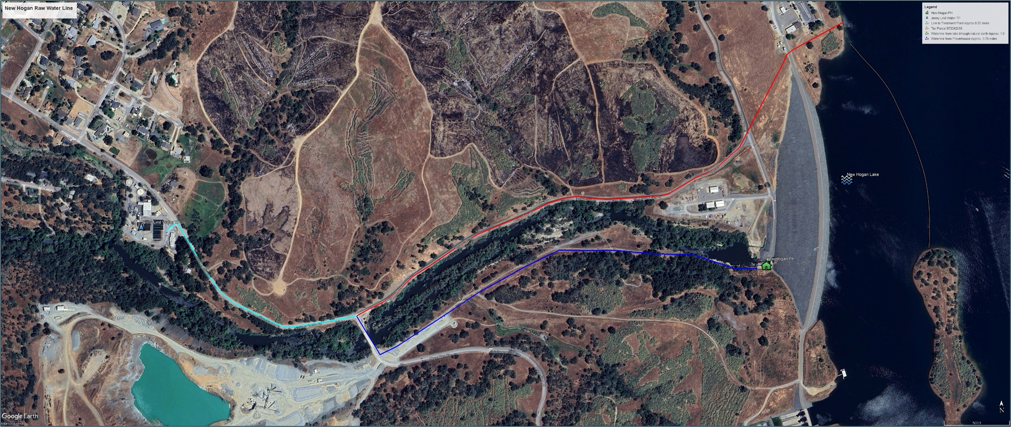


Engineering Committee September 9, 2025
Calaveras County Water District Agenda Item XZ
Jenny Lind Treatment Plant
Alternative A
Waterline to treatment plant
Alternative B
New Hogan Powerhouse
Calaveras River

Slide 6
Engineering Committee September 9, 2025
Calaveras County Water District Agenda Item XZ
Current Status/Progress
Preliminary schematic developed
Preferred alternative identified
Section 7001 application submitted
Letters of support collected
Application submitted for inclusion in USACE Section 7001 Report

Slide 7
Engineering Committee September 9, 2025
Calaveras County Water District Agenda Item XZ
Financial
Estimated total project cost $14,045,000
Federal share $10,533,750
CCWD Share $3,511,250

