Slide 1
CCWD Engineering
Committee
3/6/2024

Slide 2
Meeting Agenda
Jenny Lind A-B Construction Contract Update
La Contenta WWTP Improvements
Huckleberry Lift Station Improvements
Reeds Turnpike Pump Station Replacement
Copper Cove Lift Station 6 and 8 Construction/Schedule Impact
Other Project Updates

Slide 3
Jenny lind a-b Transmission Pipeline Construction update
Project Consist of Installation of New Dedicated Transmission Line Between Tanks A and B in Jenny Lind
  20,000 LF of 12” and 14” Ductile Iron Pipe
  5 Pressure Reducing Station
  210 Service Line Replacements (Additive Bid Item)
  Controls the pressure fluctuation in the existing Distribution System. Keep up with Demand in B Tank
Key Project Items:
Pipeline will be installed along Heinemann Dr, Hart Vickson Lane, Baldwinn Street, Usher Drive and Wind River Drive.
Work includes Grinding and Asphalt overlay for half the roadway width. Opportunity to work with the County on paving/ resurfacing other half roadway.
Project includes Rock Clause that requires District to Pay the Contractor to break non-rippable rock on Time and Materials Basis

Slide 4
Jenny lind a-b Construction Bids
Bid Results:
  Received 12 Bids from many Highly Qualified Contractors, Engineers Estimate $12.3M
  Top 5 Lowest Bids
    1. D.A. Woods $9,309,458 (Base), $1,440,810 (Service Lines)
    Ford Construction $9,590,410 (Base), $1,260,000 (Service Lines)
    Mozingo Construction $9,714,631 (Base), $1,874,250 (Service Lines)
    Mountain Cascade $9,855,650 (Base), $1,404,480 (Service Lines)
    Steve P. Rados, Inc $9,902,222 (Base), $1,543,500 (Service Lines)

Slide 5
Jenny lind a-b Additive Bid Item (Service Lines)
The Bid Item for Services Lines in Additive Bid Item. District can decide whether or not to award the additive item of work.
There are a total of 210 Service Lines that are included in Additive item. Majority of the service lines are currently one-line split at the meter box to serve two customers. The Additive Item would install a dedicated service line to each customer.
Trench restoration would include paving back the existing trench at same unit price as the existing base contract. Per County requirements, overlays will need to be performed when service lines are closer than 150-feet which is the case for only a few locations.
Overall cost for installation of 210 Service Lines:
$1,440,810 + $60,000 for Trench Restorations. Or approximately $7,150/each.
Staff is Looking for a Recommendation from the Engineering Committee on Award of the Additive Item to D.A. Woods.

Slide 6
La Contenta Wastewater Treatment Plant Design
Request for Proposals
Key Project Improvements:
Design system to meet current commitments, while sizing infrastructure for full build out.
Proposed Phase 3 Improvements:
  Second Activated Sludge Basin and Clarifier (Biolac or Equal)
  Rehabilitation of Existing Biolac
  Biological Nutrient Removal (BNR), needed for a Future Discharge Permit.
  Electrical Improvements
  Recycled Water Pipe Improvements
  Storage Pond Drain Improvements
La Contenta Service Area Overview
  Existing Infrastructure at the Treatment Plant is nearing capacity.
  Currently 1,054 Connection or 1,110 Equivalent Dwelling Units (EDUs).
  Total Current Service Commitments 1,577 EDUs
  Total possible connection at is 2,250 EDUs at full build out (Based on 2020 General Plan). Down from 2,695 EDUs identified in 2017 Master Plan.
  Current Permitted Flows 200,000 GPD (ADWF), At 165 Gal/EDU = 1,212 EDUs

Slide 8
RFP Schedule/Considerations
Staff is requesting concurrence from Engineering Committee to Issue the RFP for Design Services. Design Proposal would be brought to the Board for Full Approval.
There is not adequate funding in the current 5-Year CIP plan to complete the Construction. Funding for Portions of this Project would come from fees collected from new Developers, where commitments have already been made.
Roadmap for staying ahead of the necessary improvements at WWTP.
Staff considered taking the Design-Build Approach, attended seminars on this approach. Design-Build may not viable because funding is not currently available.
Additional improvements “Phase 4” would need to be completed prior to full build out.

Slide 9
La Contenta Huckleberry Lift Station
Request for Proposals
Lift Station Overview
  Main Lift Station in La Contenta Service Area, Pumps to the Wastewater Treatment Plant through 12” Pipeline.
  Existing Pumps are Incorrectly Sized.
  Operational issues with existing pumps at low/high flow conditions.
  Lift Station is subject to flooding.
  The existing facility is in poor condition.
  Need to increase capacity to meet Service Requirements.
Key Project Improvements:
Construct new wet well with pumps that are appropriately sized (two low flow, 3 high flow pumps)
Construct flood protection wall around perimeter site.
New electrical and control building.
New larger electrical service and standby generator.
Decommission or Demolish the existing facilities.

Slide 10
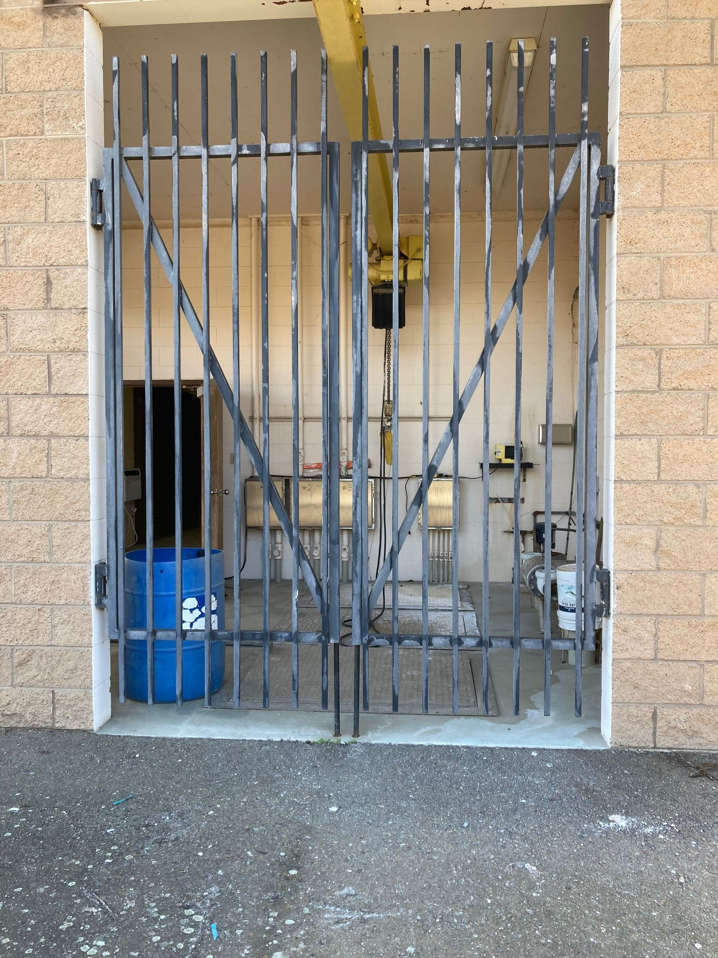
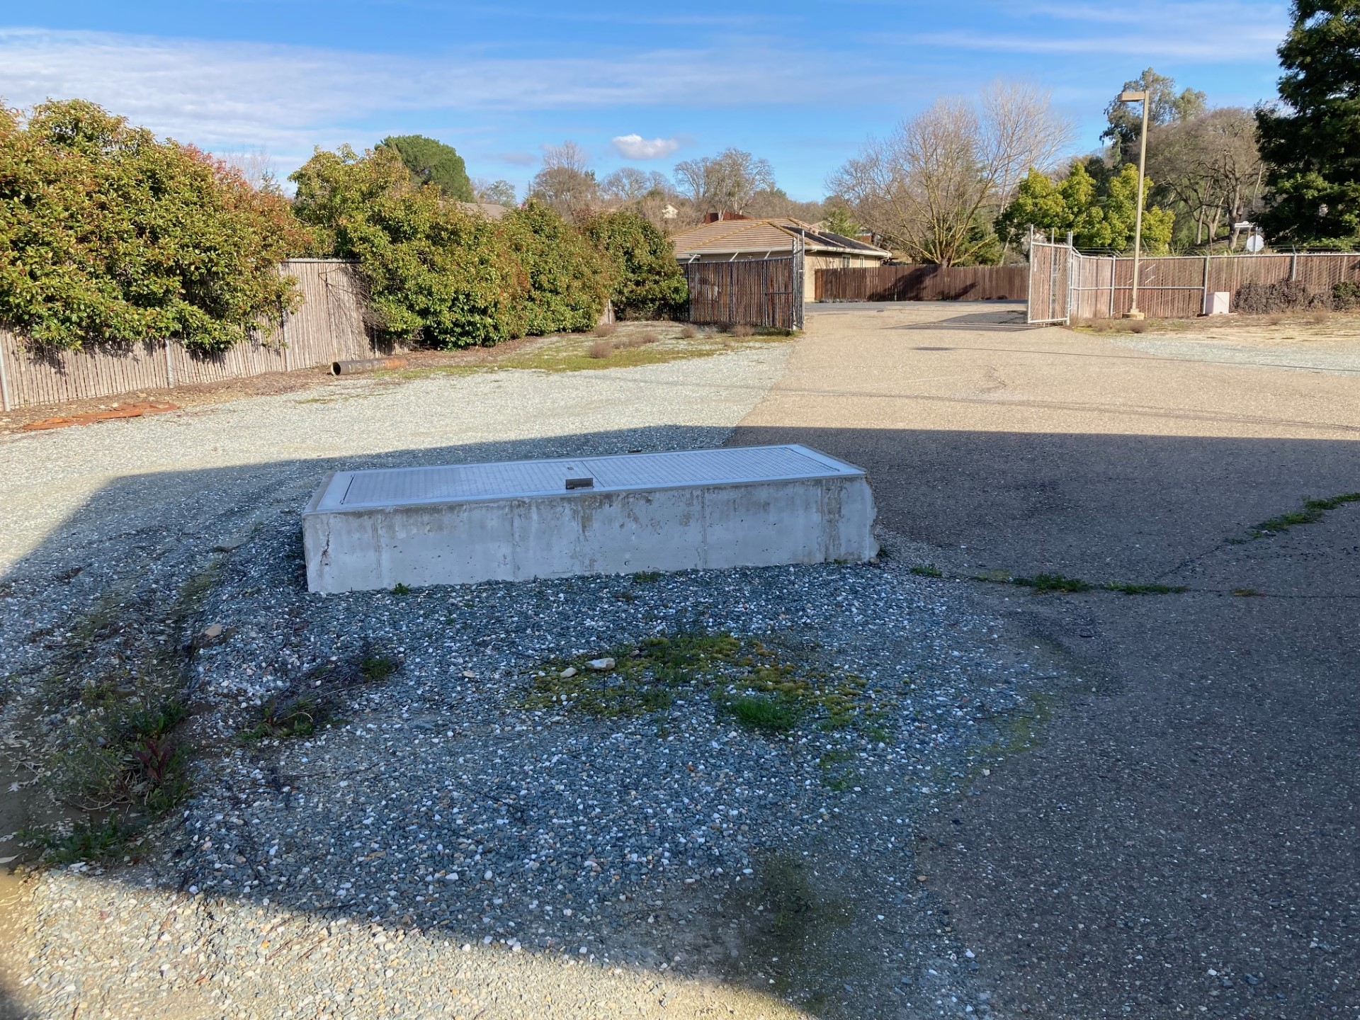
Existing Huckleberry Lift Station

Slide 12
Reeds turnpike pump station Project
Pump Station Overview
  Existing pump station operates at 100-gpm to supply potable water and fire water for the historic district of Copperopolis and the recent development of Copper Valley Town Square.
Key Project Improvements
Increase the firm pumping capacity and redundancy to reliably serve existing and continued development of Copper Valley Town Square.

Slide 13
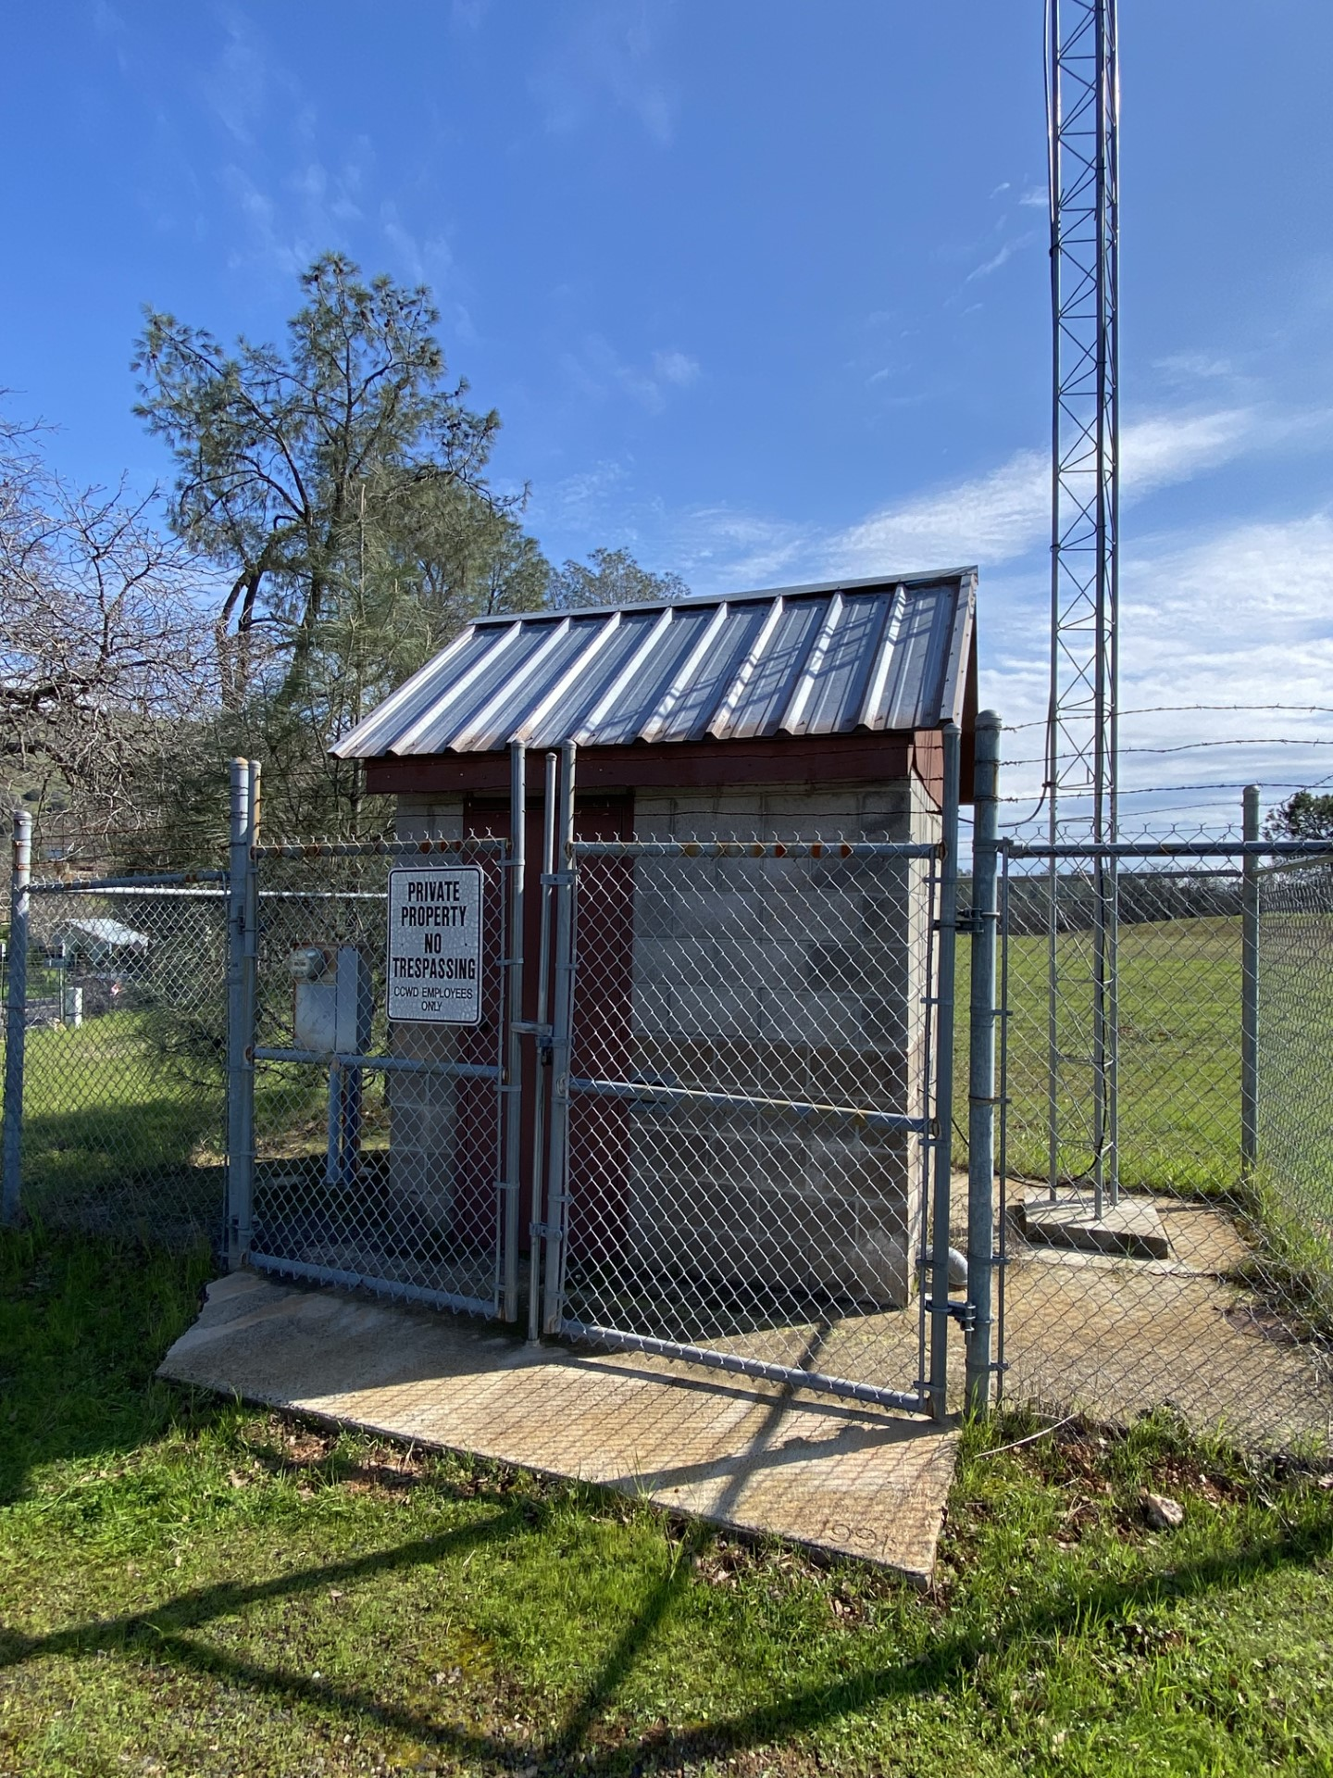
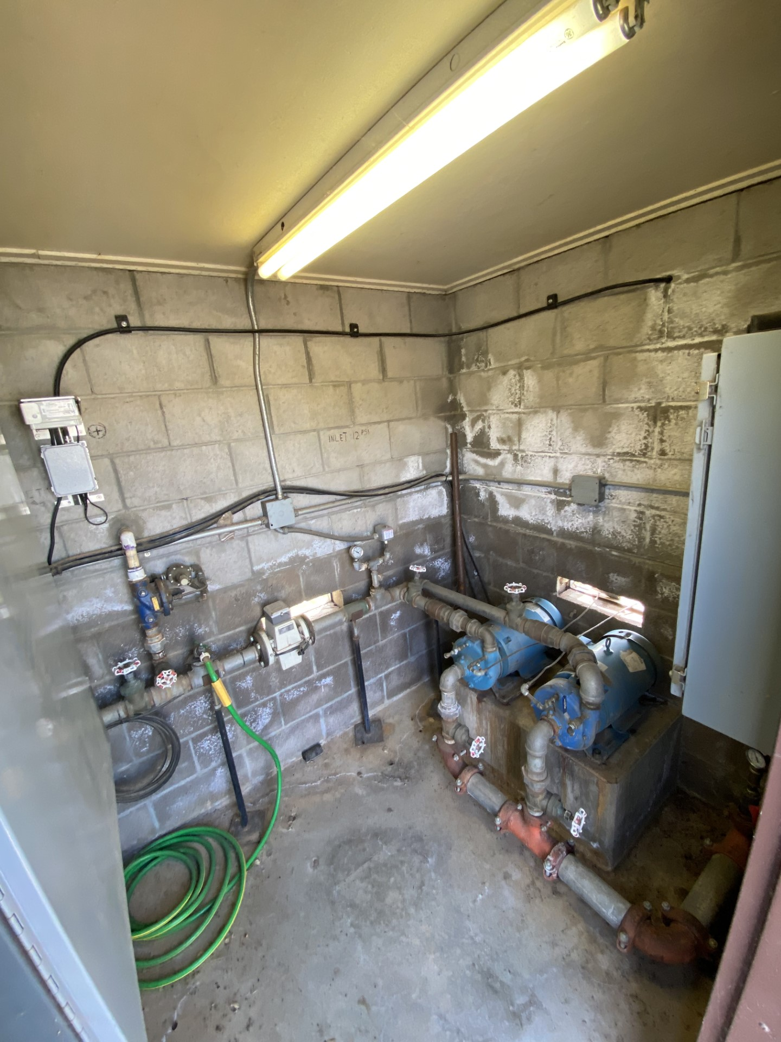
Existing Reeds turnpike Pump station

Slide 14
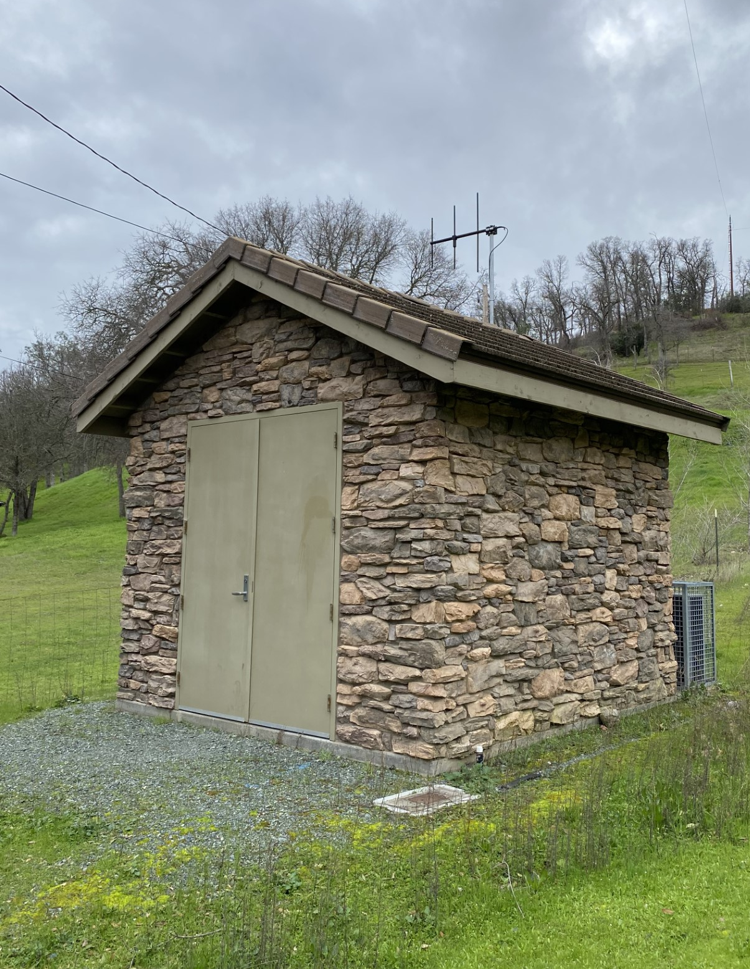
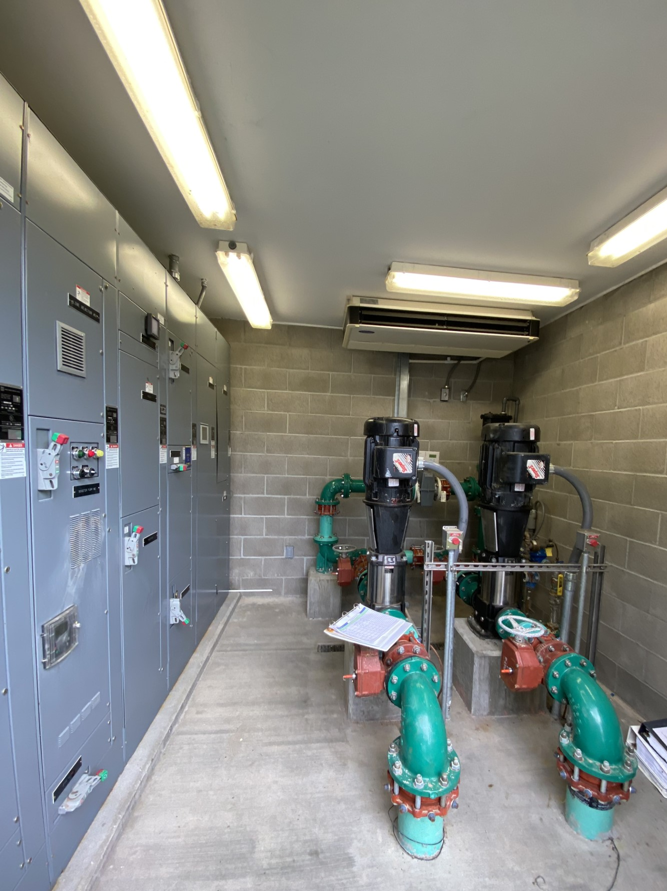
Proposed Design of the new pump station
Similar in design to the District's pump station located on Dennis Court in Valley Springs, CA.

Slide 15
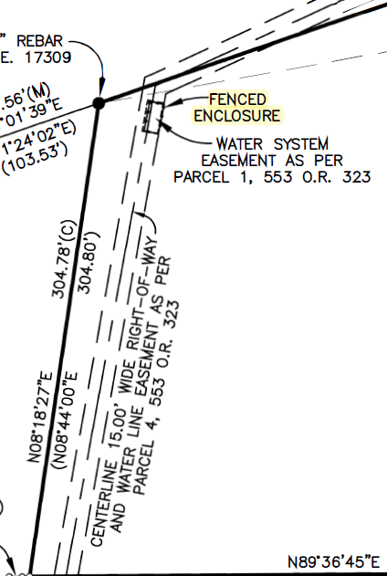
LOCATION OF NEW PUMP STATION
Existing pump station is within the District's Right-of-way.
Weber, Ghio & Associates Inc. is working on the design and alignment of the new pump station.
District staff has established contact with the landowner of the adjacent parcel and will work with the landowner if the new pump station encroaches outside the right-of-way.

Slide 16
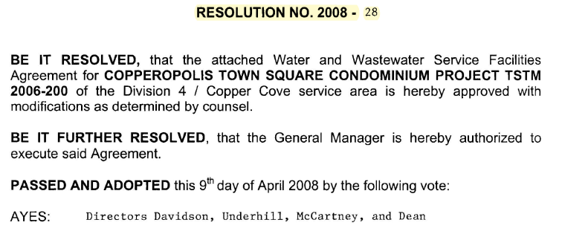
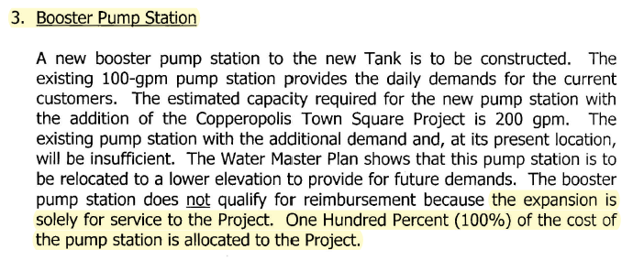
Financial Considerations
This is a development driven project needed as part of the Copper Valley Square.
The developer is solely financially responsible for the project.

Slide 17
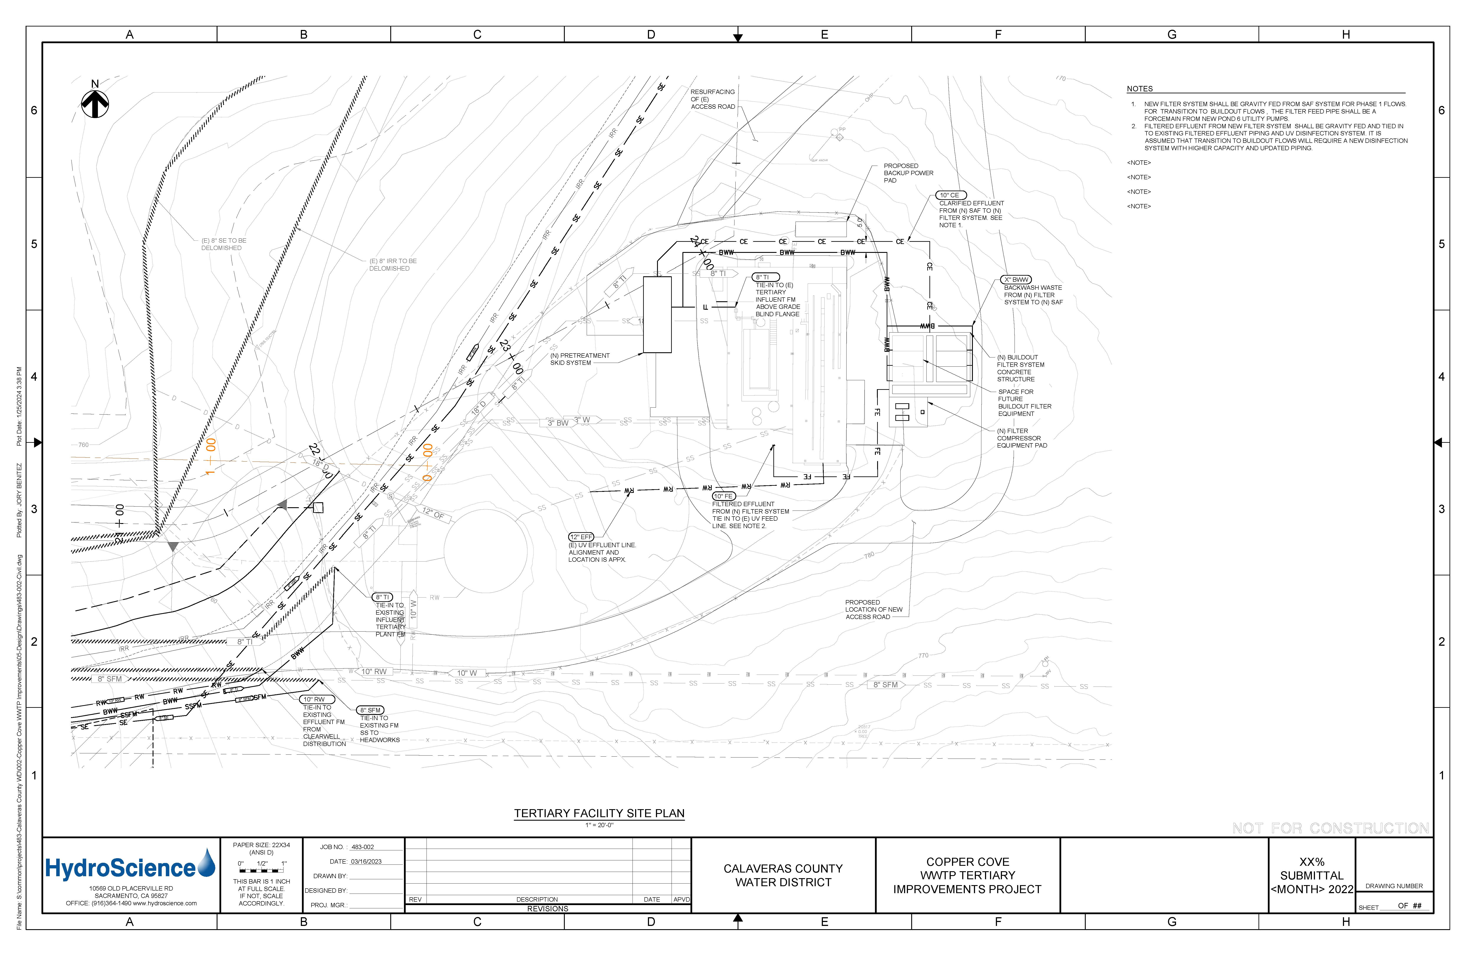
OTHER UPDATES
Copper Cove WWTP Tertiary Treatment Improvements.
US Army Corps of Engineers and CCWD continue to develop the project.
HydroScience has initiated design for the treatment plant and Dewberry has initiated the environmental studies.
The USACE has stated that an Environmental Assessment (EA) is needed.
An EA for this project will extend the schedule about 12 months.
The design technical review by USACE has been eliminated (treatment systems is not part of their charge) and therefore is no longer on the schedule’s critical path.
The project schedule indicates that construction would start in August of 2025.

Slide 18
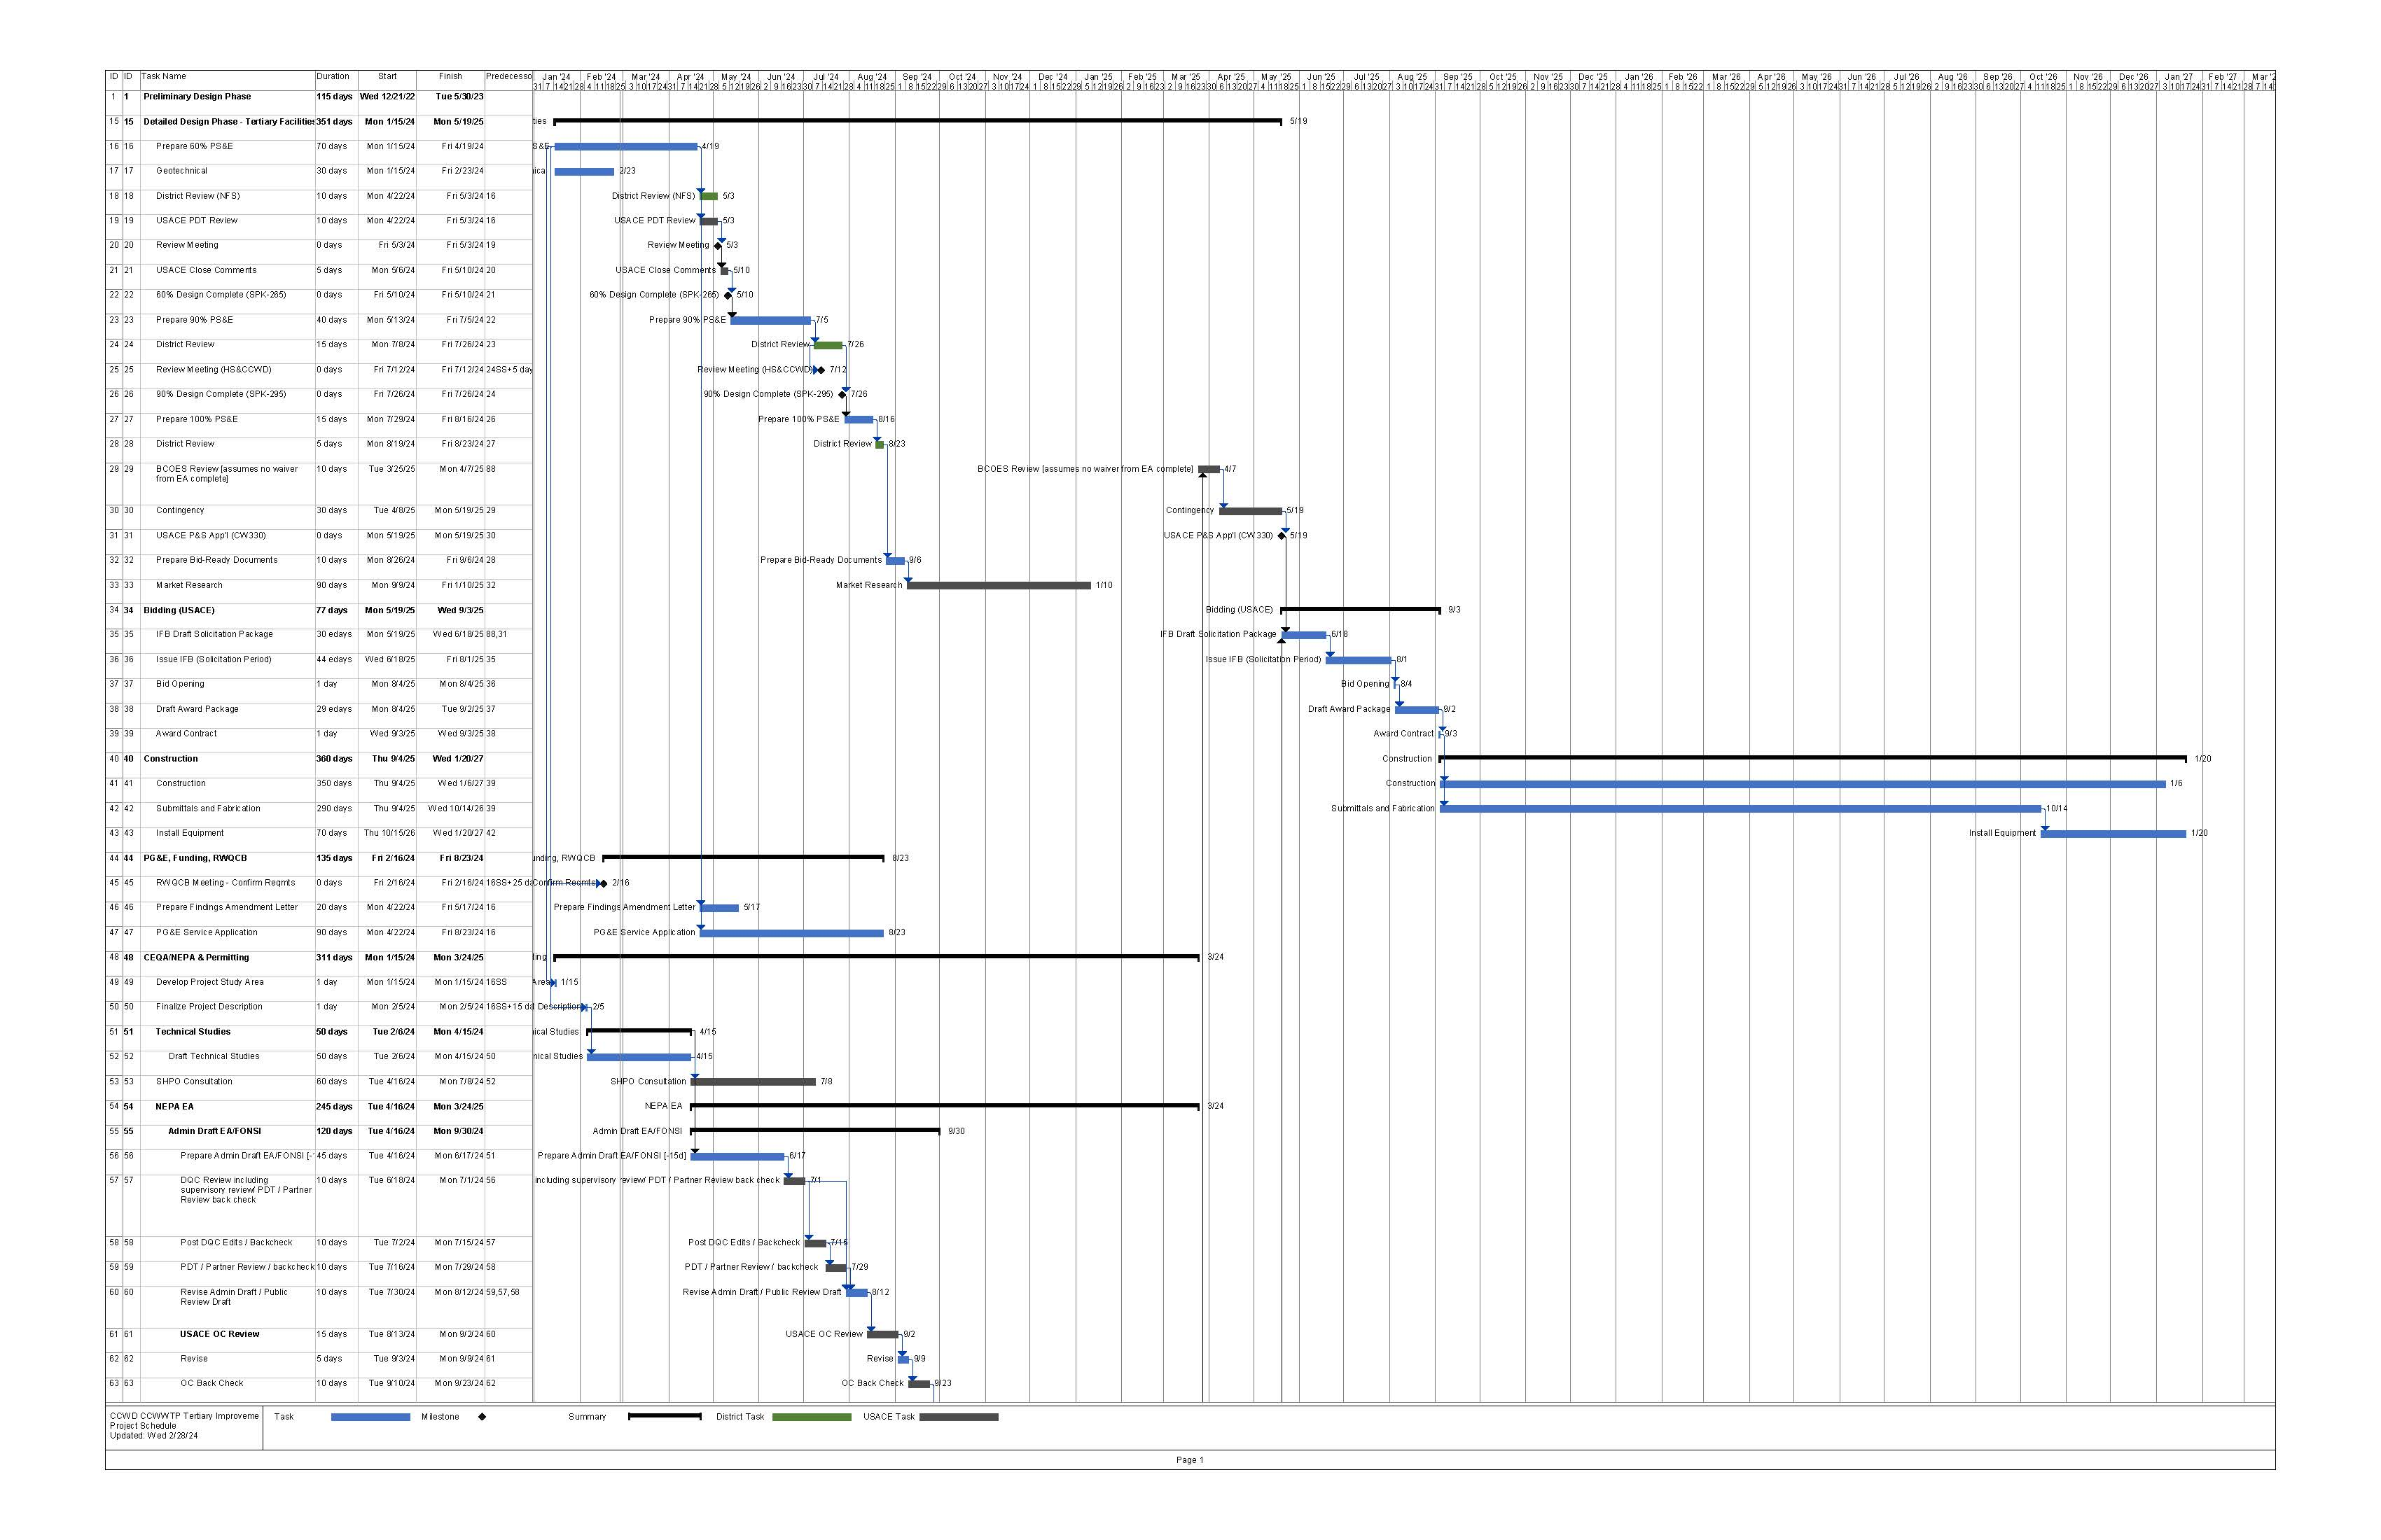
Project Schedule

Slide 19
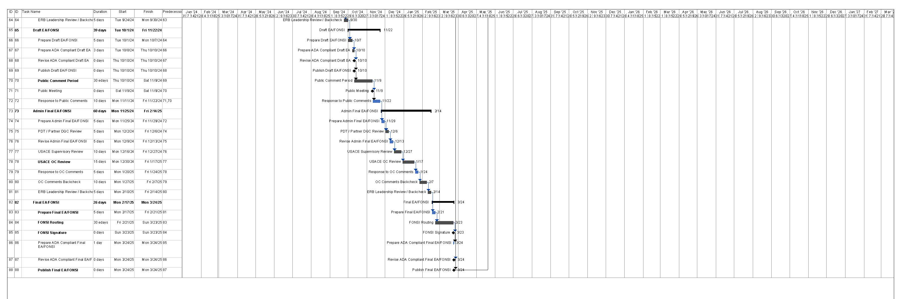
Project Schedule

