Slide 1
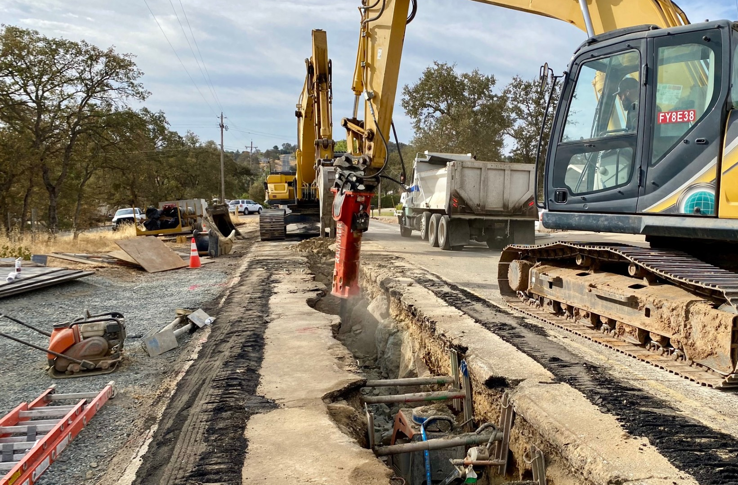
CCWD ENGINEERING COMMITTEE CIP UPDATE
10/29/24

Slide 2
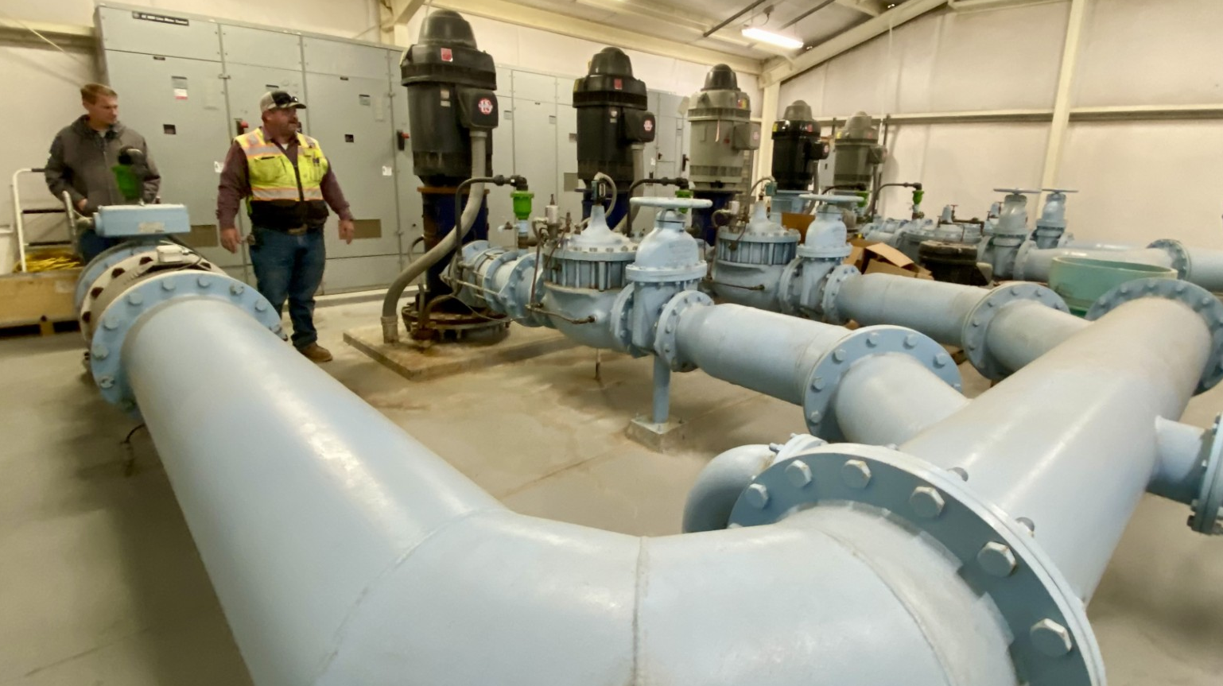
CONSTRUCTION PHASE
Copper Cove Lift Stations 6, 8, 15 & 16 and Lift Stations 12 & 13 Force Main Bypass Project
Copper Cove Water System Improvements Project
Jenny Lind Water System A-B Water Transmission Pipeline
Jenny Lind Clearwell #2 Rehabilitation
West Point Water Supply Reliability Improvements
West Point and Wilseyville Wastewater Consolidation Project

Slide 3
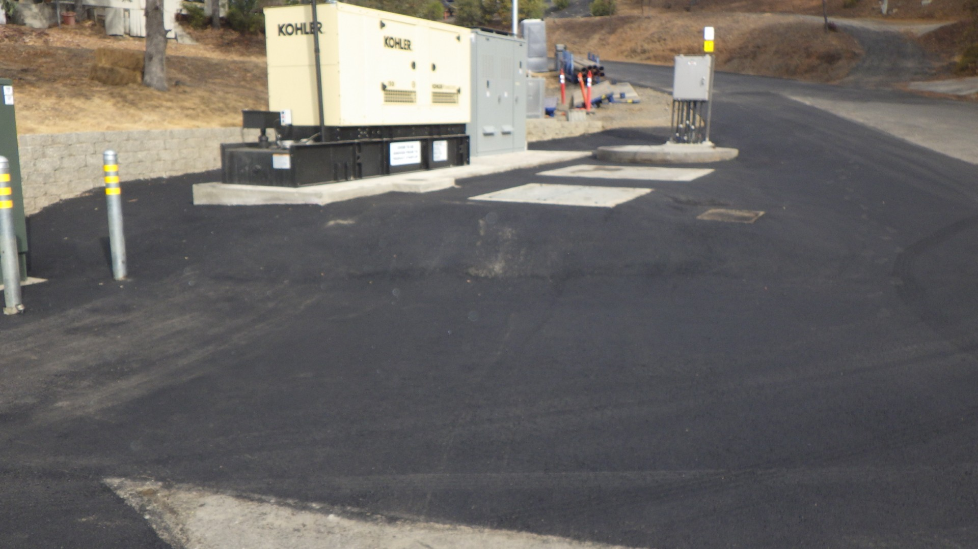
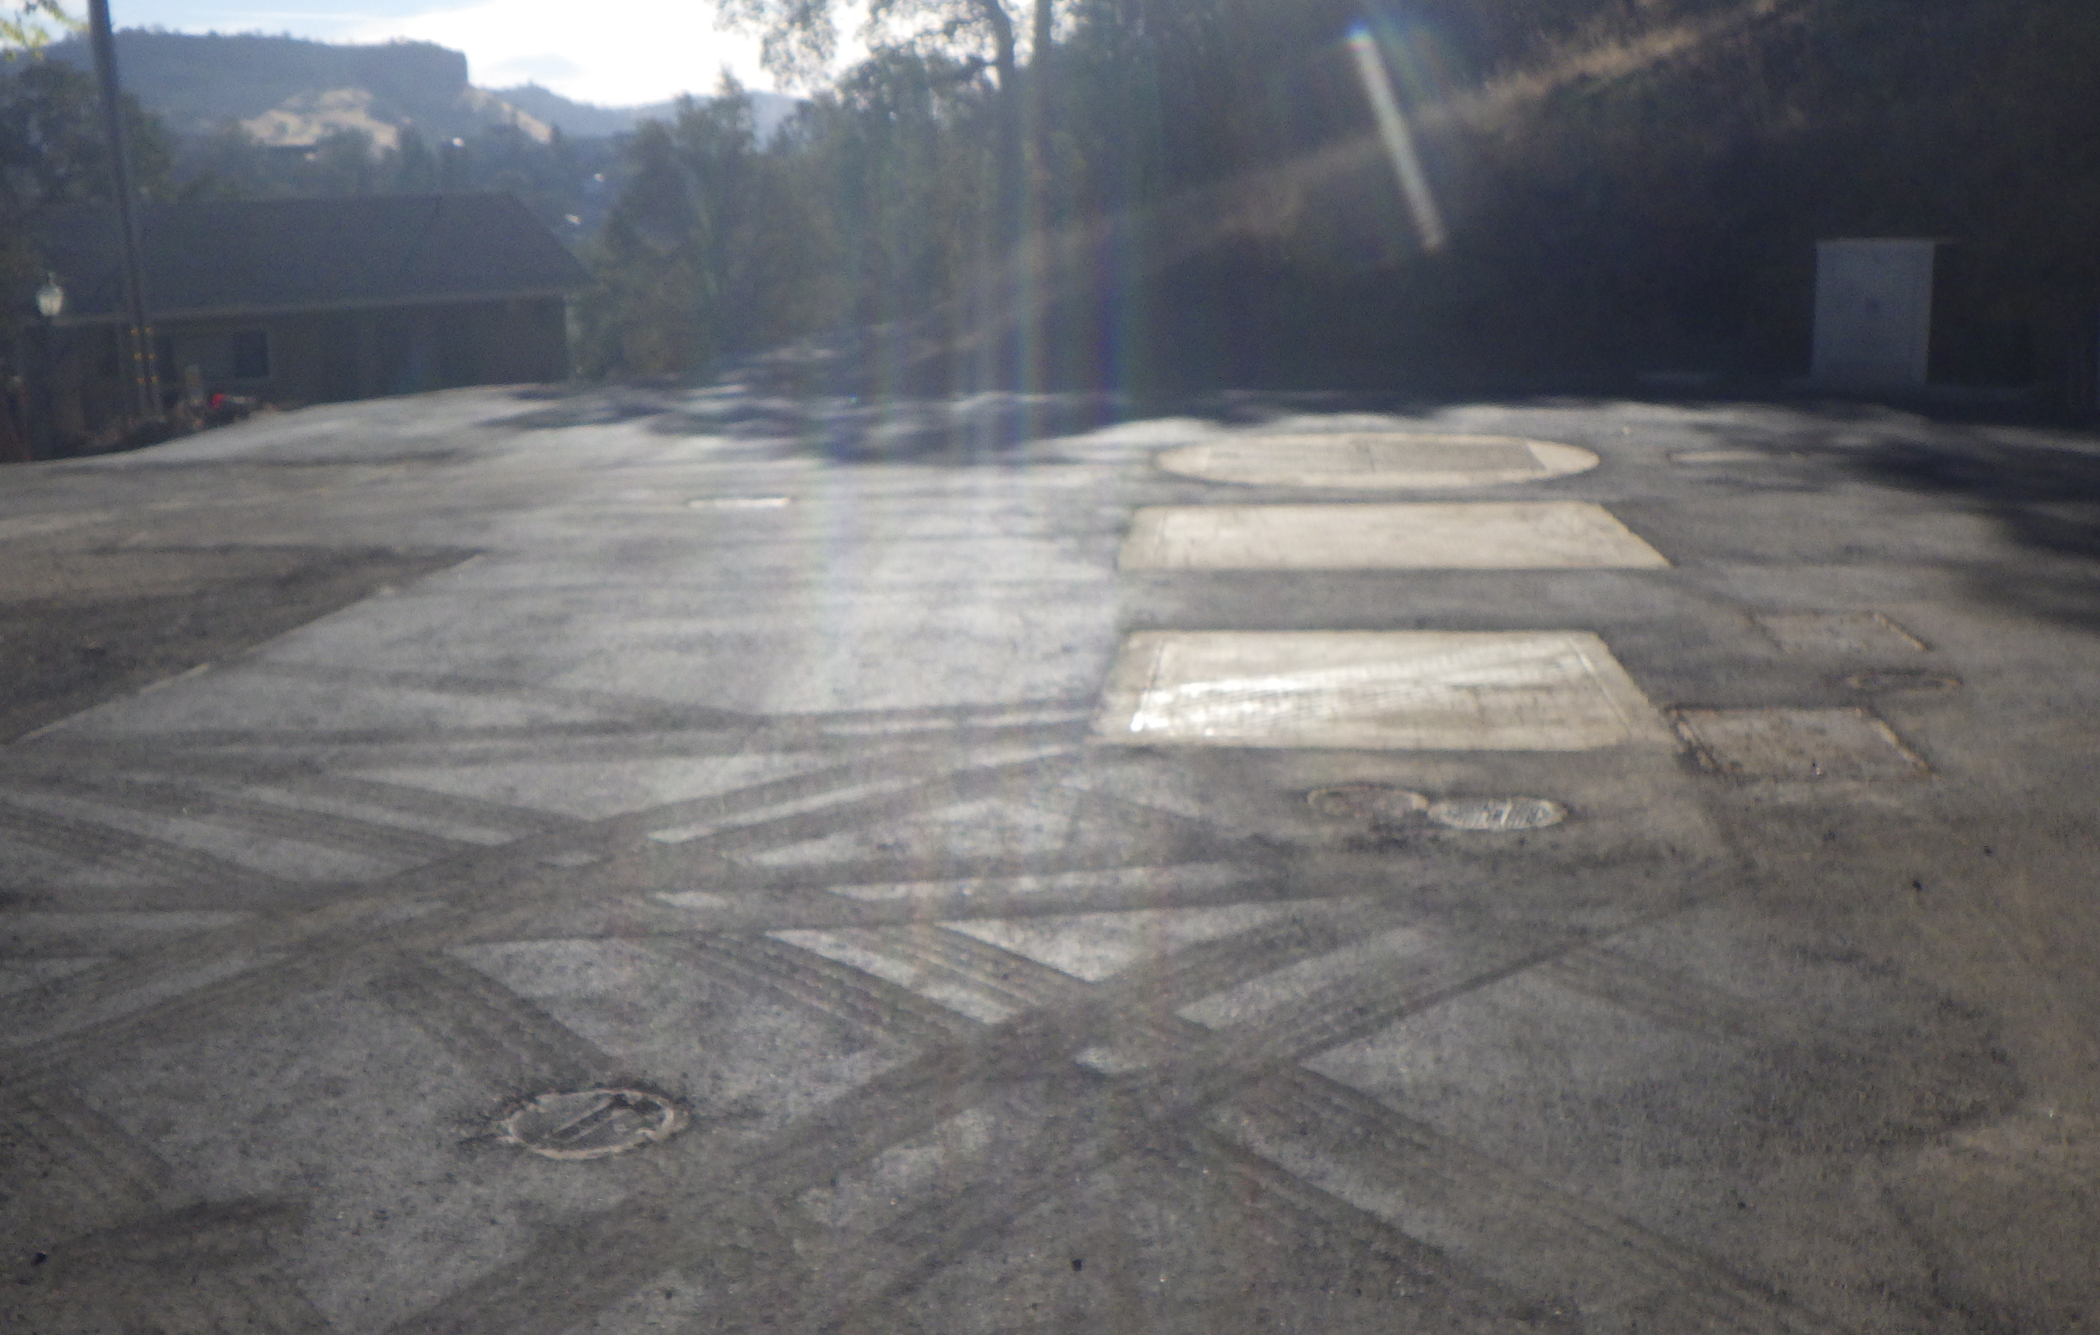
Lift Stations 6
Copper Cove Lift Stations 6, 8, 15 & 16 and Lift Stations 12 & 13 Force Main Bypass Project
Lift Stations 15

Slide 4
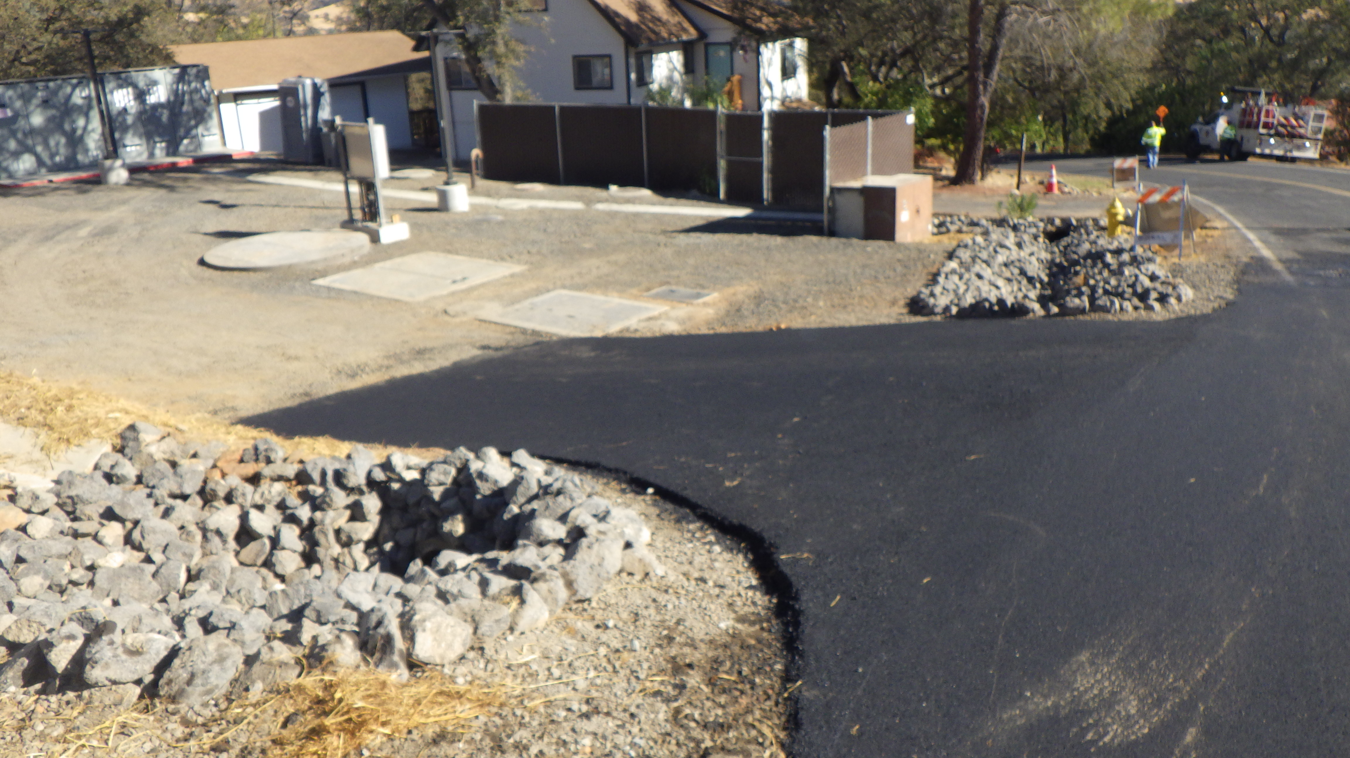
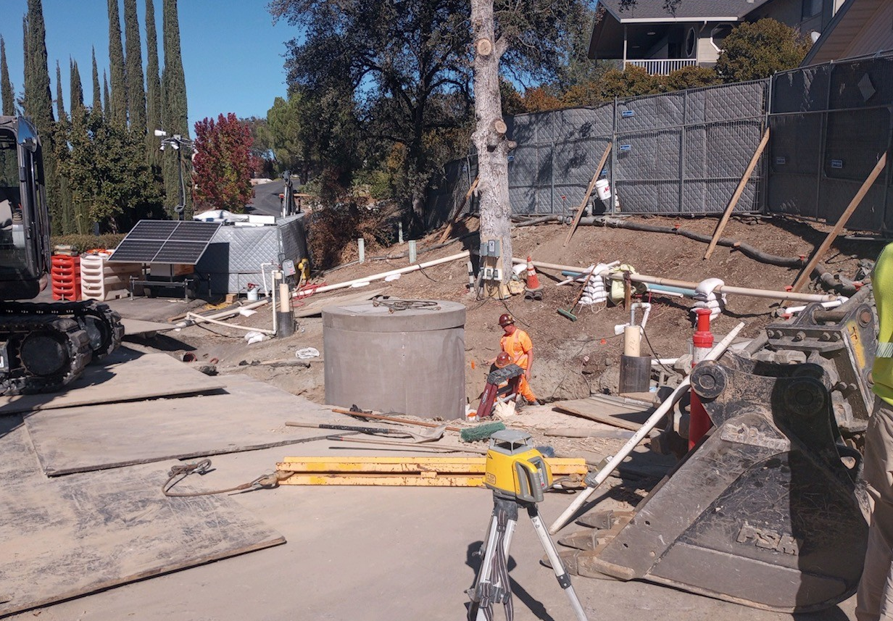
Lift Stations 8
Copper Cove Lift Stations 6, 8, 15 & 16 and Lift Stations 12 & 13 Force Main Bypass Project: Cont.
Lift Stations 18

Slide 5
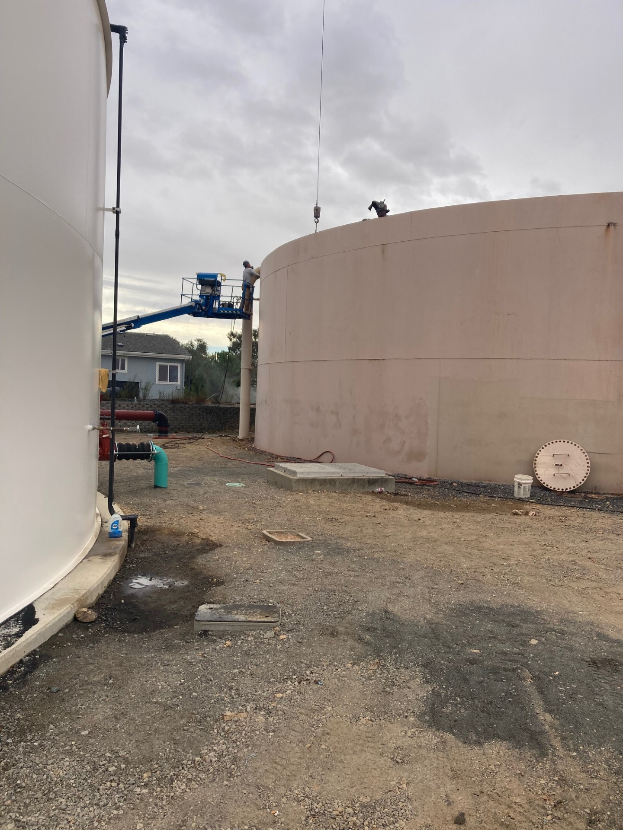
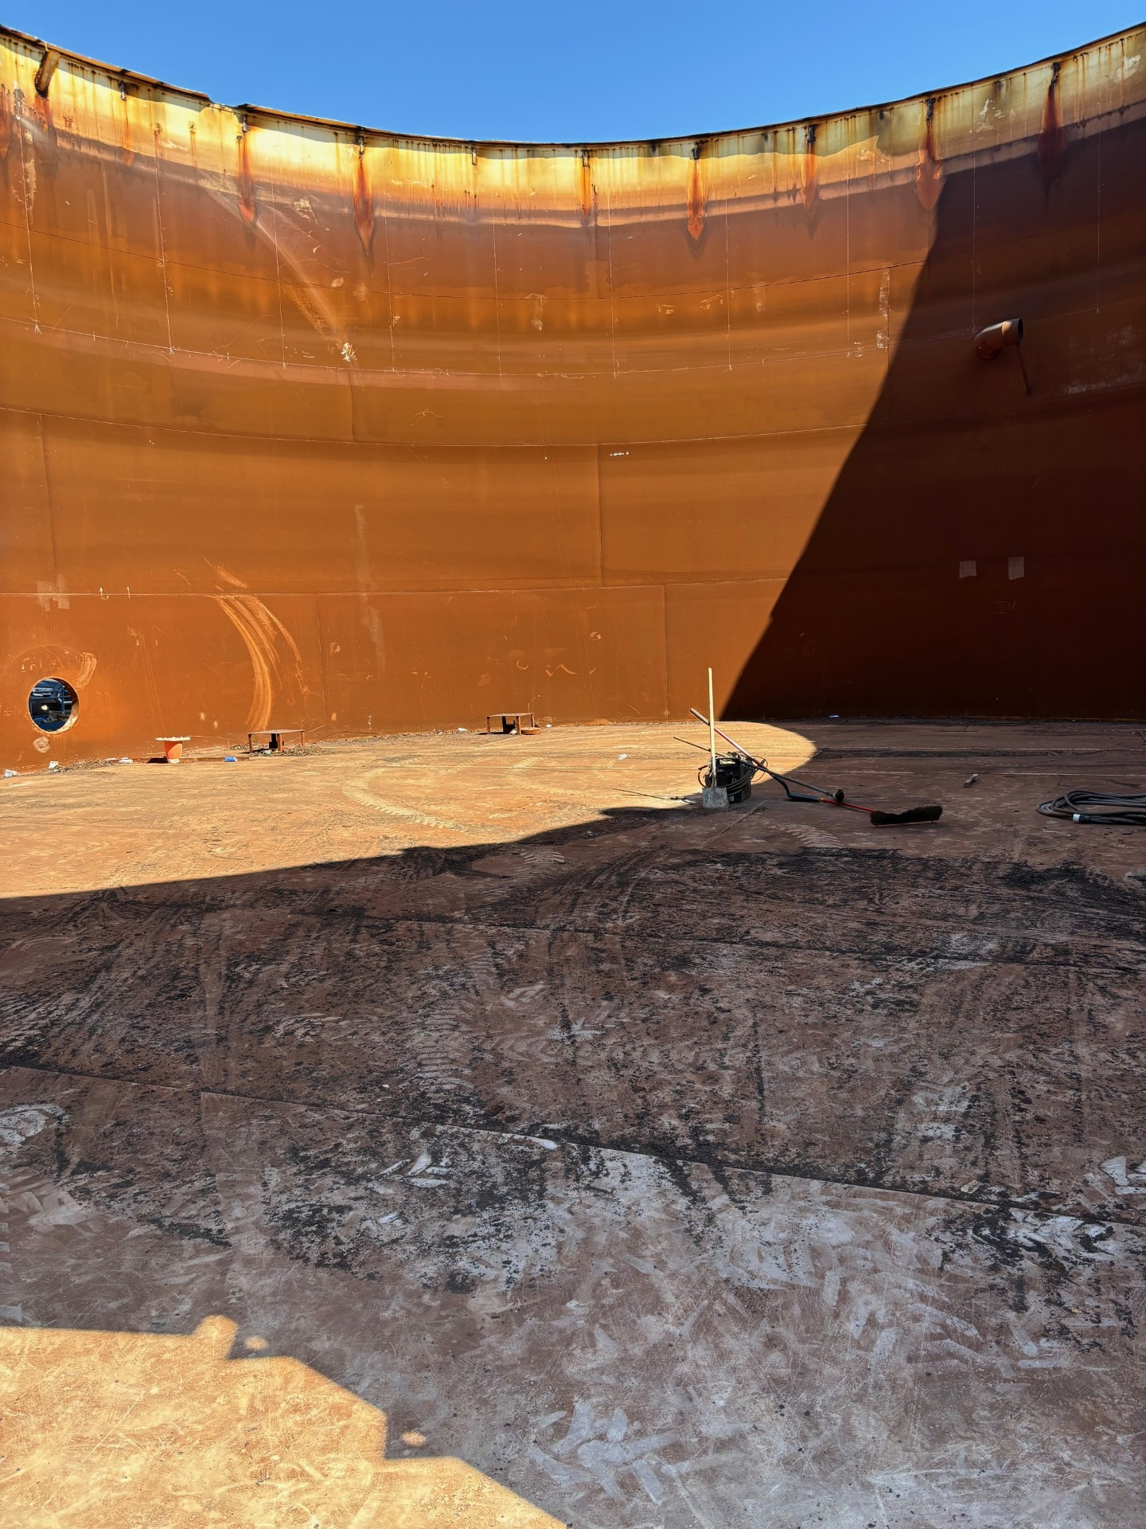
Copper Cove Water System Improvements Project
Tank B

Slide 6
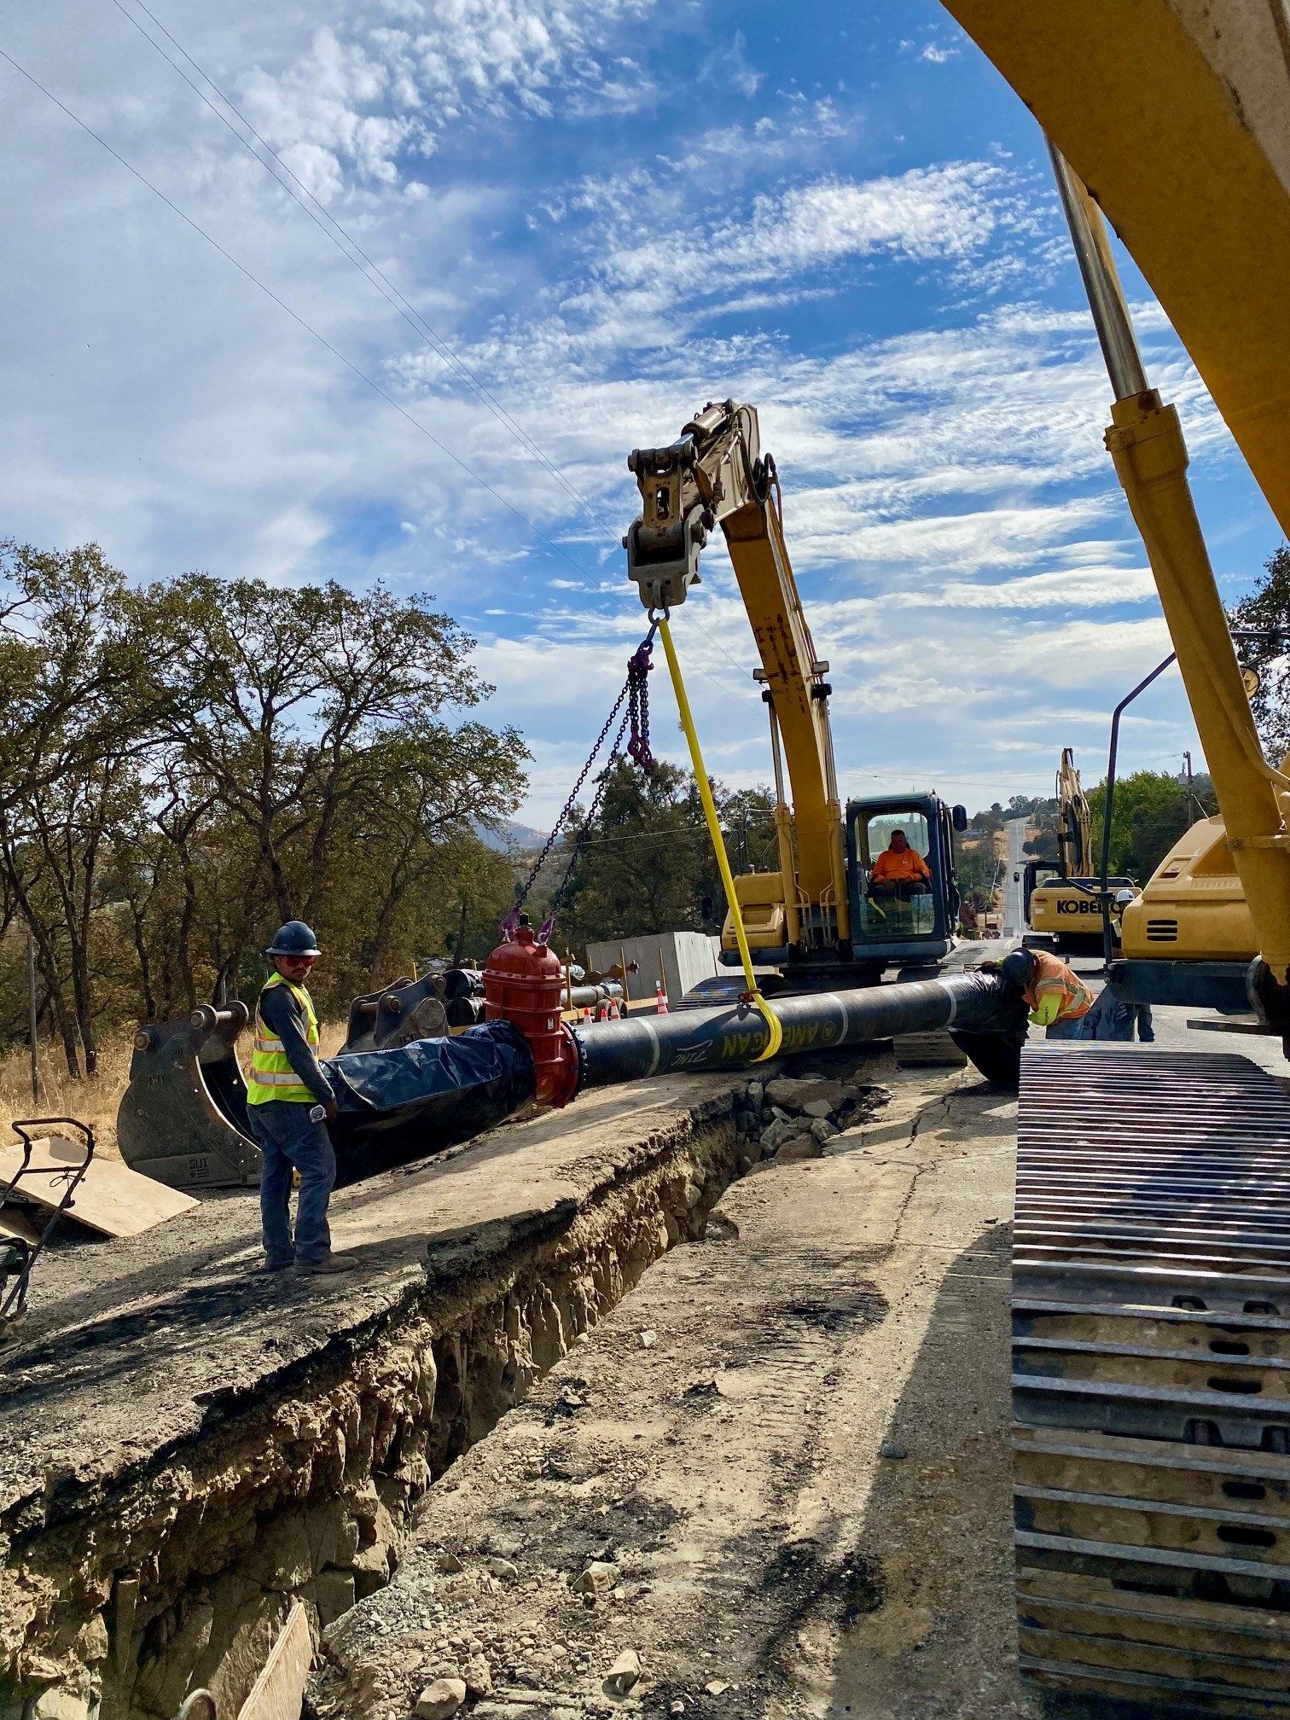
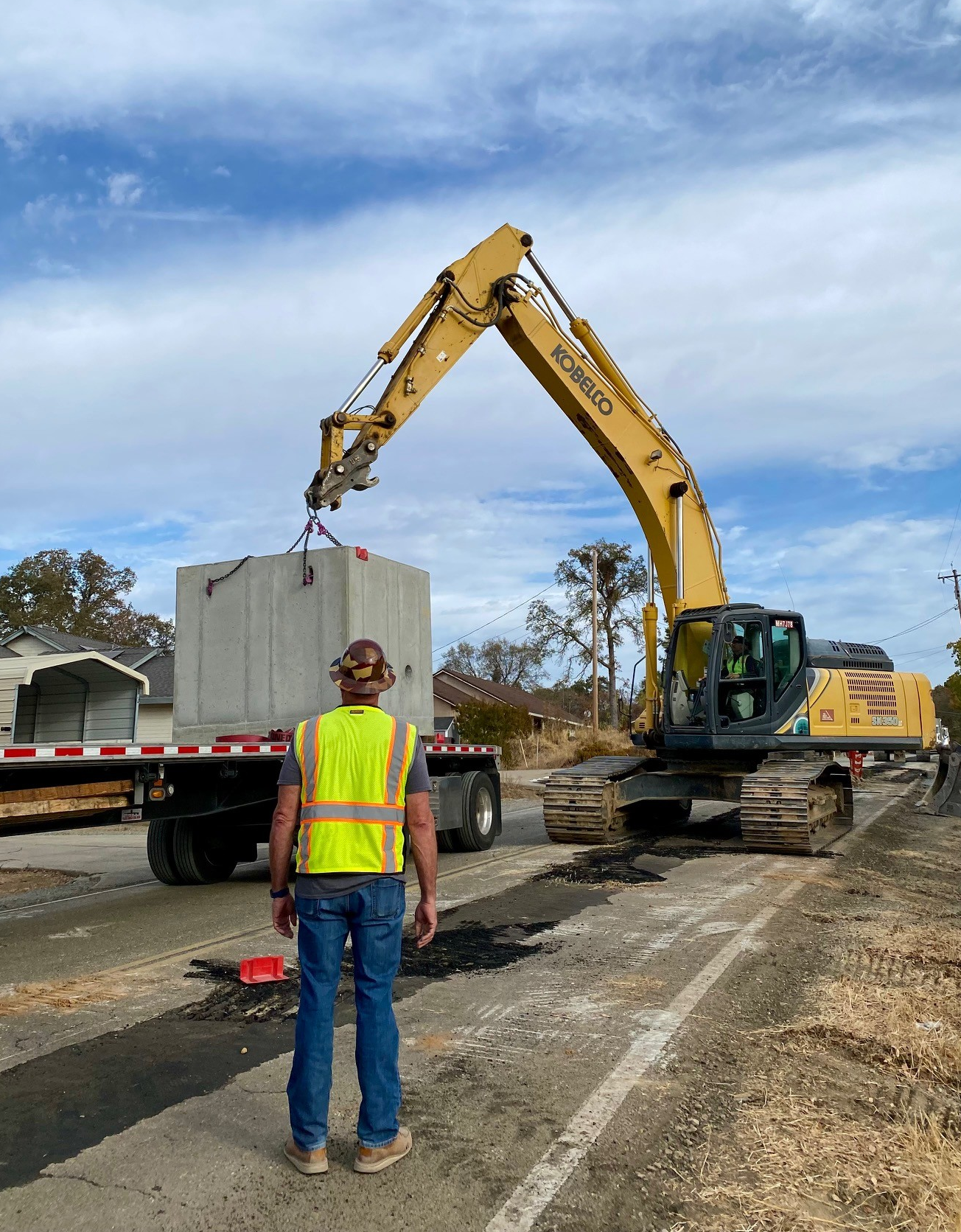
Jenny Lind Water System A-B Water Transmission Pipeline

Slide 7
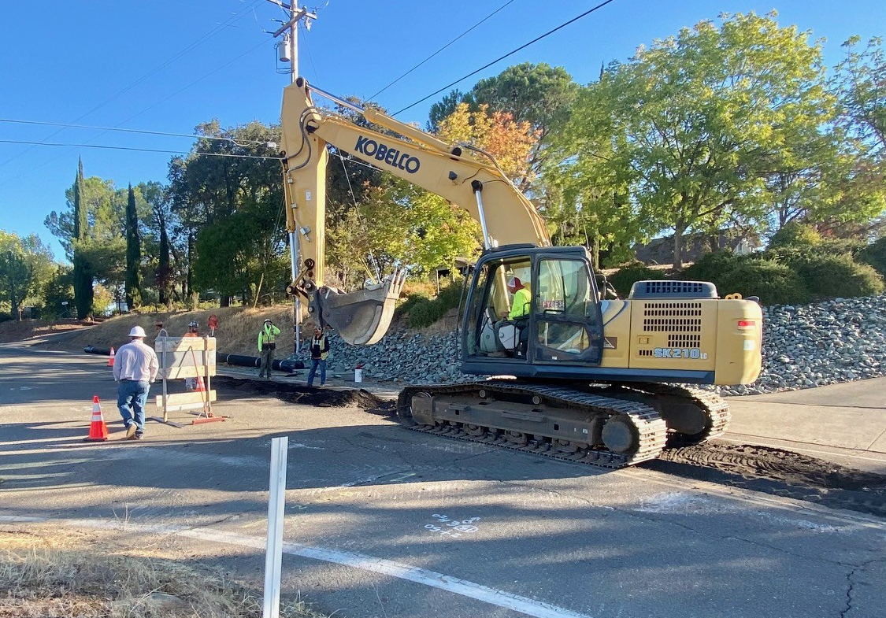
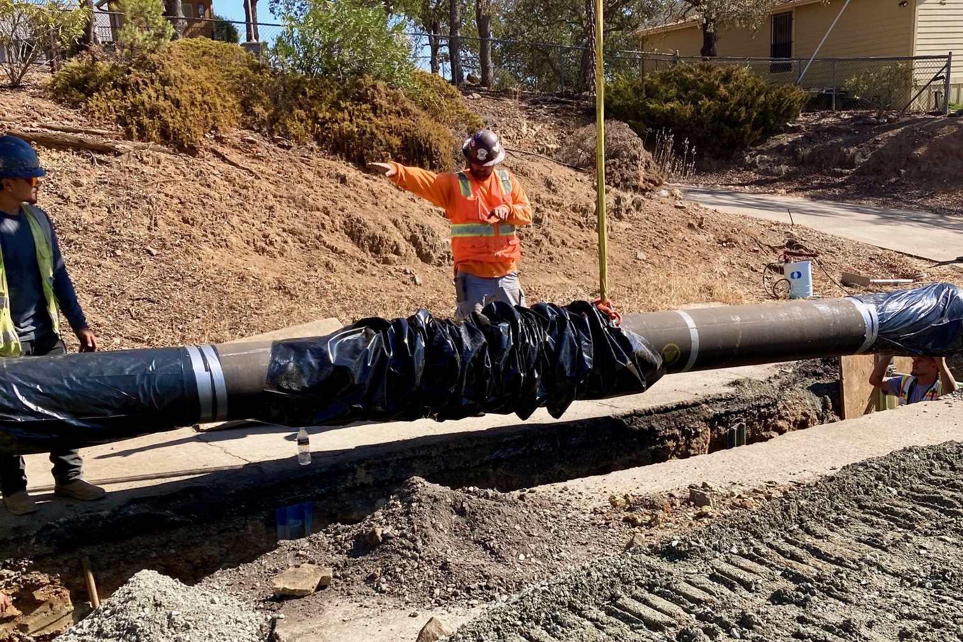
Jenny Lind Water System A-B Water Transmission Pipeline: Cont.

Slide 8
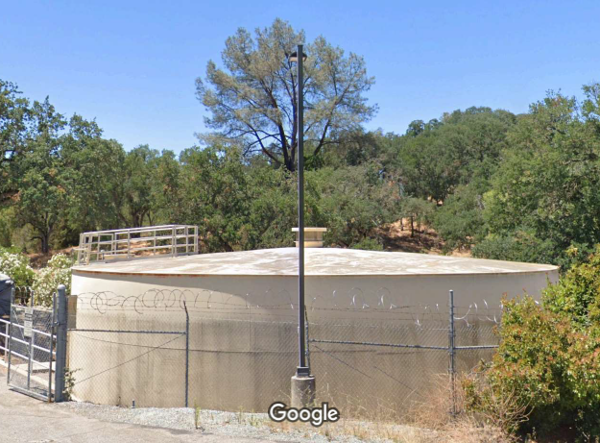
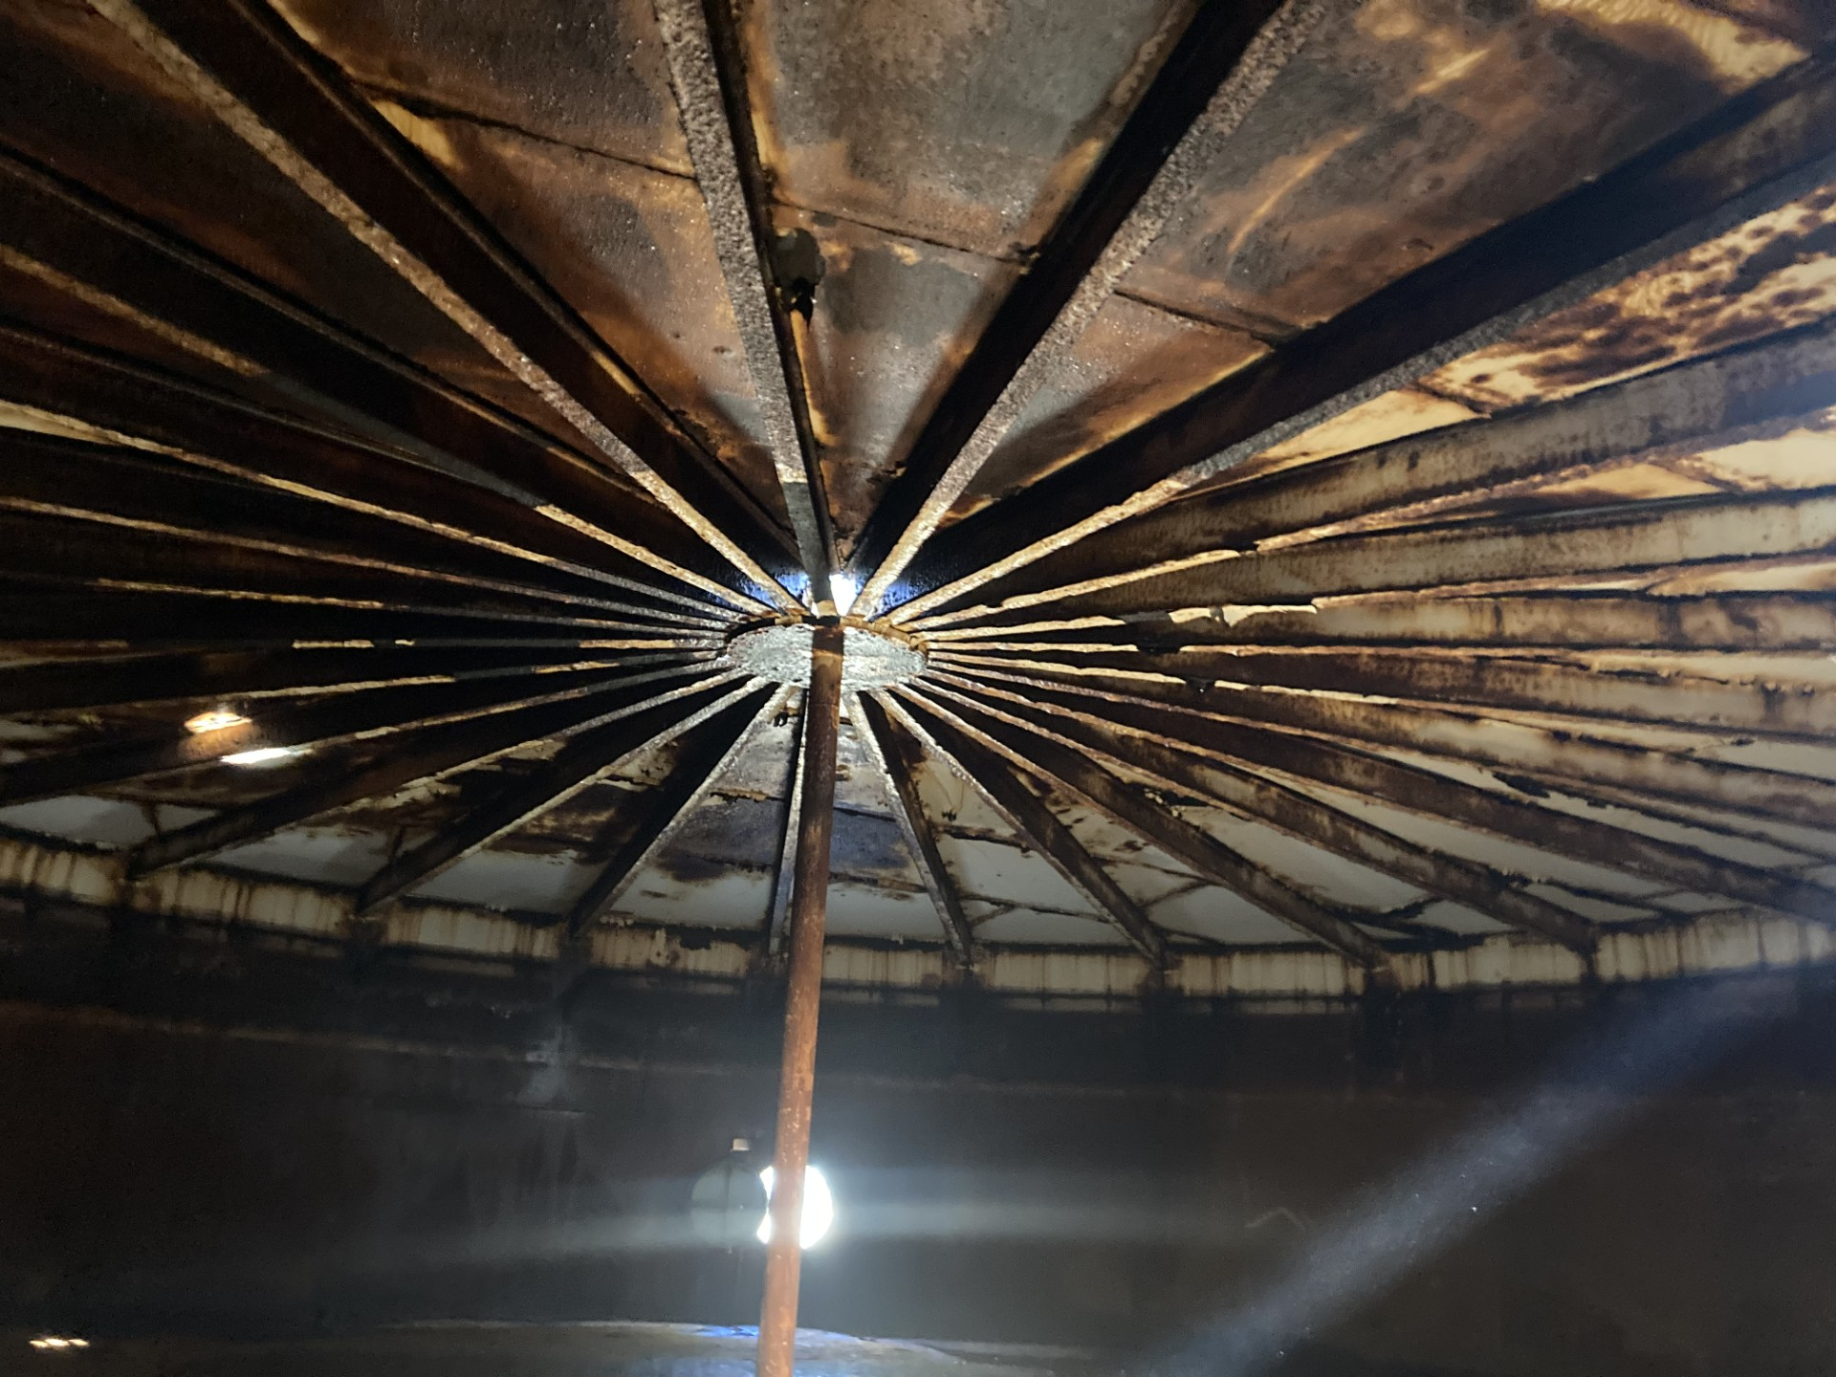
Jenny Lind Clearwell #2 Rehabilitation

Slide 9
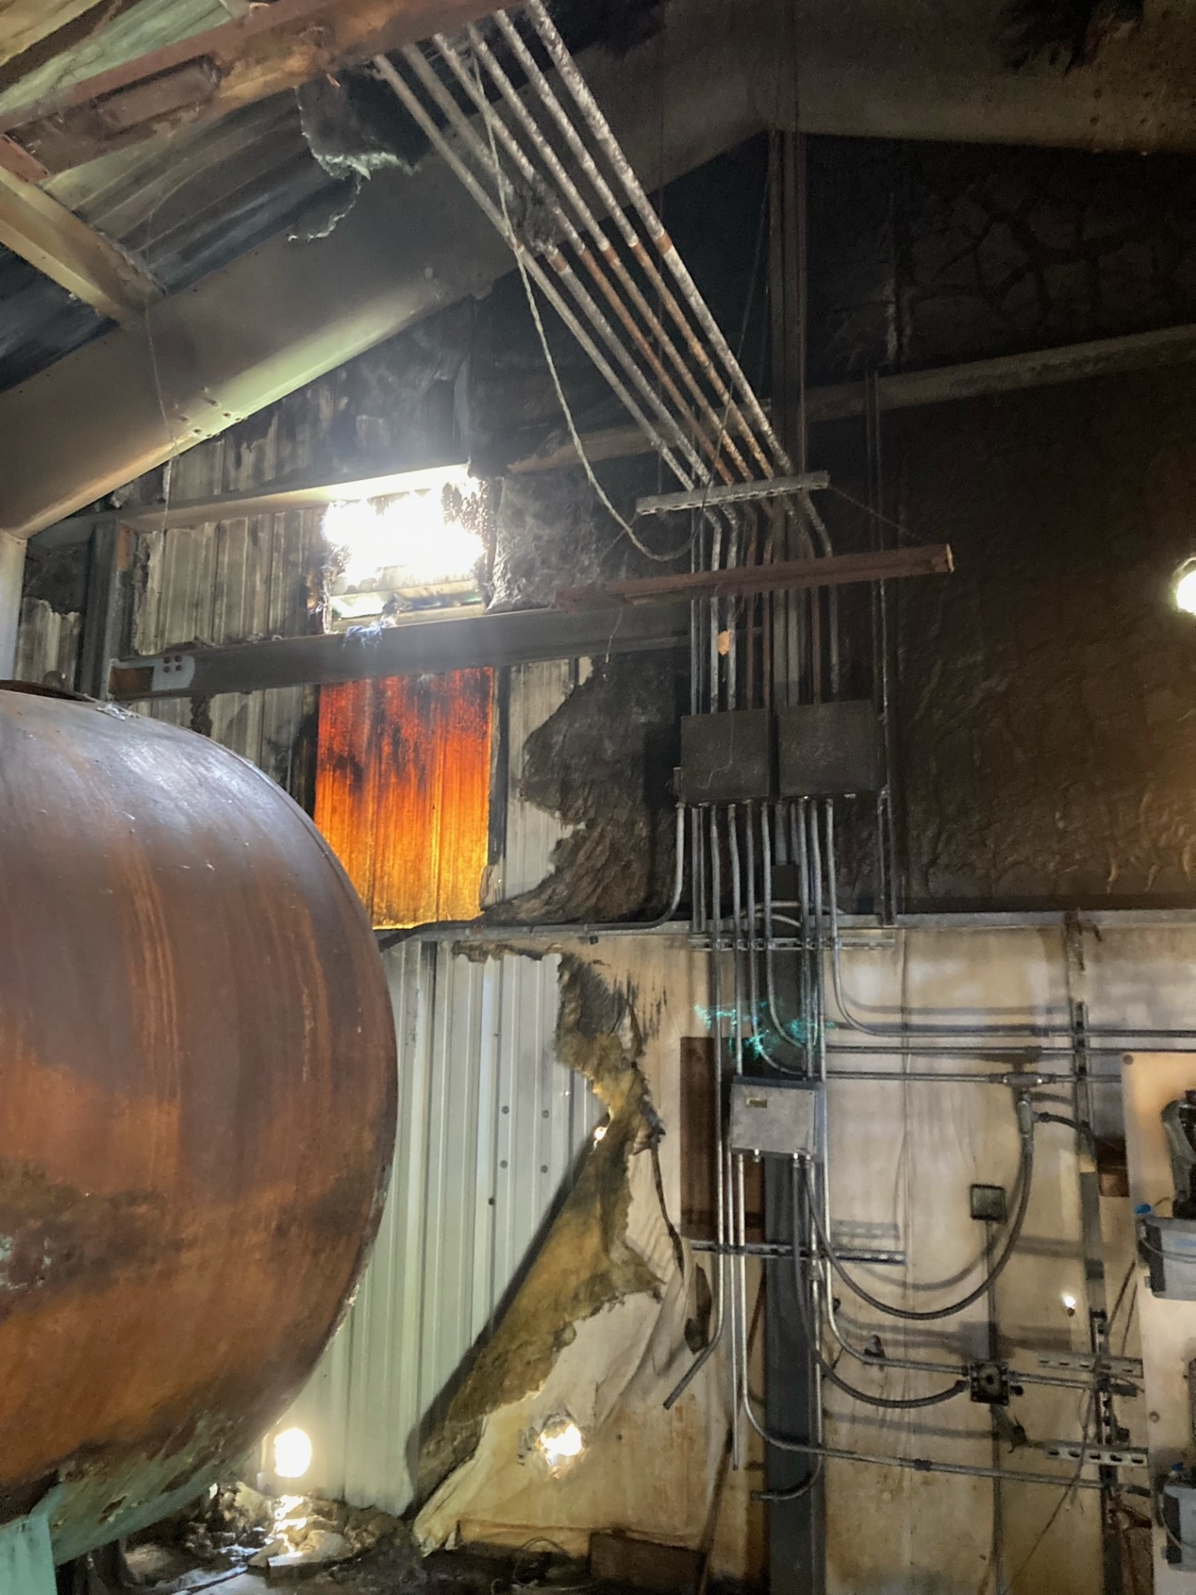
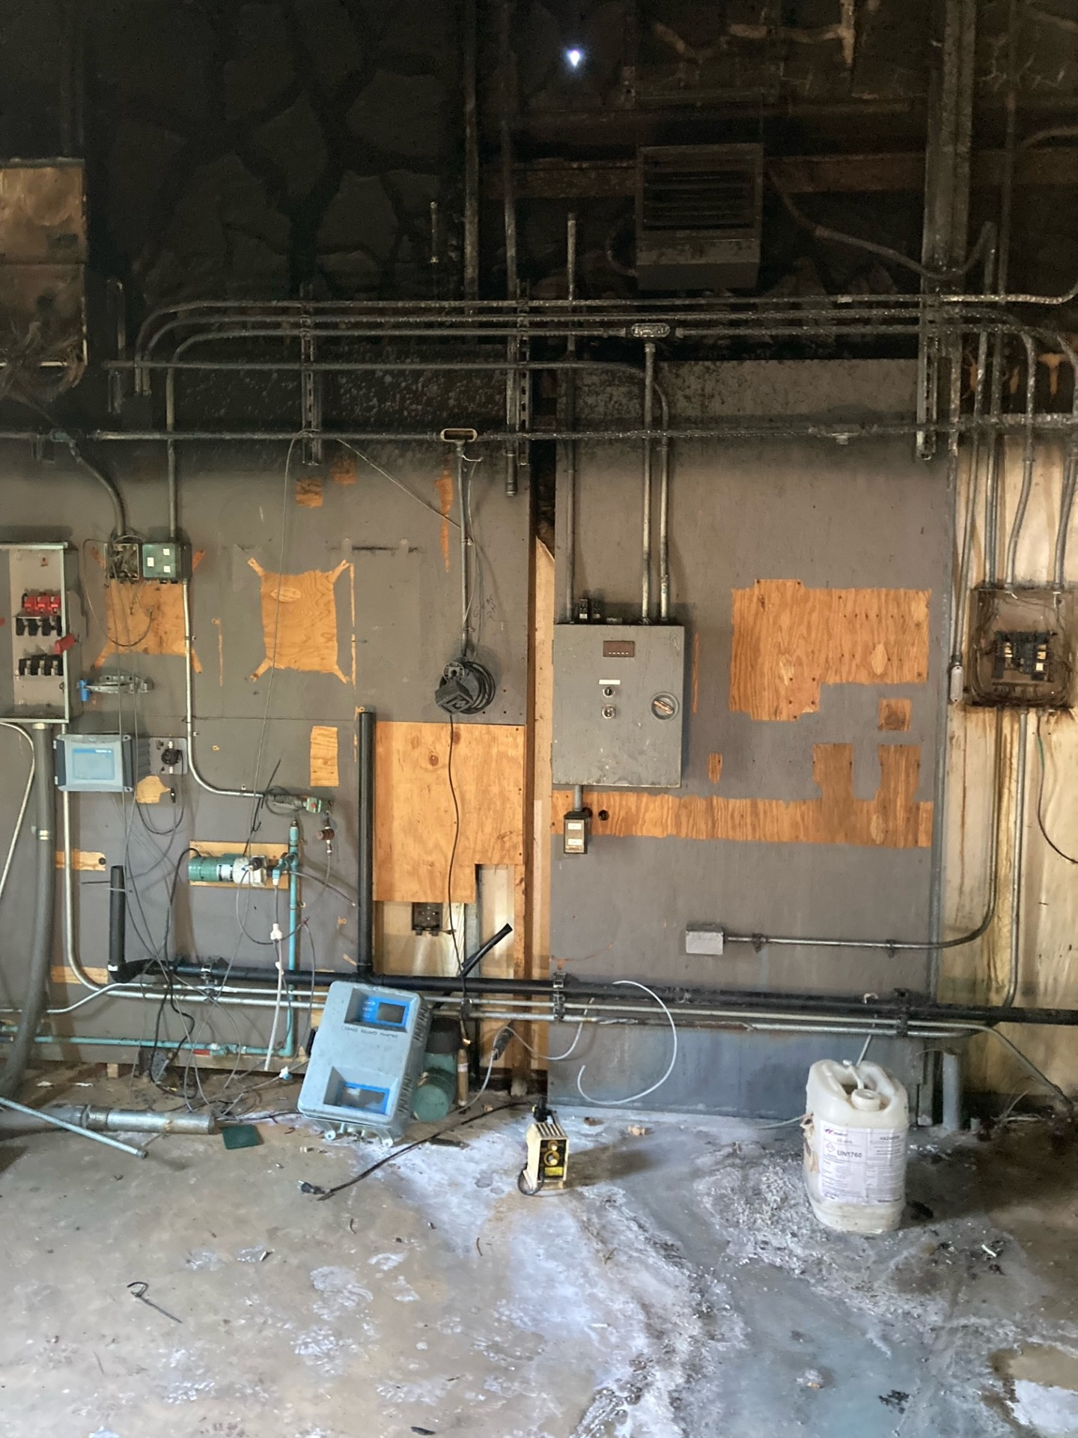
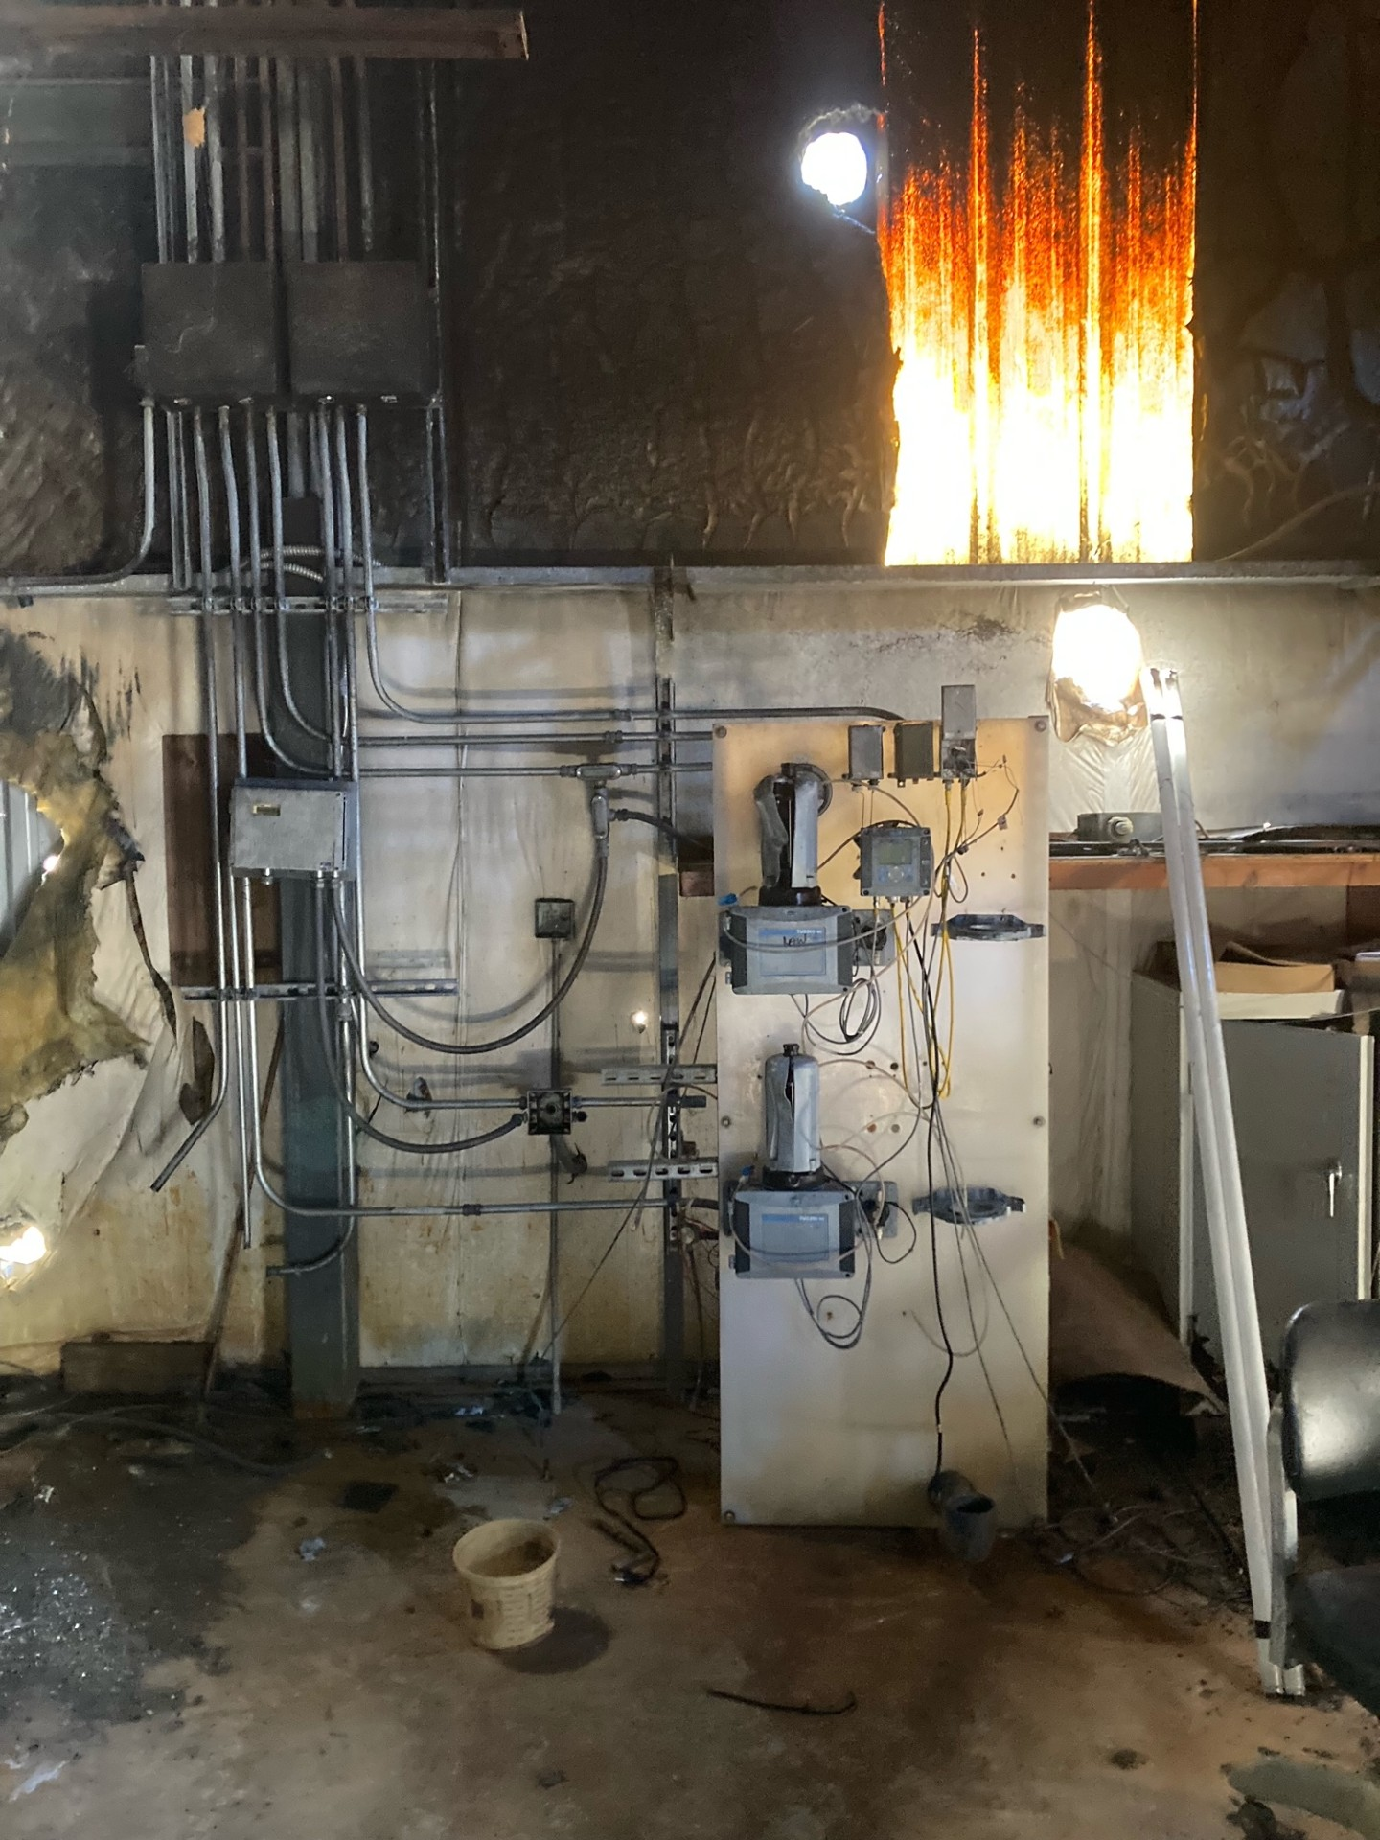
West Point Water Supply Reliability Improvements

Slide 10
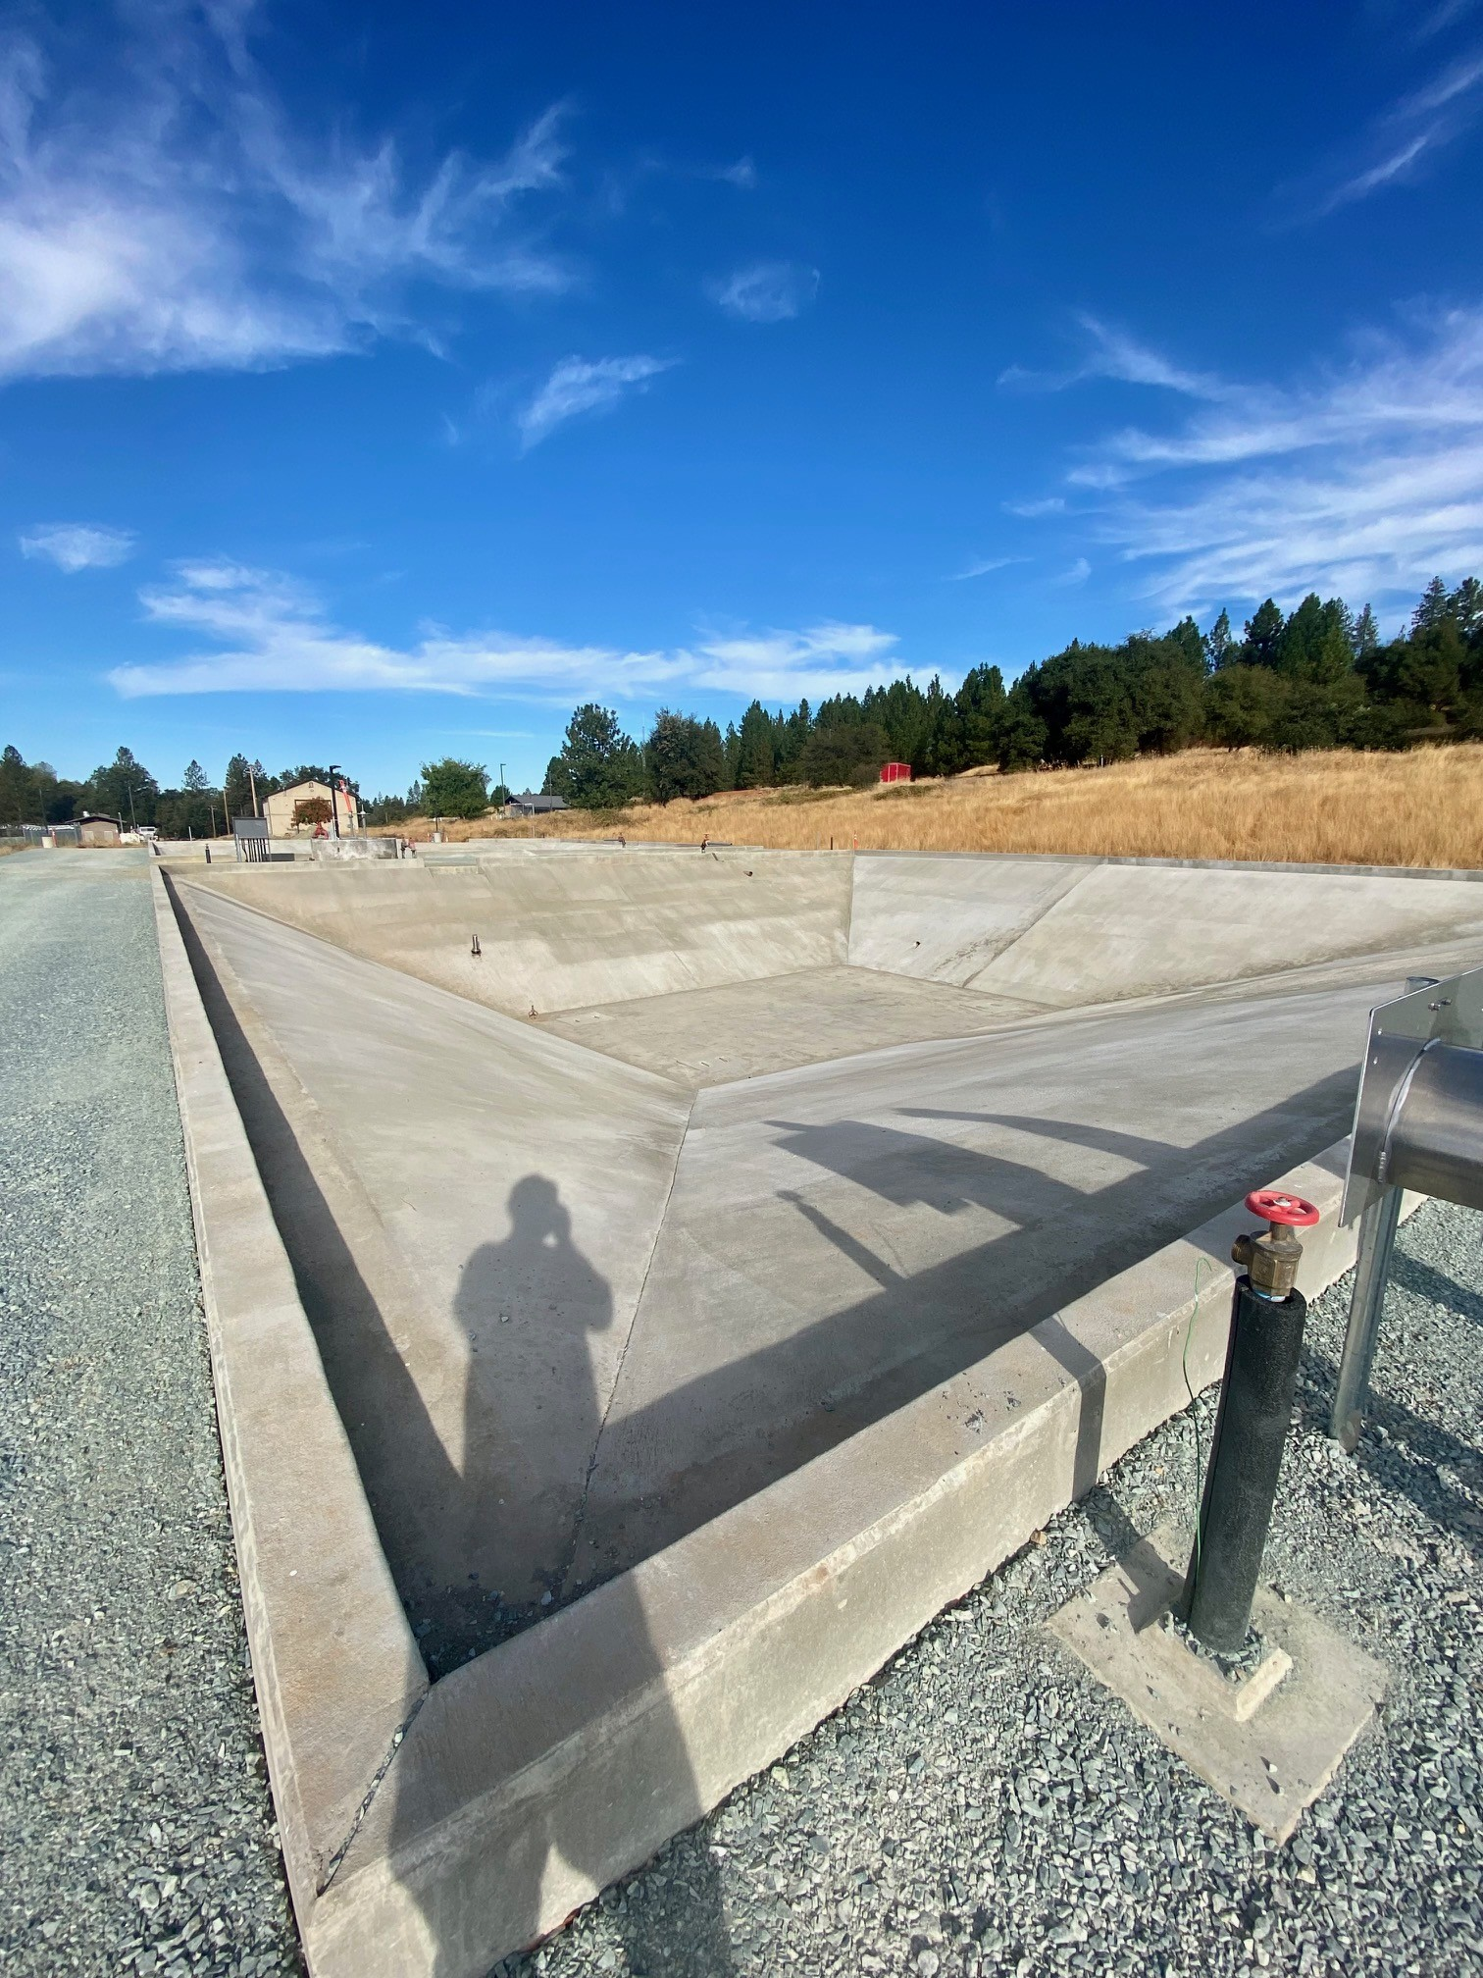
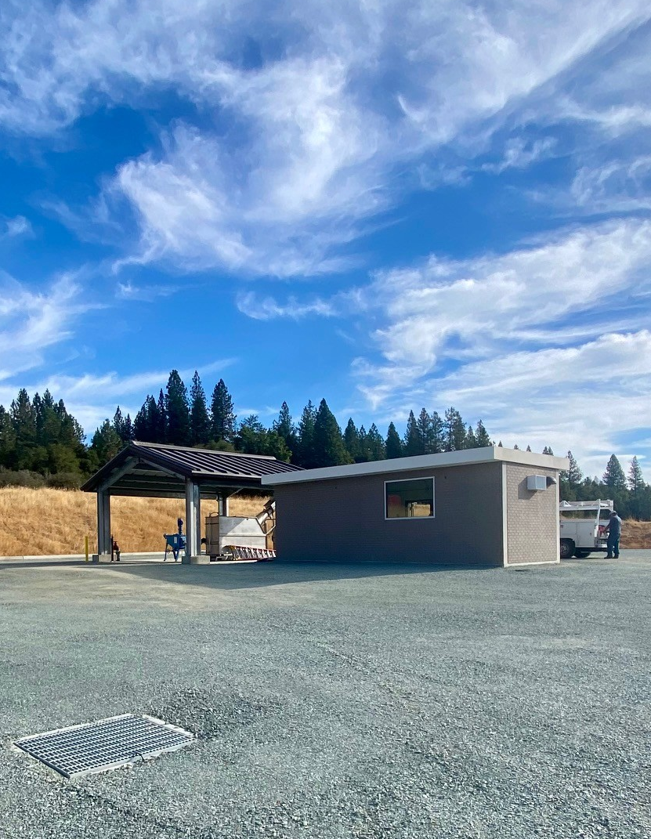
West Point and Wilseyville Wastewater Consolidation Project

Slide 11
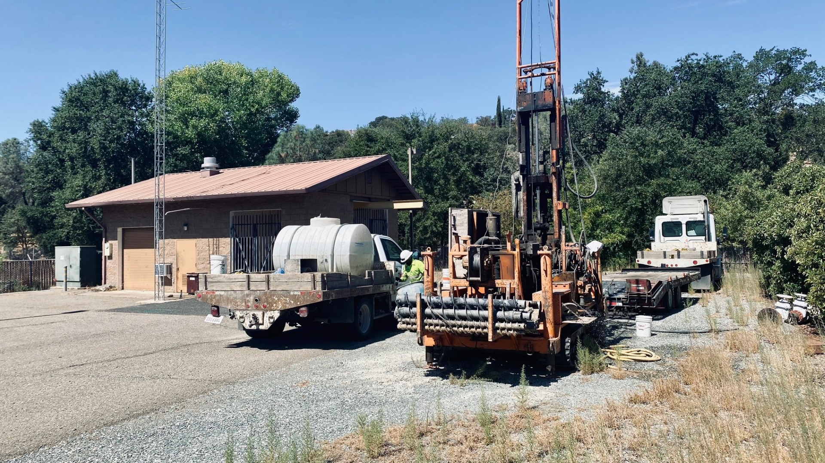
DESIGN PHASE
Ebbetts Pass Hunters Raw Water Intake Pumps
Arnold Wastewater Secondary Clarifier Improvements Project
Sawmill Tank Management Program
Wallace Tank Replacement
Copper Cove Wastewater Treatment Plant Tertiary Treatment Improvements and Facilities Plan (USACE Section 219 Project – Increment No. 1).
Copper Cove C Transmission Line & Pump Station

Slide 12
DESIGN PHASE
Cont.
Lake Tulloch Intertie Project
La Contenta Biolac and Clarifier
Huckleberry Lift Station
West Point Water Supply Drought Project

Slide 13
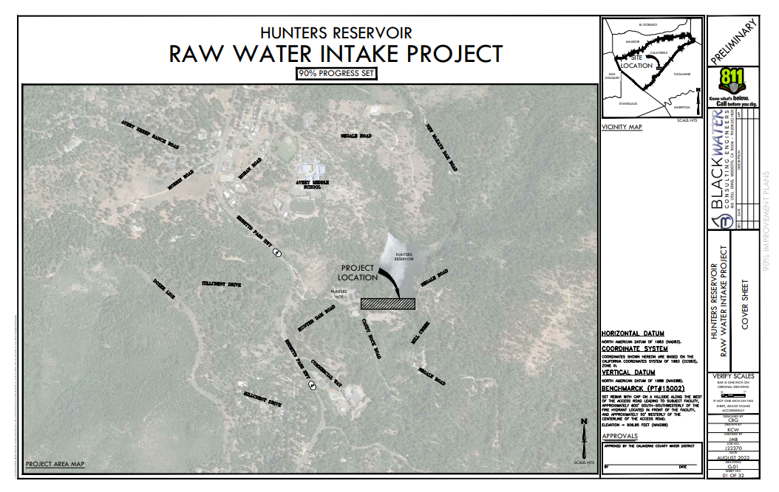
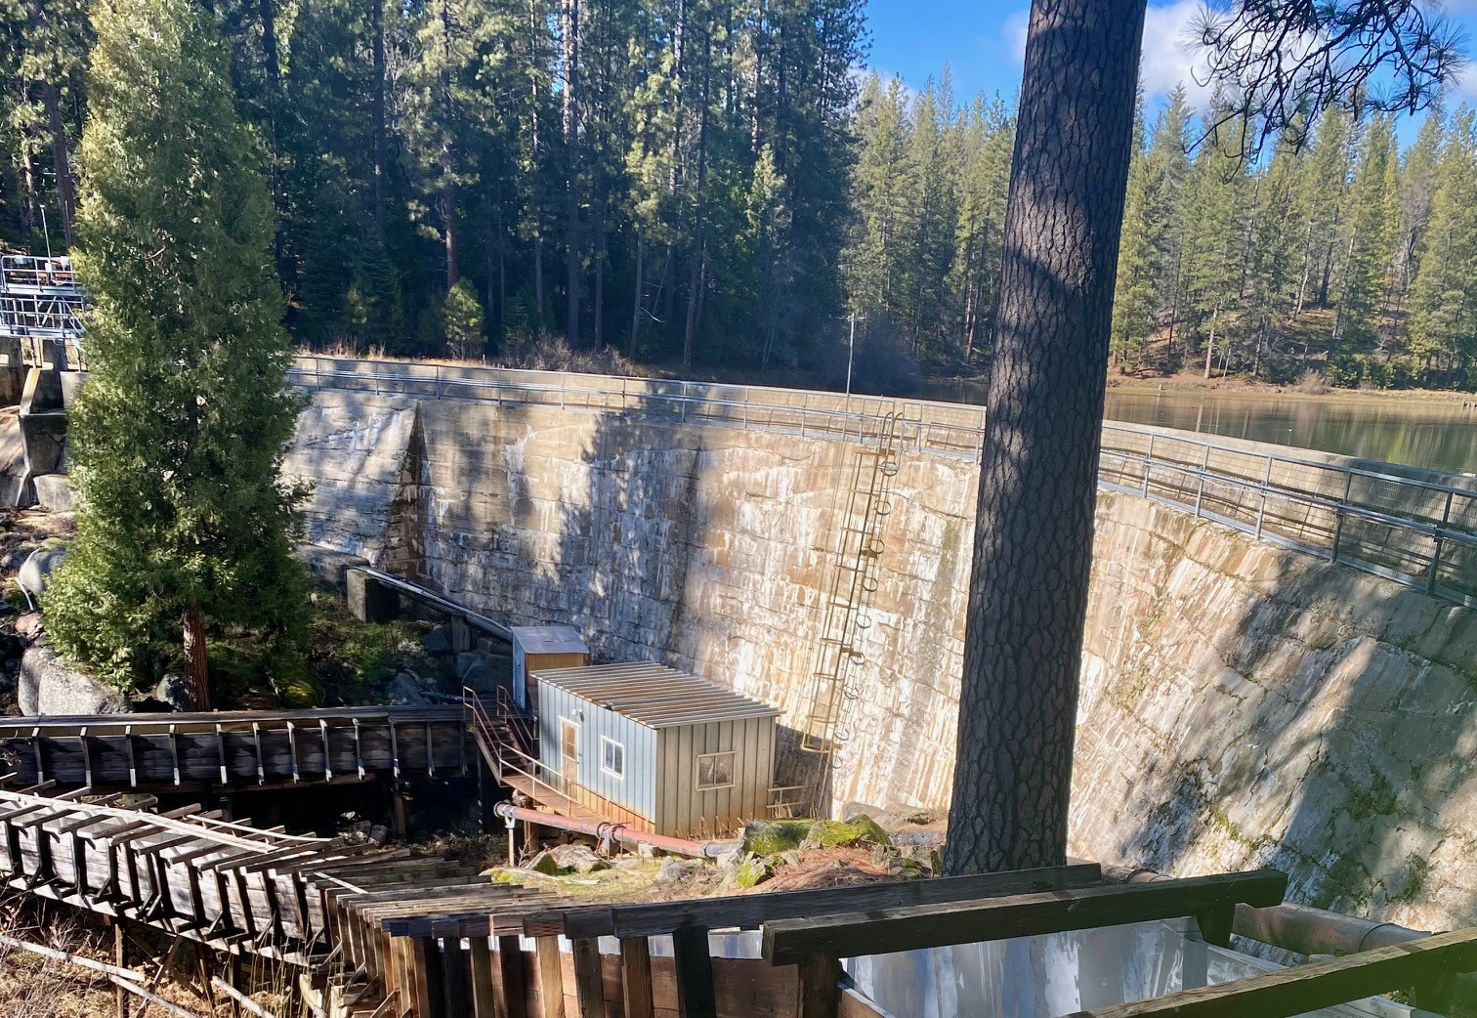
Ebbetts Pass Hunters Raw Water Intake Pumps

Slide 14
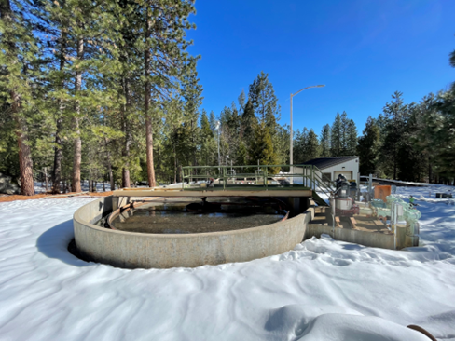
Arnold Wastewater Secondary Clarifier Improvements Project

Slide 15
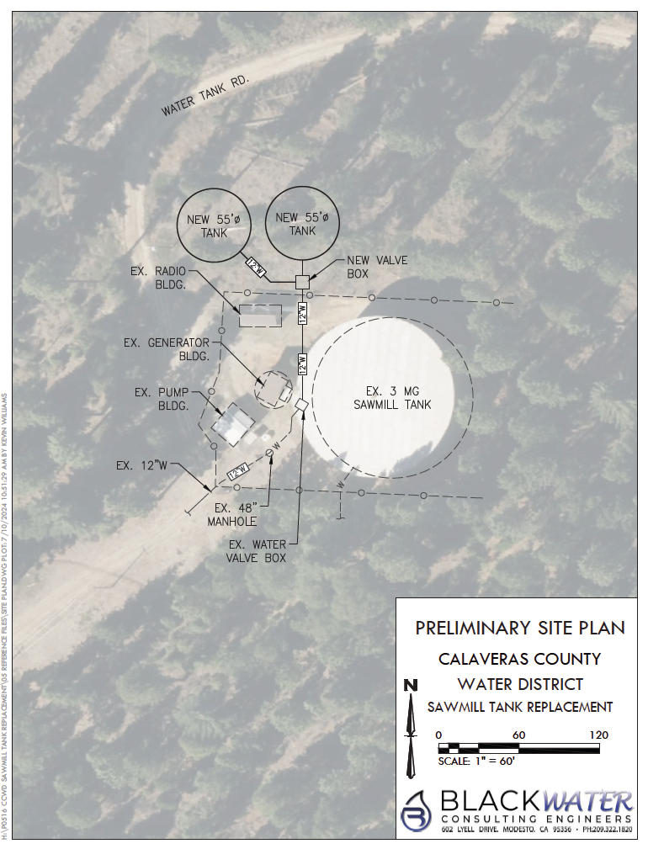
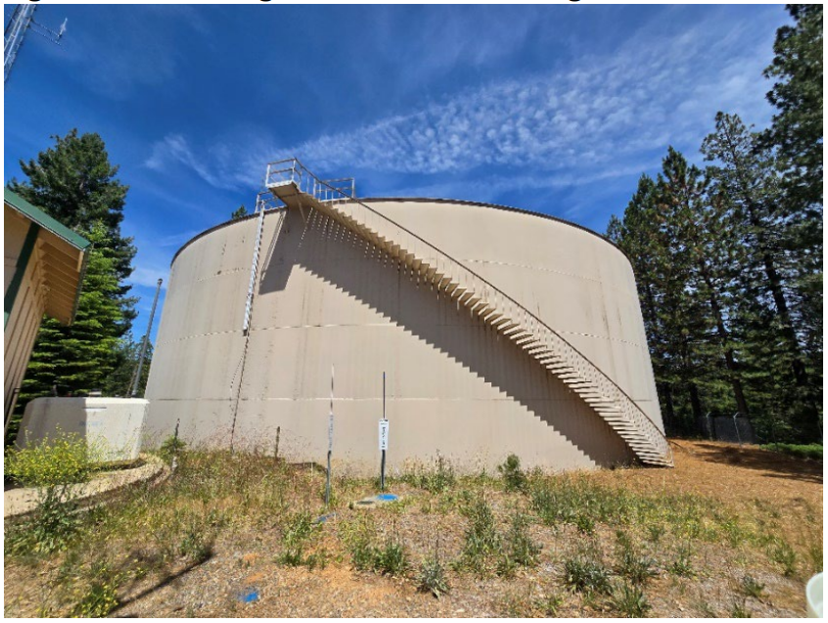
Sawmill Tank Management Program

Slide 16
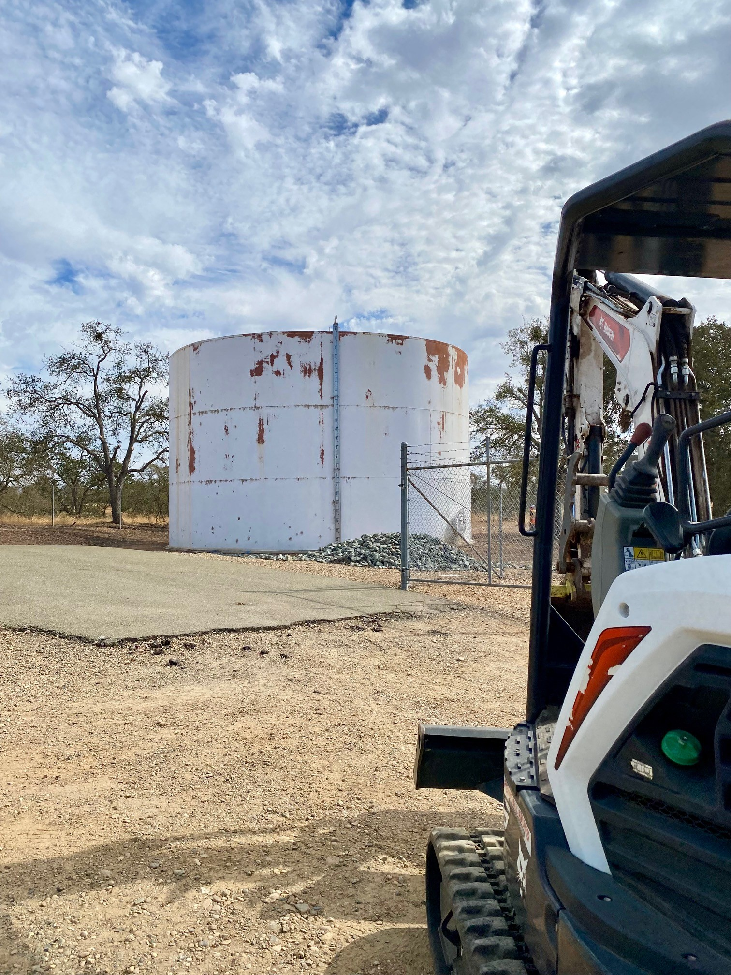
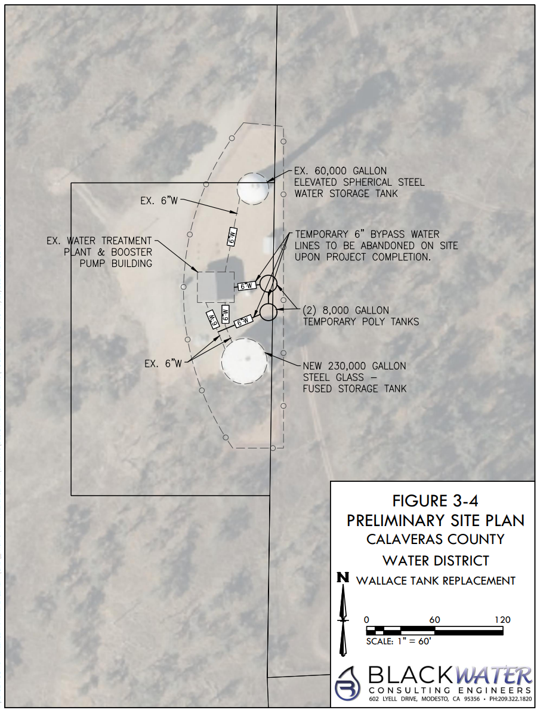
Wallace Tank Replacement

Slide 17
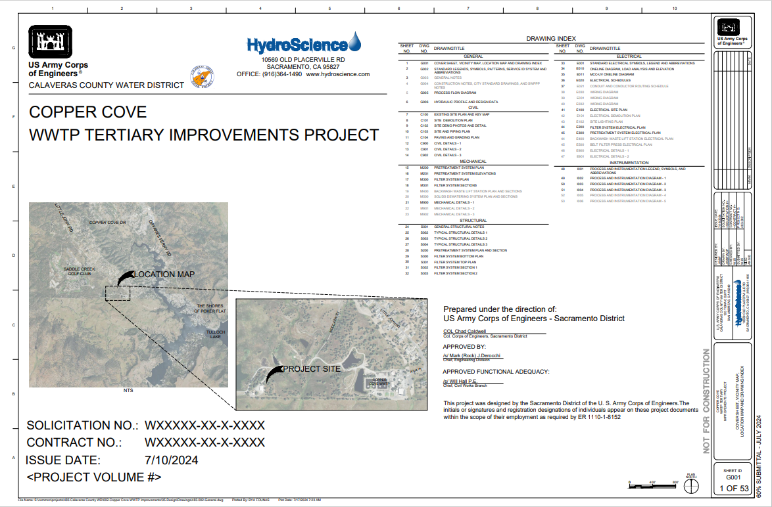
Copper Cove Wastewater Treatment Plant Tertiary Treatment Improvements and Facilities Plan (USACE Section 219 Project – Increment No. 1)

Slide 18
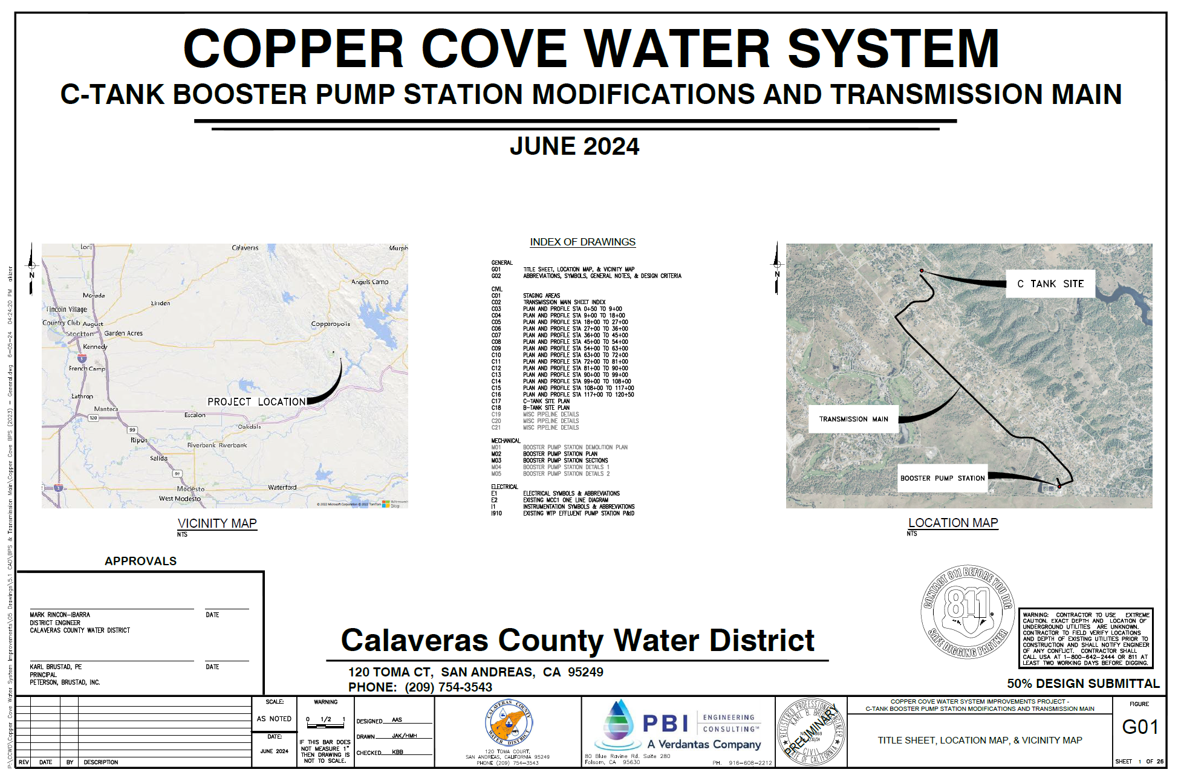
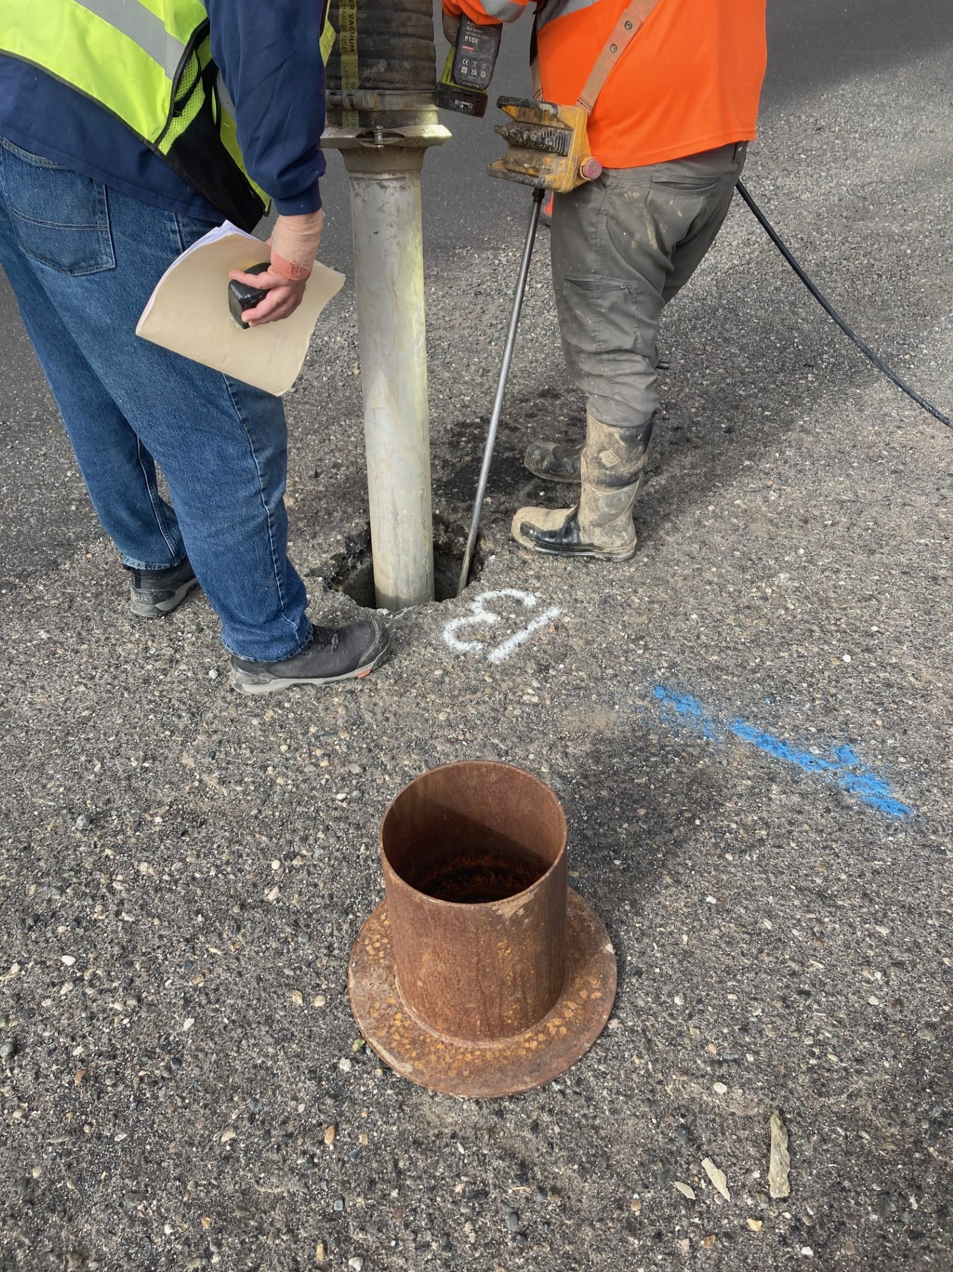
Copper Cove C Transmission Line & Pump Station

Slide 19
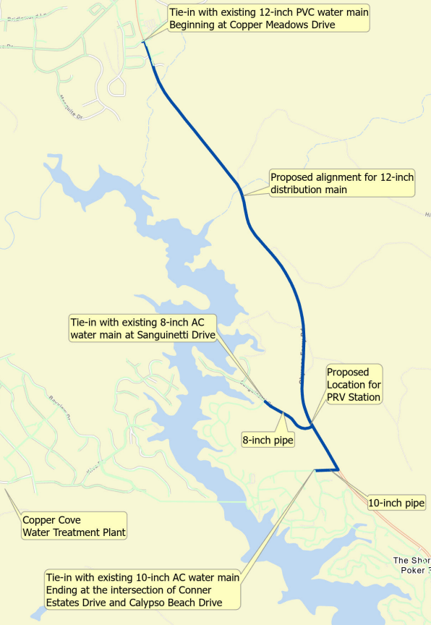
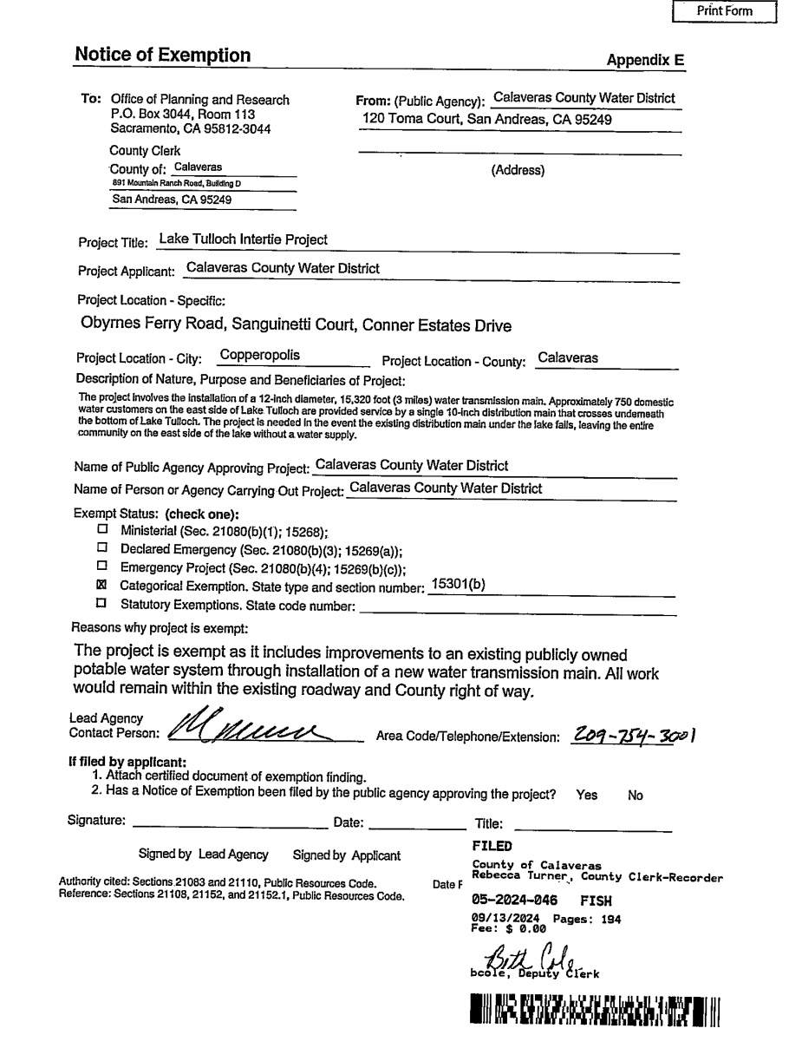
Lake Tulloch Intertie Project

Slide 20
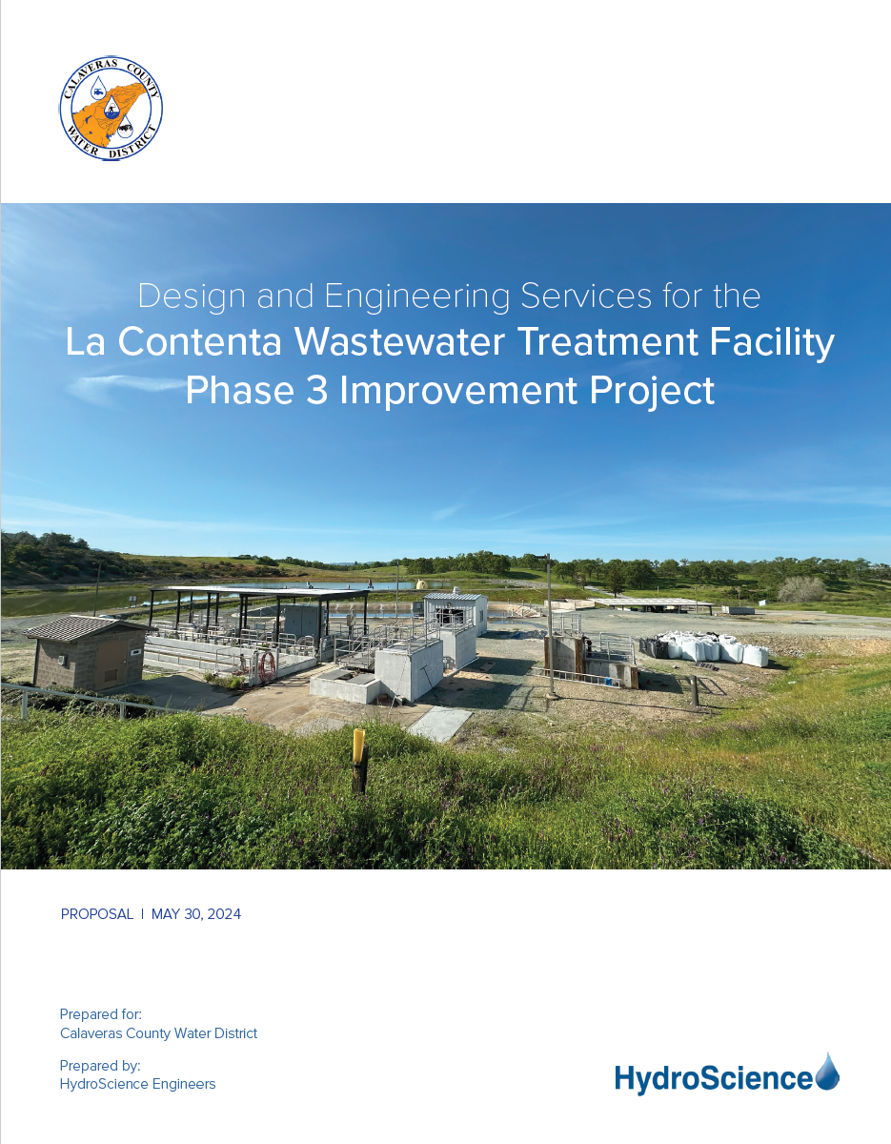
La Contenta Biolac and Clarifier

Slide 21
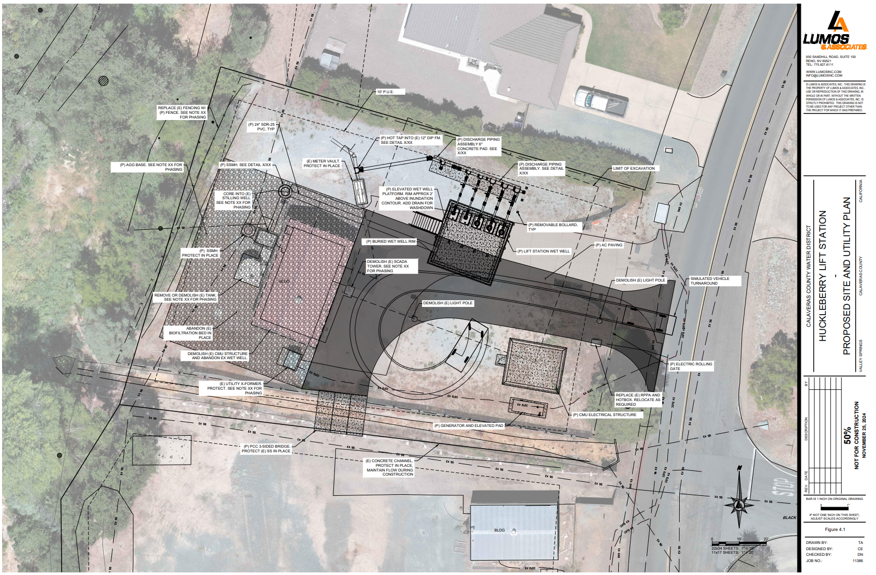
Huckleberry Lift Station

Slide 22
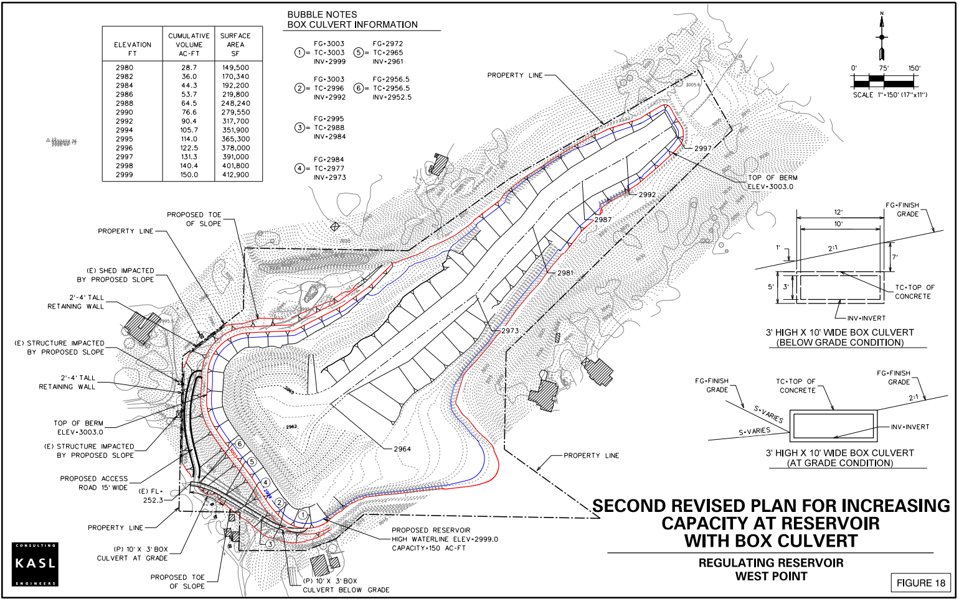


West Point Water Supply Drought Project

Slide 23
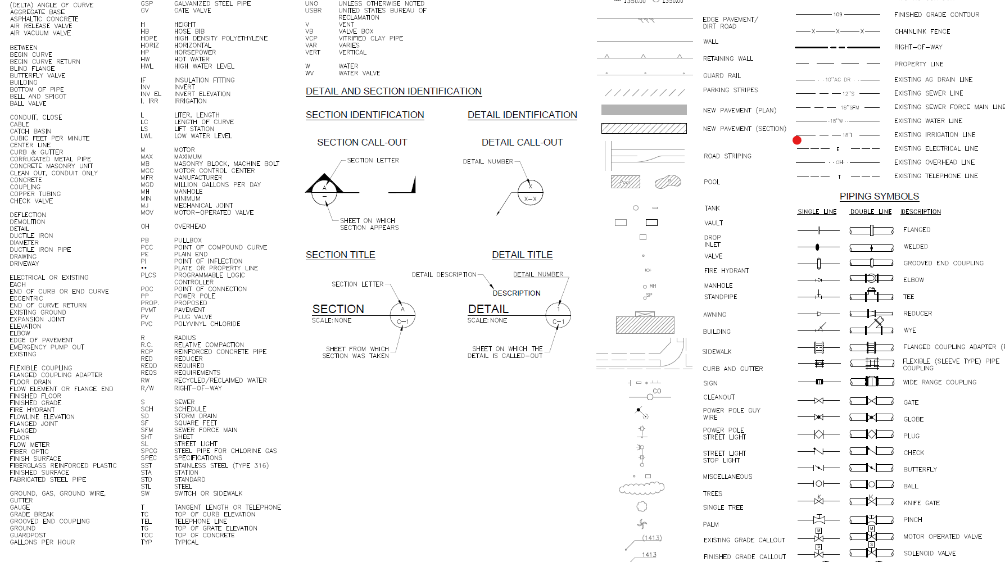
Thank you

