Slide 1
CUSTOMER
SERVICE
UPDATE

Slide 2
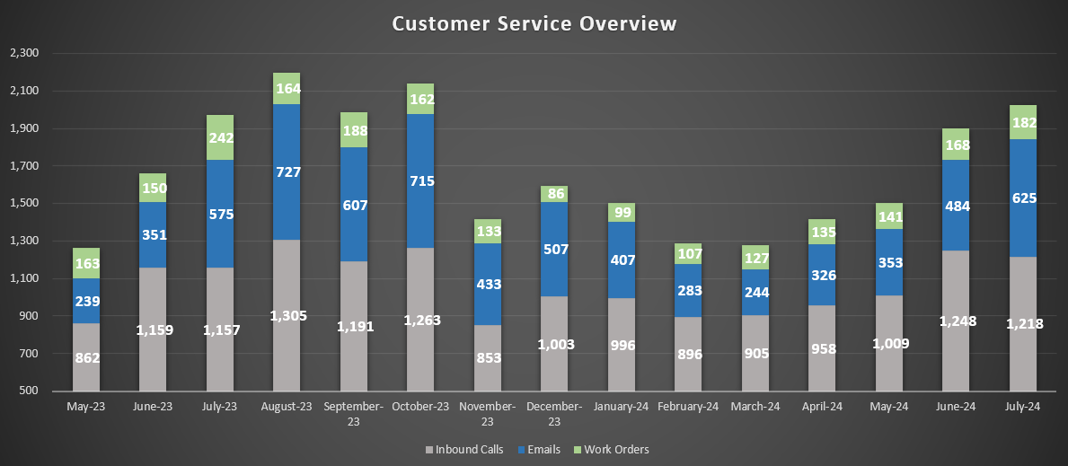
CORRESPONDENCE & SERVICE ORDERS
Common Inquiries for July:
Customer/District leaks & concerns
Start/stop service
Customer Assistance Program enrollment
Call Analytics:
Avg. Calls/Day
55
Avg. Handle Time
3:41
Total % Hours Handling Calls
20%
Avg. Wait Time
1:16

Slide 3
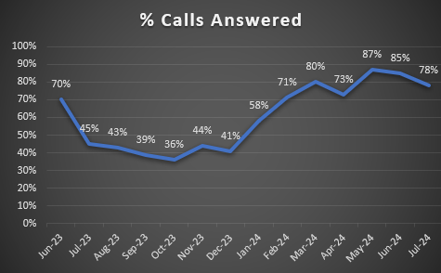
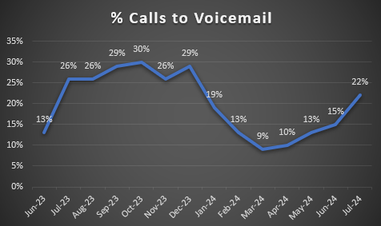
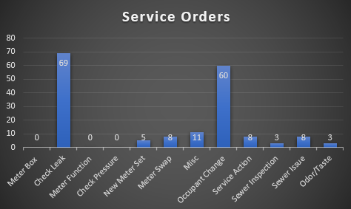
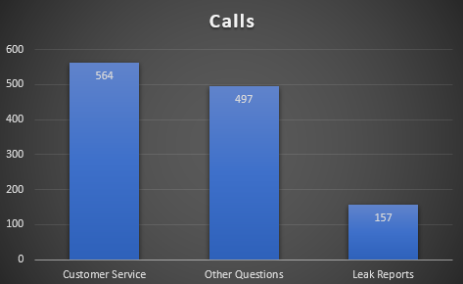
CORRESPONDENCE & SERVICE ORDERS
NEW CUSTOMER SERVICE STAFF!
DAILY OPERATIONS/TASKS
ONBOARDING
CROSS-TRAINING
WEEKLY DEPARTMENT MEETINGS
COMING SOON:
OPERATIONS RIDE-ALONGS

Slide 4
CUSTOMER PORTAL & ASSISTANCE
PORTAL
Current Membership – 9,414* ( +332 accounts since March)
*this number reflects active and inactive portal memberships
Total Current Active Memberships Linked to a UB Account – 9,015
Unique Current Active Memberships Linked to a UB Account – 8,466
Total Active UB Accounts – 13,889
% of Active Accounts Registered for the Portal – 61%
ASSISTANCE PROGRAM
Renewal Process for CAP Completed!
All CAP renewals were processed by July 1, 2024
237 Water Customers/175 Wastewater Customers are capable of being assisted through the program
Current Enrollment
196 Water Customers
109 Wastewater Customers

Slide 5
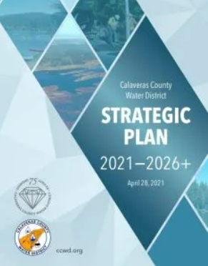
CUSTOMER SERVICE &
CCWD’S STRATEGIC PLAN
Customer Experience
Established Division Standards to set priorities and operational baseline for staff
Streamlined phone system set up to provide more immediate assistance to customers
Planned water shutdown call, text, email notifications using billing system
Interactive customer portal to provide access to account activity and usage
Fiscal Responsibility
Partnership with Finance to implement Core Financials module within Tyler Enterprise System
Regular, timely and accurate billing of all water and wastewater accounts
Understanding and communication of policies governing the furnishing of water and wastewater
Operational Integrity
Development of standard operating procedures for efficiency and consistency
Pulling data and reports for Operations and Water Resources to fulfill regulatory reporting requirements
Programs, Projects and Initiatives
Integration of billing system with Automated Metering Infrastructure (AMI) network
Regular evaluation and amendment to existing policies, and implementation of new policies
Stewardship of the Customer Assistance Program (CAP)
Distribution of free water efficiency materials to customers who are seeking to conserve
People and Partnership
Collaboration with State and local agencies on customer financial assistance
Enduring Organization
Onboarding of Representatives to meet operational and customer needs
Training opportunities for all staff to develop professionally and support in-house succession
HOW DO WE
STACK UP?

Slide 6
THANK YOU

